Slide 2
Leveraging Audit Management Software (TeamMate Suite)
Billy Benge
TIGTA Office of Audit

Slide 3
Leveraging Audit Management Software
Presenters – Agencies
Billy Benge – U.S. Treasury Inspector General for Tax Admin.
Tammi Vanlandingham – Veterans Affairs OIG
Elizabeth Goebels – National Science Foundation OIG
Margaret Wasco – U.S. Postal Service OIG
Janel Ellison – Department of Energy OIG

Slide 4
Leveraging Audit Management Software
Presenters
Billy Benge
Tammi Vanlandingham
Elizabeth Goebels
Margaret Wasco
Janel Ellison
– Topics
– Keys to Leveraging, MIS Reporting, Assessing Risk
– MIS Reporting
– New SAR custom features
– MIS Dashboards and Large MIS Integration
– Risk Assessment methodologies

Slide 5
Leveraging Audit Management Software
Presenters
Billy Benge
Tammi Vanlandingham
Elizabeth Goebels
Margaret Wasco
Janel Ellison
– Topics
– Keys to Leveraging, MIS Reporting, Assessing Risk
– MIS Reporting
– New SAR custom features
– MIS Dashboards and Large MIS Integration
– Risk Assessment methodologies

Slide 6
Leveraging Audit Management Software
Please Note
The Federal Government does not endorse this or any other commercial software product or technology.
The views, perspectives and practices presented are those of the presenter and do not necessarily reflect the views of the entity they represent.

Slide 7
Leveraging Audit Management Software
Newton
Gravity
The Moon, the Stars
Naming the familiar…

Slide 8
Leveraging Audit Management Software
Newton
Gravity
The Moon, the Stars
Naming the familiar…

Slide 9
Leveraging Audit Management Software
Why leverage …?
“There is no question that good innovation is very much alive in the U.S., but there are serious questions regarding how it is being applied... The consumer-driven model is creating an environment of junk technology.” – Tim O'Reilly
(Interview: Dan Rather Reports)

Slide 10
Leveraging Audit Management Software
Why leverage …?
Consumer business model has taken over IT... (Apps for things I never knew I needed and still not sure I need them...)
Plug and play is a marketing tag line. Must leverage any system for the benefits. This is critical for an Audit Mgt. System
Audit Management Technology maturity…

Slide 11
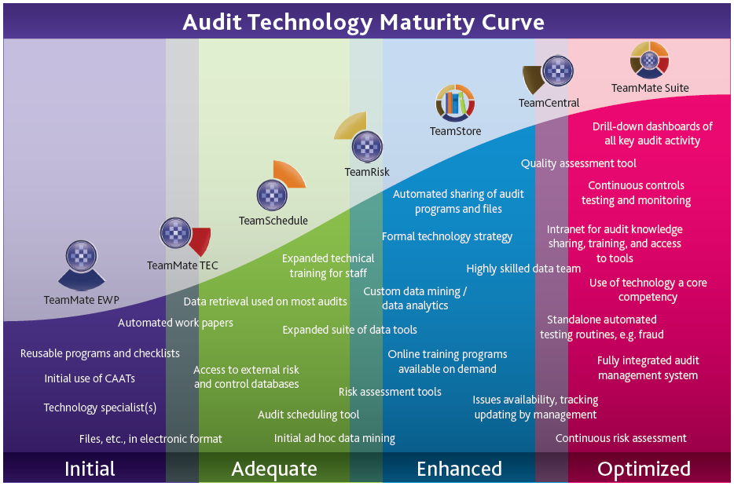
Leveraging Audit Management Software

Slide 12
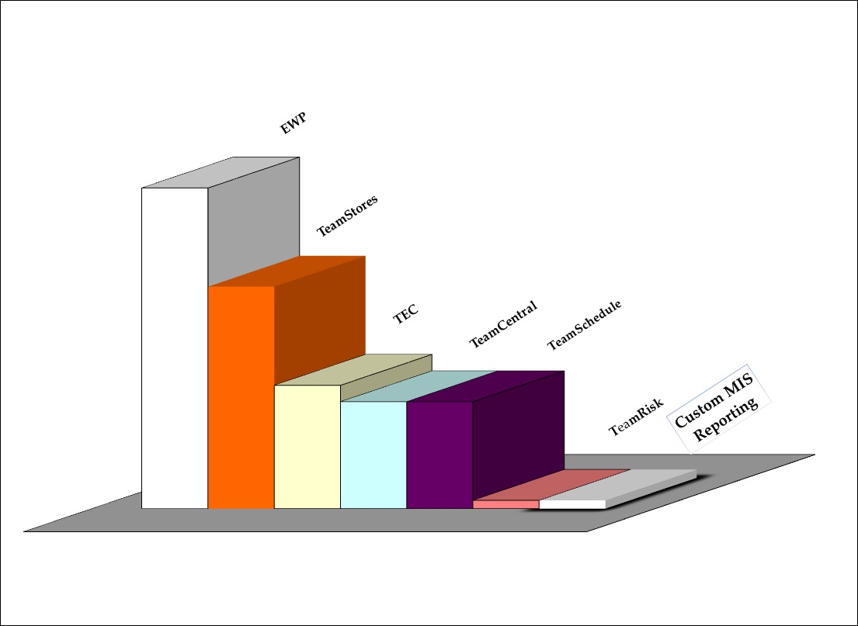
Leveraging Audit Management Software
Suite Utilization Government – 2010/2011

Slide 13
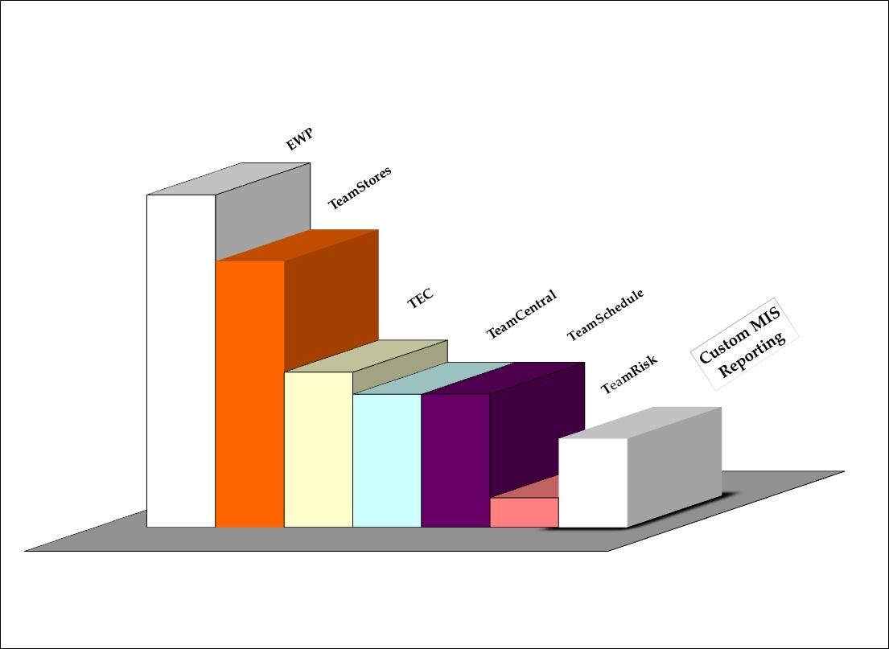
Leveraging Audit Management Software
Suite Utilization Government – 2012

Slide 14
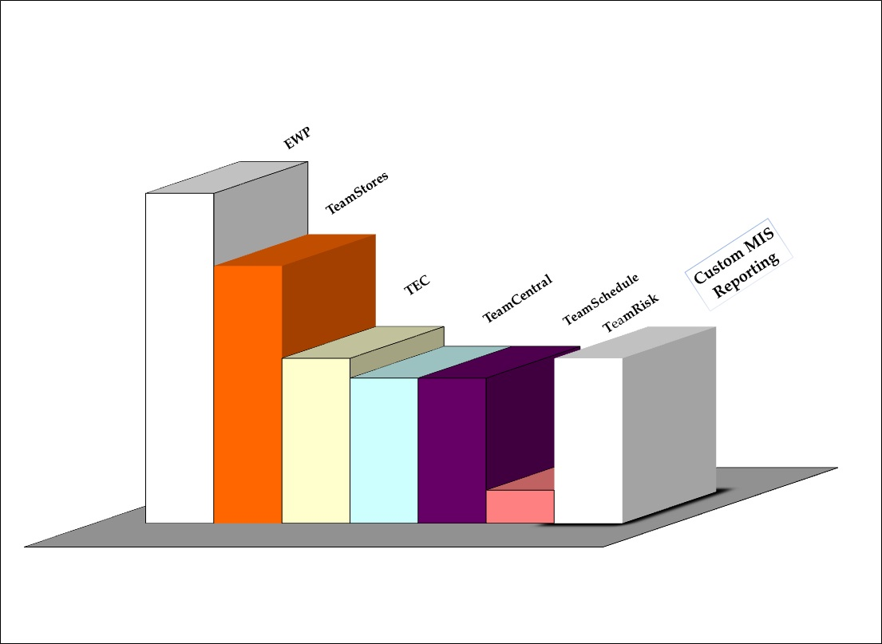
Leveraging Audit Management Software
Suite Utilization Government – 2013

Slide 15
Leveraging Audit Management Software
Software Technology Maturity
Phase shifts in evolution…
In 2006 – Full Suite introduced…true AMS
Some clients replaced or augmented MIS
In 2009 – new architecture…true Enterprise
Business Intelligence Tools…

Slide 16
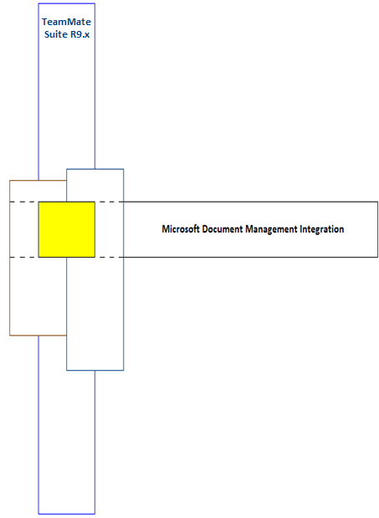
Vertical and Horizontal Intersection (perception)

Slide 17
1. TeamRisk – COSO risk-based auditing
Client and web-based user interface
Audit Entity Universe
Risk and Controls cross-references
2. TeamSchedule project planning resource cost tracking
3. TeamCentral Workflow/Management Information System
Milestones Tracking
360 Custom MIS Reporting
Knowledge Base – consolidated repository
4. TEC Time / Expense Capture – detailed tracking
5. TeamAdmin – Suite administration
Policies and controls – centralized workflow oversight
Audit Libraries, Templates, Terminology and Categories
User account maintenance over access, etc
6. TeamStores
Key Knowledge Base component
Suite repository for components and controls
Exception and audit execution component repository
7. TeamMate EWP – project management
Reliable and well organized cross-referencing / hyperlink features
Remote / Offline Replication engine
Audit trail of supervisory review
Audit Plan components structure – Objectives and Steps, Results and Summaries data Input
Exception (i.e. finding) input and repository integration
Milestone integration tracking
Risks and Controls integrated input
vertical
alignment
w/ auditing
business
processes

Slide 18
Leveraging Audit Management Software
The Art and Science of Leveraging AMS / MIS
Not only a science…not only an art
They exist simultaneously and cooperatively… (example)
New way of thinking, not just new thoughts…
The process of dismantling old processes and paradigms
Agency culture is a fundamental consideration
Positioning support roles – Audit services and/or IT services
Integration lies between customization and process re-engineering
…aligning with an optimum path of progression

Slide 19
Leveraging Audit Management Software
The Art and Science of Leveraging AMS / MIS
Not only a science…not only an art
They exist simultaneously and cooperatively… (example)
New way of thinking, not just new thoughts…
The process of dismantling old processes and paradigms
Agency culture is a fundamental consideration
Positioning support roles – Audit services and/or IT services
Integration lies between customization and process re-engineering
…aligning with an optimum path of progression

Slide 20
Leveraging Audit Management Software
The Art and Science of Leveraging AMS / MIS
Not only a science…not only an art
They exist simultaneously and cooperatively… (example)
New way of thinking, not just new thoughts…
The process of dismantling old processes and paradigms
Agency culture is a fundamental consideration
Positioning support roles – Audit services and/or IT services
Integration lies between customization and process re-engineering
…aligning with an optimum path of progression

Slide 21
Leveraging Audit Management Software
The Art and Science of Leveraging AMS / MIS
…aligning with an optimum path of progression

Slide 22
Leveraging Audit Management Software
The Art and Science of Leveraging AMS / MIS
Slow and steady continuum of progression
or
do you take a Quantum Leap …?

Slide 23
Leveraging Audit Management Software
The Art and Science of Leveraging AMS / MIS
Slow and steady continuum of progression
and when
do you take a Quantum Leap …?

Slide 24
Leveraging Audit Management Software
Time…
Energy…
Momentum…

Slide 25
Leveraging Audit Management Software
Time…
Energy…
Momentum…

Slide 26
Federal TeamMate Community
User Group

Slide 27
Leveraging Audit Management Software
Federal TeamMate Community
84 agencies / 9,024 users (auditors, inspectors some investigators)
Largest user group.
Meet annually, but regularly share best practices, solutions and many innovations...
Custom work for government sector
Suite is headed toward a government-specific software version ( we have examples of that to share )
Federal group has become a culture that co-exists with the unique cultures of each agency
TeamMate Positions

Slide 28
Leveraging Audit Management Software
Agency Snapshots
Treasury Inspector General for Tax Administration
Veterans Affairs OIG
National Science Foundation OIG
United States Postal Service OIG
Department of Labor OIG

Slide 29
Leveraging Audit Management Software
TIGTA Snapshot
EWP since 1998 (14 years)
500 users in ‘98, currently 300
Suite expansion in 2006 – TEC, Schedule, Central (6 years)
Replaced former Management Information System in 2006
Data Validation – SQL Triggers, Procedures, email Notifications
Expanded MIS Reporting in 2006 – Central Web
Expanded Custom MIS Reporting in 2007/2008 – Bus. Intel / SSRS
Currently expanding into TeamRisk
Currently repositioning to expand Custom MIS Reporting (Bus. Intel)

Slide 30
Leveraging Audit Management Software
TIGTA Snapshot
EWP since 1998 (14 years)
500 users in ‘98, currently 300
Suite expansion in 2006 – TEC, Schedule, Central (6 years)
Replaced former Management Information System in 2006
Data Validation – SQL Triggers, Procedures, email Notifications
Expanded MIS Reporting in 2006 – Central Web
Expanded Custom MIS Reporting in 2007/2008 – Bus. Intel / SSRS
Currently expanding into TeamRisk
Currently repositioning to expand Custom MIS Reporting (Bus. Intel)

Slide 31
Leveraging Audit Management Software
TIGTA Snapshot: Suite Leverage / Resource Emphasis

Slide 32
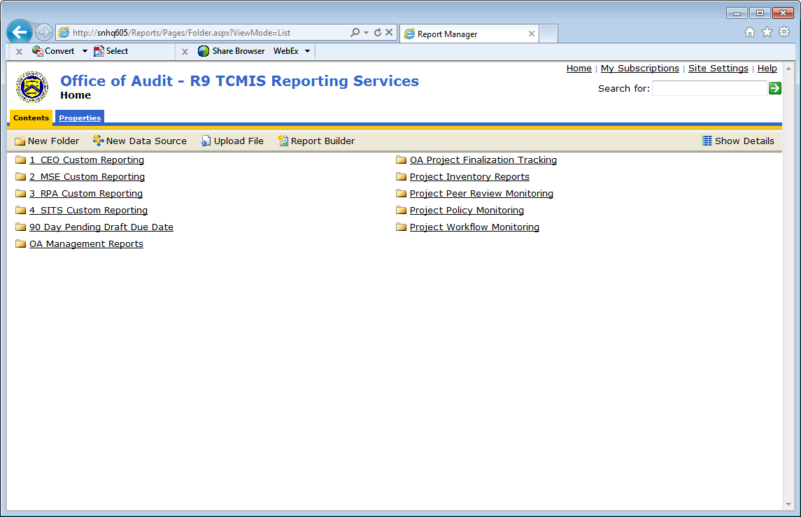
TIGTA Snapshot: MIS Suite-Wide Custom Reporting

Slide 33
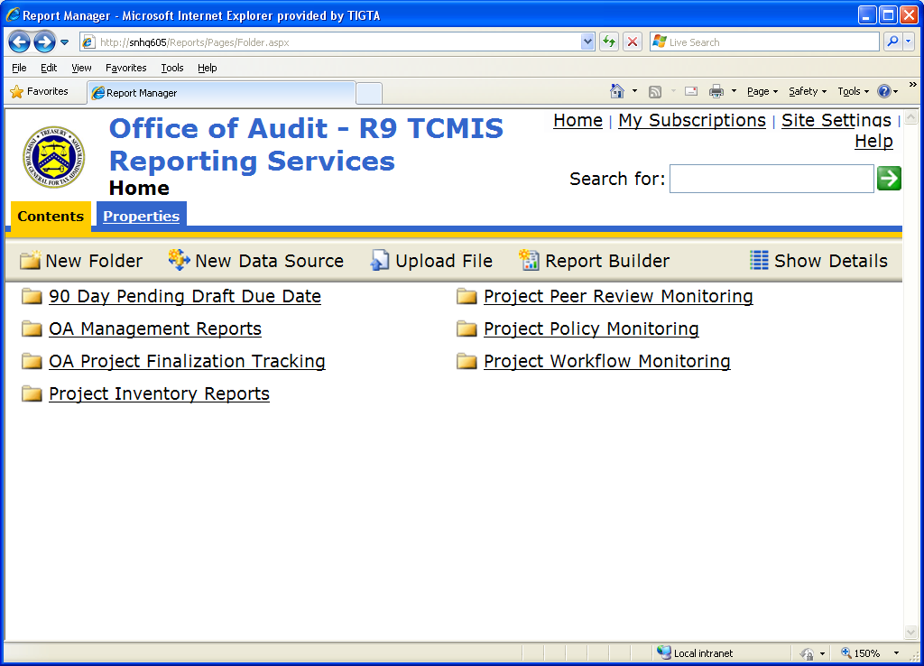
Integrating Government Sector Business Processes and Methodologies
TIGTA Snapshot: MIS Suite-Wide Custom Reporting

Slide 34
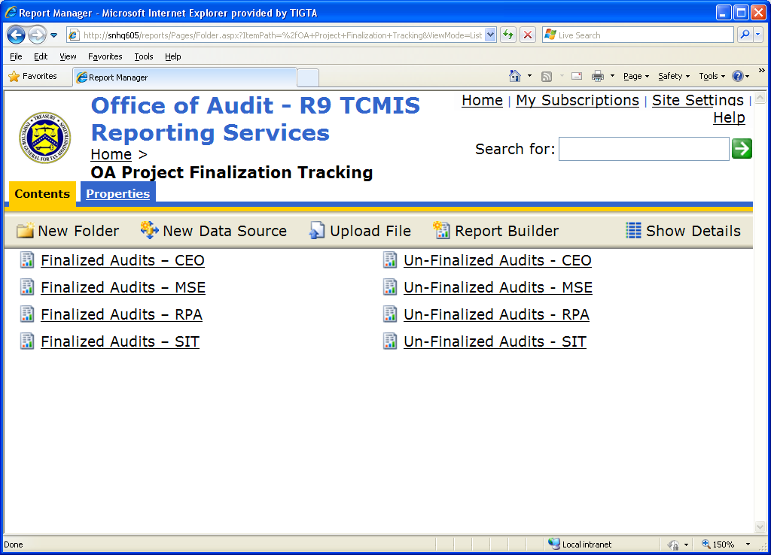
Integrating Government Sector Business Processes and Methodologies
TIGTA Snapshot: MIS Suite-Wide Custom Reporting

Slide 35
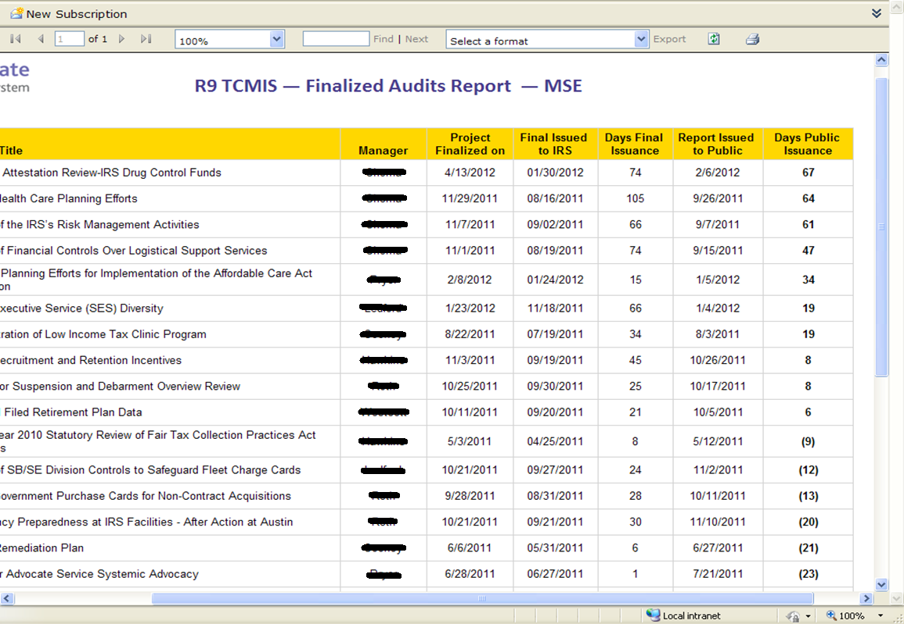
Integrating Government Sector Business Processes and Methodologies
TIGTA Snapshot: MIS Suite-Wide Custom Reporting

Slide 36
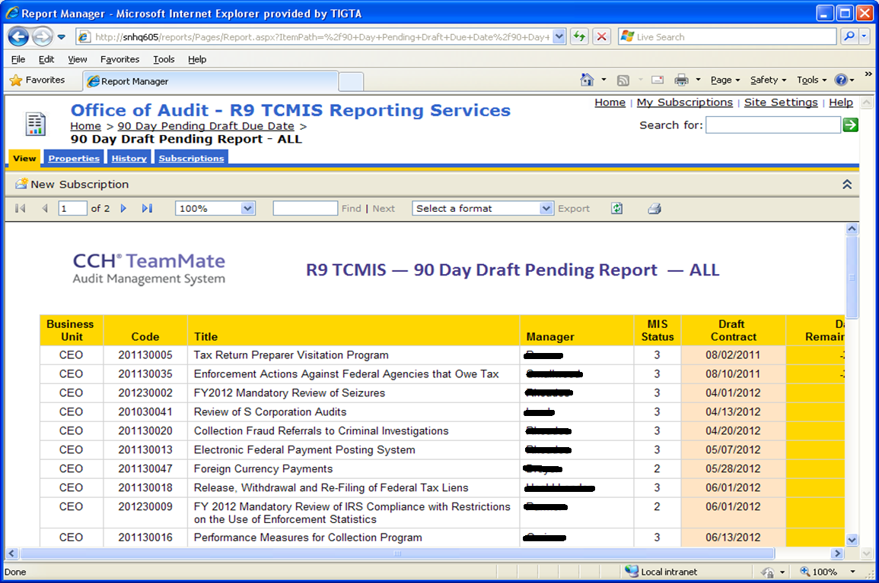
Integrating Government Sector Business Processes and Methodologies
TIGTA Snapshot: MIS Suite-Wide Custom Reporting

Slide 37
Leveraging Audit Management Software
Questions

Slide 38
Leveraging Audit Management Software
VA Custom Reporting

Slide 39
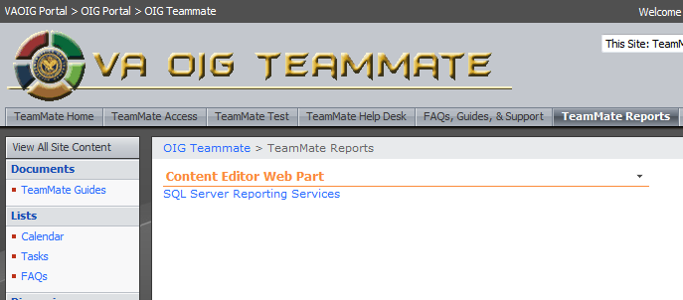
Leveraging Audit Management Software

Slide 40
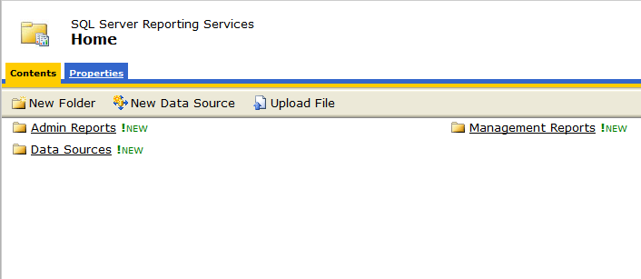
Leveraging Audit Management Software

Slide 41
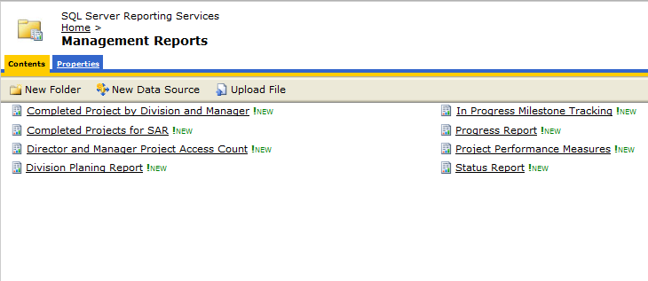
Leveraging Audit Management Software

Slide 42
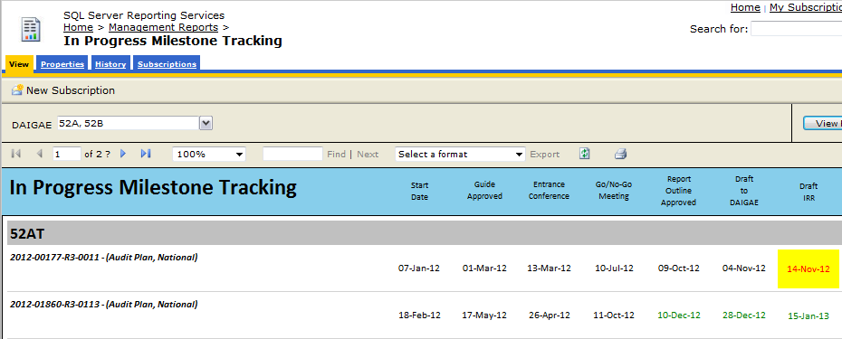
Leveraging Audit Management Software

Slide 43
Leveraging Audit Management Software

Slide 44
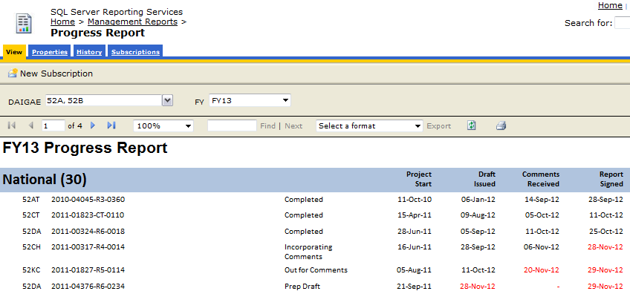
Leveraging Audit Management Software

Slide 45
Leveraging Audit Management Software

Slide 46
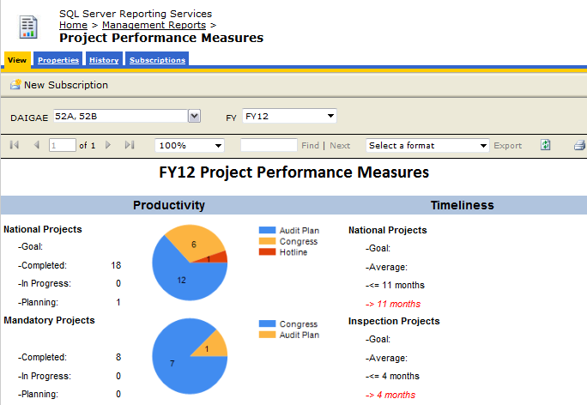
Leveraging Audit Management Software

Slide 47
Leveraging Audit Management Software
Questions

Slide 48
Leveraging Audit Management Software
National Science Foundation
SAR Project

Slide 49
Background
TeamMate has the capability for tracking findings and recommendations for audit resolution but did not align well with the IG Act or OMB Circular A-50 requirements.
Each OIG has its own system for semiannual reporting.
In 2011, TeamMate Federal Users Group approached Wolters Kluwer requesting Semiannual Reporting capability in TeamMate.

Slide 50
Using TeamCentral for SAR Reporting
Workgroup of approximately 13 OIGs developed requirements for semiannual report tables.
Tables are based on requirements in the IG Act and OMB Circular A-50.
Semiannual reporting available in TeamMate Release 10.3- set for first quarter of 2013.
Wolters Kluwer is willing to customize semiannual report tables.
Notes:
USPS
DOD
DOE
DOL
GSA
HHS
NSF
TIGTA
Treasury
USDA
State Department
Amtrack
DOT

Slide 51
Available Semiannual Report Tables
Questioned Costs
Funds Put to Better Use
Issued Reports for the Period
Prior Reports with No Management Decision

Slide 52
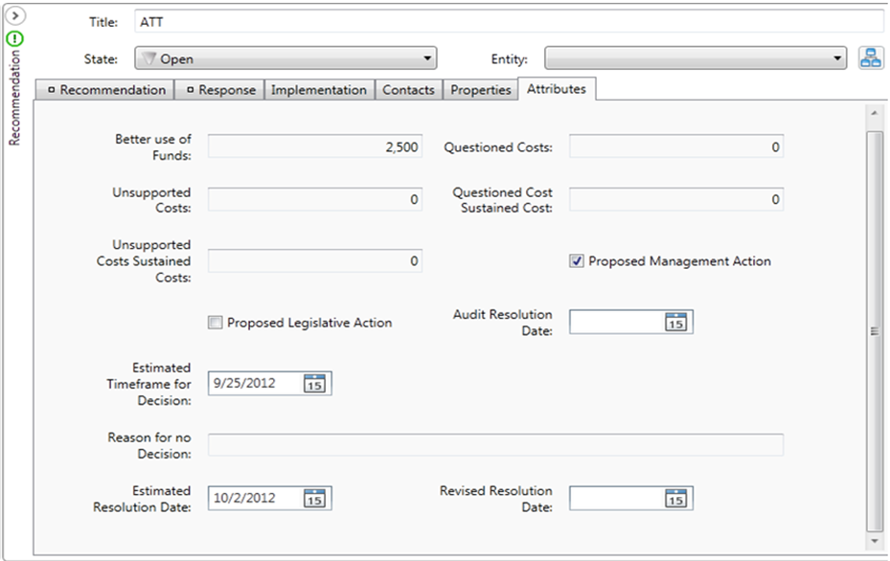
EWP Recommendation Attributes

Slide 53
Reports in TeamCentral

Slide 54
Reports Issued with Questioned Costs

Slide 55
Issued Reports with Recommendations for Better Use of Funds

Slide 56
List of Reports Issued During the Period

Slide 57
Prior Reports without Management Decision

Slide 58
Implementing SAR Tables in TeamCentral
Upgrade to 10.3.
Follow TeamMate instructions.
Run dual SAR tracking systems.

Slide 59
Leveraging Audit Management Software
Questions

Slide 60
Leveraging Audit Management Software
USPS – MIS

Slide 62
TeamCentral Dashboards
Information is available for all projects
The TeamCentral Dashboard is user-customizable so that you can manage what is important to your agency.

Slide 63
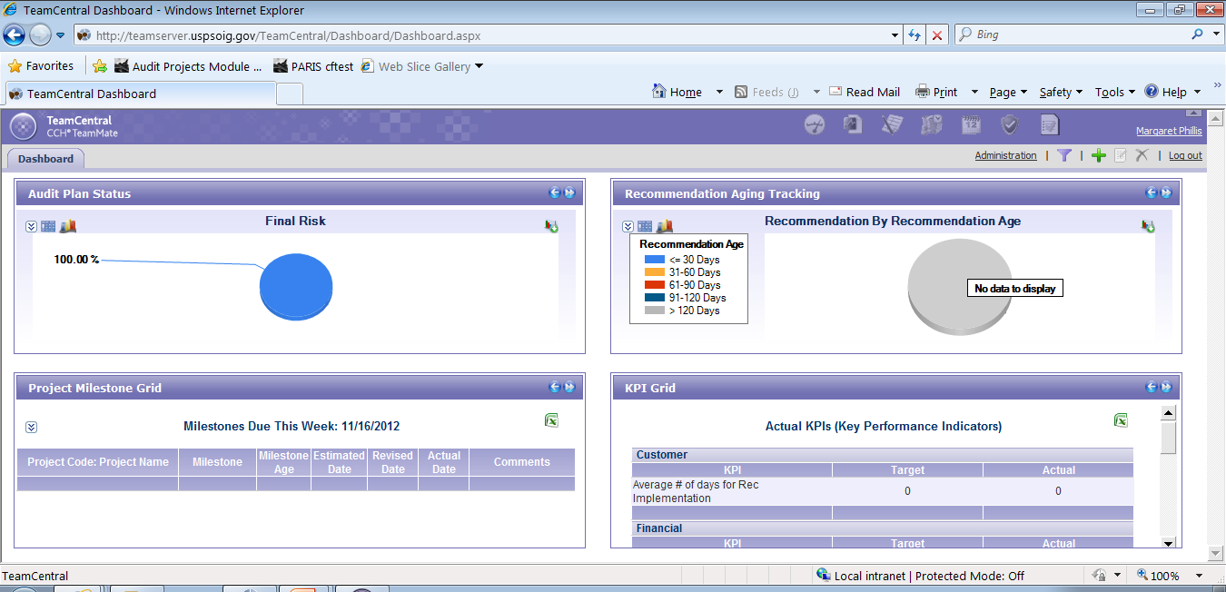
TeamCentral Dashboard Example

Slide 64
TeamMate EWP Dashboards
Presented upon launching the application
Provide a wealth of information including:
Milestones status
Completion progress
Assignment status

Slide 65
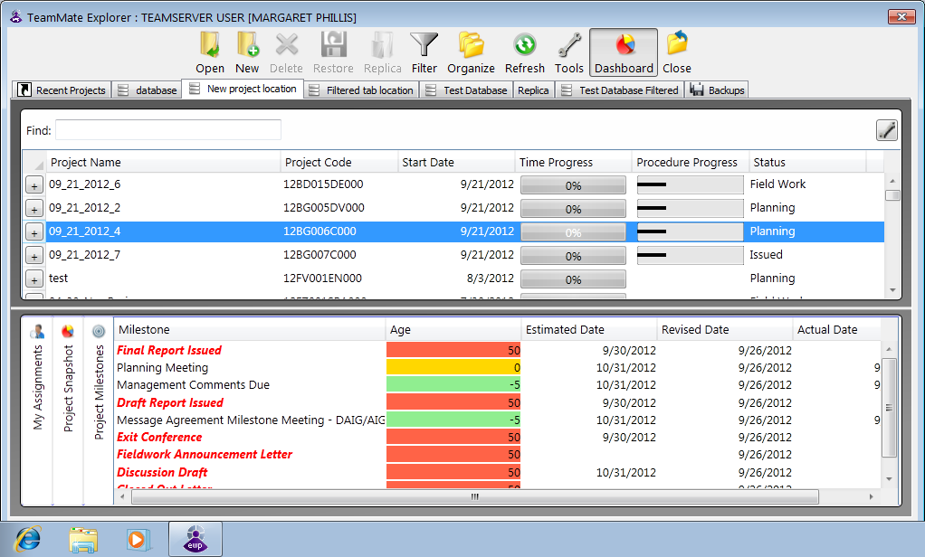
TeamMate EWP Milestone Dashboard

Slide 66
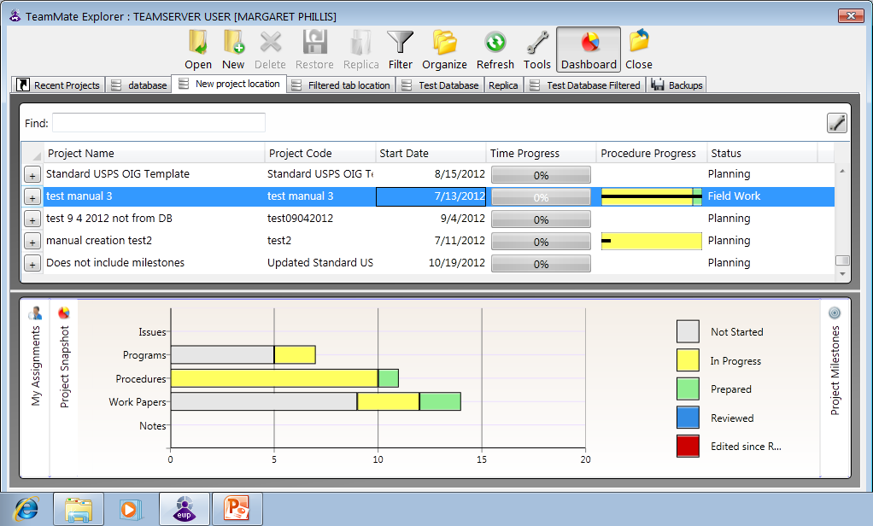
TeamMate EWP Work Status Dashboard

Slide 67
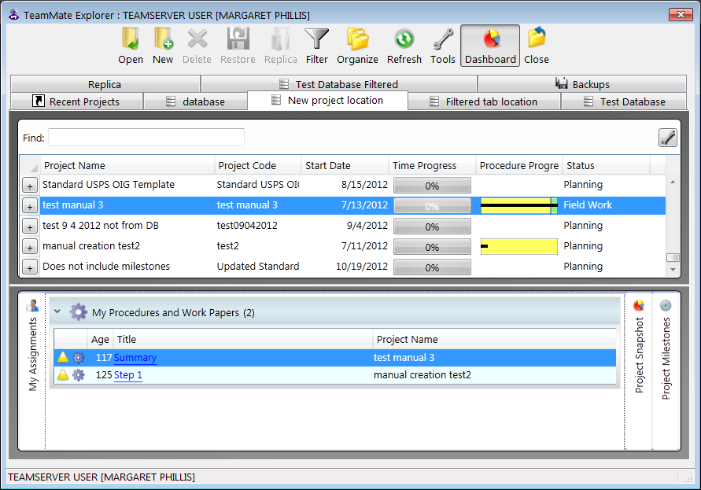
TeamMate EWP Assignment Dashboard

Slide 68
Leveraging Audit Management Software
Questions

Slide 69
Leveraging Audit Management Software
Risk Assessments with TeamRisk
TIGTA

Slide 70
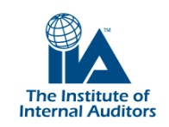
Leveraging Audit Management Software
To remain relevant in 2012, internal auditors need to move beyond a static, cyclical audit approach and adopt a continuous, comprehensive approach to audit and risk assessment – one that optimizes the use of technology.
PricewaterhouseCoopers “Internal Audit 2012” September 2007

Slide 71
Leveraging Audit Management Software
TeamRisk history
First focus group / demo in 2002 (San Francisco)
Demo’s at annual User Forums
2002-2009 …very few clients interested (1 Federal agency, DOL) (during this period, product evolved w/o marketing…)
2009 66% of clients at NYC/Northeast user group using tool…
DOL, DLA, DOE, TIGTA…

Slide 72
Leveraging Audit Management Software
TIGTA: Custom TeamRisk Methodology

Slide 73
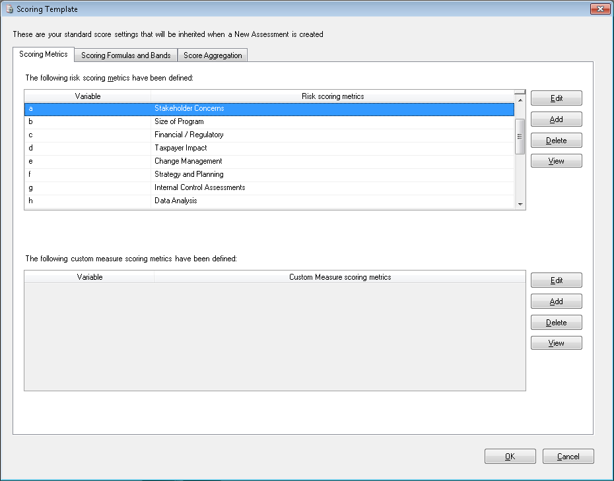
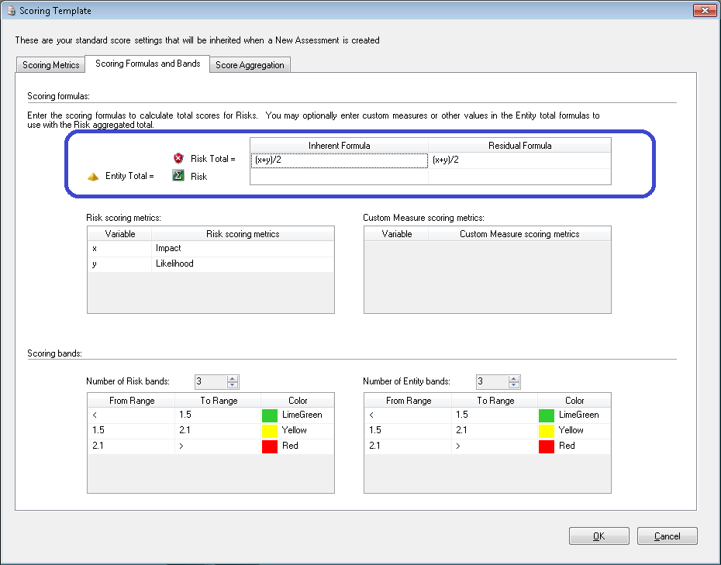
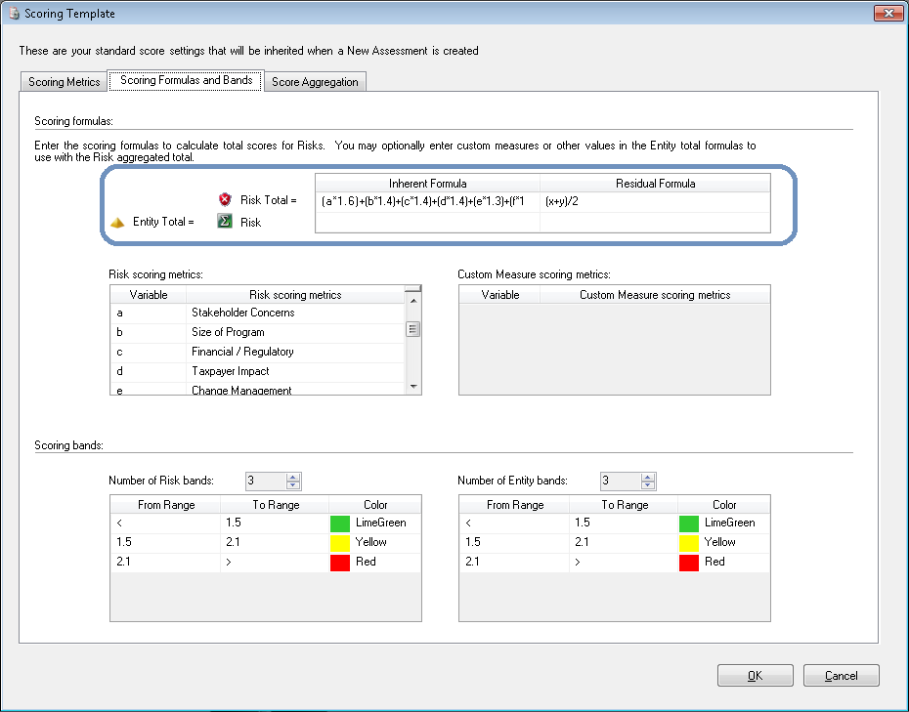
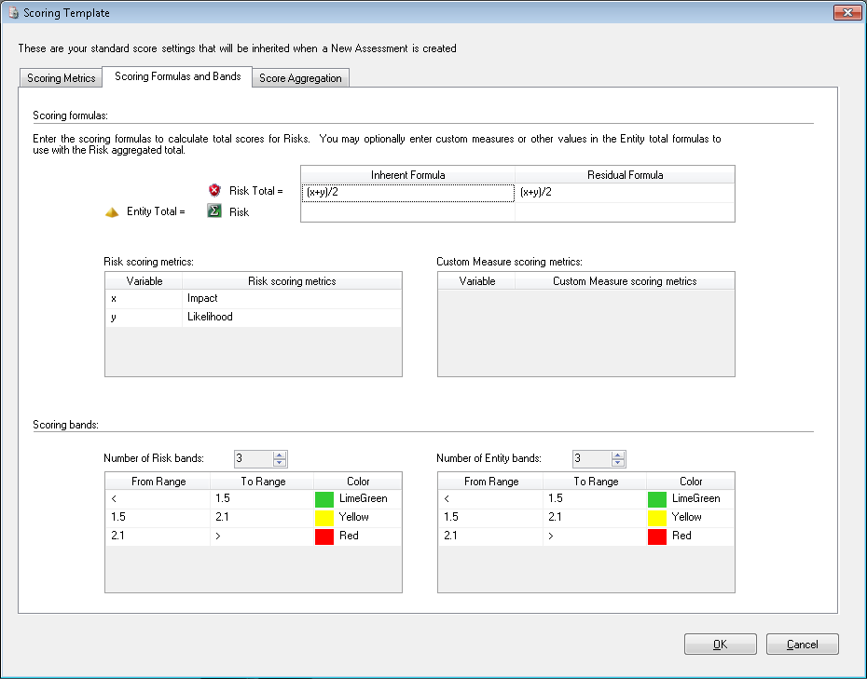
Leveraging Audit Management Software
TIGTA: Custom TeamRisk Methodology

Slide 74
Leveraging Audit Management Software
Risk Assessments with TeamRisk
Dept. Of Energy OIG

Slide 75
Leveraging Technology for Risk Based Audit Plans
Department of Energy
Rich History
Manhattan Project’s Atomic Bomb (Atomic Energy Commission in 1946)
Energy Crisis (Department of Energy in 1977)
Diverse Mission
to ensure America’s security and prosperity by addressing its energy, environmental, and nuclear challenges through transformative science and technology solutions
Transform our Energy Systems
Promote Science and Engineering Enterprise
Secure Our Nation
Management and Operational Excellence
Workforce
>15,000 Federal Employees
>90,000 Contractor employees
Notes:
I fear the day that technology will surpass our human interaction. The world will have a generation of idiots. -Albert Einstein:
If you can't explain it simply, you don't understand it well enough. -Albert Einstein

Slide 76
I. Define the Audit Universe
DOE Structure
Located in 28 states
Three Under Secretaries (Energy, Nuclear Security, and Science)
Advanced Research Projects Agency – Energy
Energy Information Administration
Loans Program Office
4 Power Marketing Administrations (Bonneville, Southeastern, Southwestern, Western)
13 Staff and Support Offices
22 Operations and Site Offices
24 Research Laboratories and Facilities
17 National Laboratories
OIG Organization
3 Divisional Directors (Central, Eastern, Western)
8 Assistant Directors (Central 2, Eastern 3, Western 3)
21 Audit Groups at 13 sites

Slide 77
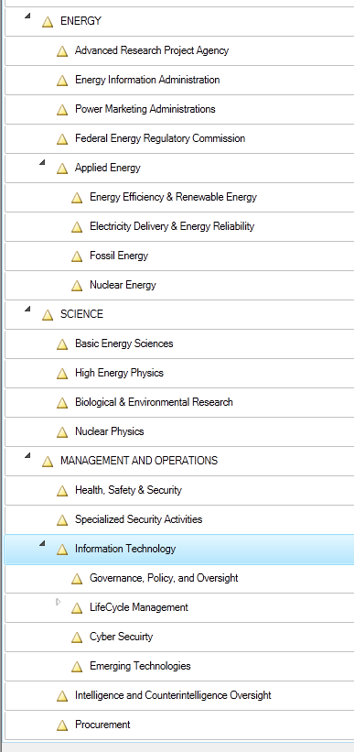
I. Define the Audit Universe
DOE Structure (Less than 40 Entities to Assess Risk)
Located in 28 states
Three Under Secretaries (Energy, Nuclear Security, and Science)
Advanced Research Projects Agency – Energy
Energy Information Administration
Loans Program Office
4 Power Marketing Administrations (Bonneville, Southeastern, Southwestern, Western)
13 Staff and Support Offices
22 Operations and Site Offices
24 Research Laboratories and Facilities
17 National Laboratories
IG Organization was used last year.
Over 500 Entities to Assess Risk
Overlaps
Gaps

Slide 78
II. Define Agency 0bjectives, and Identify Risk and Controls
STRATEGIC
2. Operations
3. Reporting
4. Compliance

Slide 79
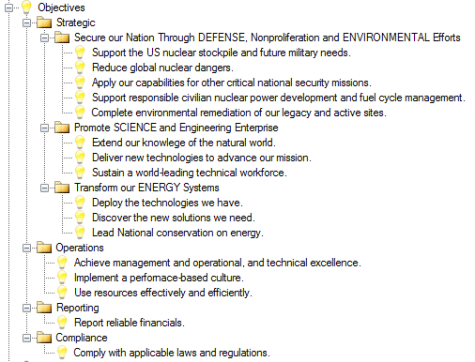

Slide 80
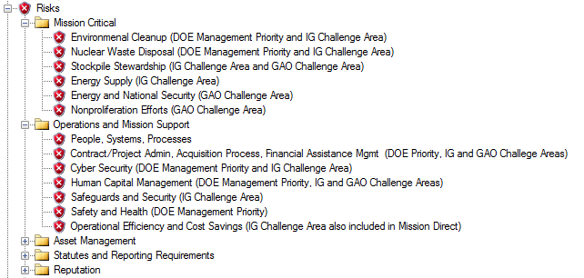
II. Define Agency 0bjectives, and Identify Risk and Controls

Slide 81
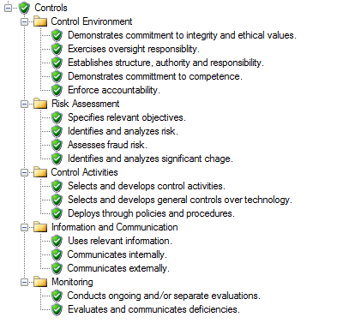

Slide 82
III. Risk Assessment and the Effectiveness of Controls
Striving to refine and improve the risk assessment and planning process….
Last Decade

Slide 83
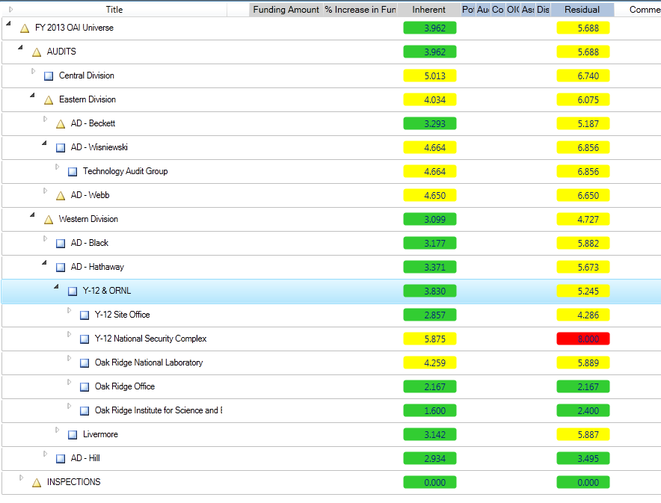
III. Risk Assessment and the Effectiveness of Controls
Last Year – Using TeamRisk but not utilizing controls

Slide 84
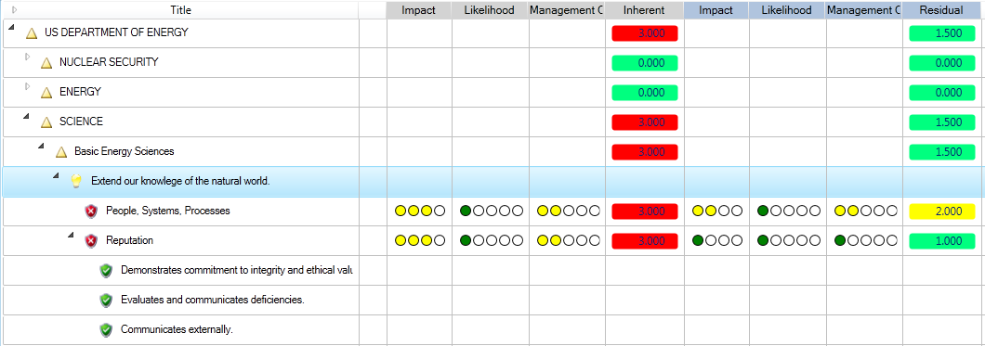
III. Risk Assessment and the Effectiveness of Controls
Current – using controls

Slide 85
Leveraging Audit Management Software
Questions

Slide 87
Extending TeamMate Functionality: TeamMate Customization
TeamMate offers customization services for organizations’ unique needs
Why customize?
Application conforms to YOUR organization’s needs
Possibly avoid building or buying another application

Slide 88
Case Study: USPS OIG TeamMate Customization
USPS OIG entered into contract with TeamMate to allow TeamMate to exchange data with USPS OIG’s Existing Internally-Developed Audit Management Information System
Extends the functionality of both applications
Provides opportunities to simplify data input for USPS OIG Office of Audit staff
Ensures greater data consistency and reliability for USPS OIG management reports

Slide 89
Case Study: USPS OIG TeamMate Customization
USPS OIG Audit MIS
USPS OIG KCE Audit Projects Module
TeamMate 10.2.1

Slide 90
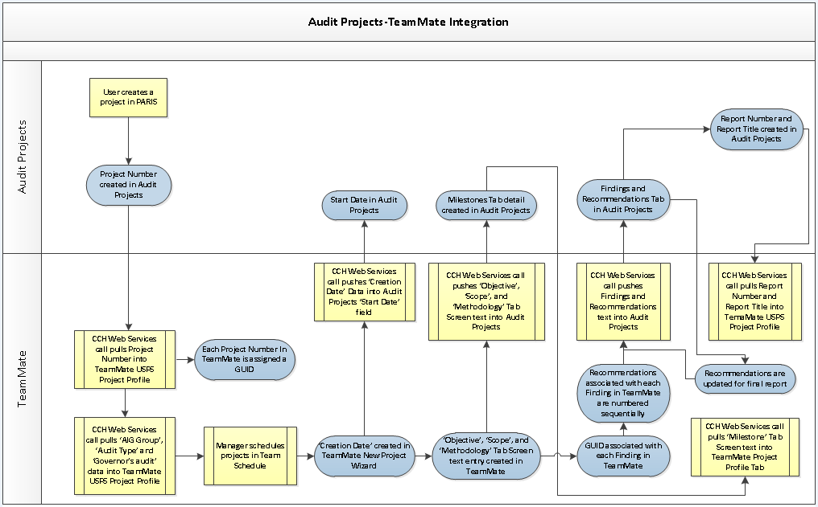
USPS OIG TeamMate Customization

Slide 91
USPS OIG TeamMate Customization

Slide 92
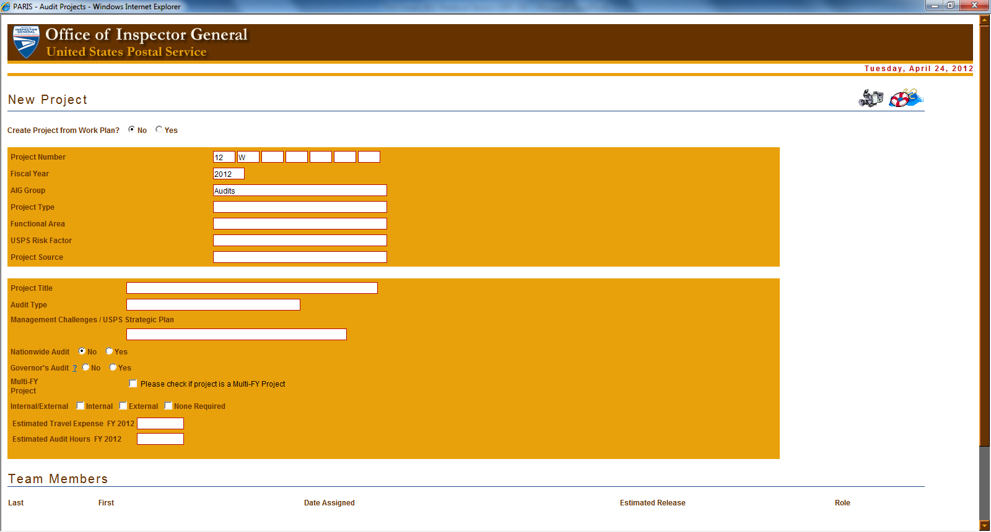

Slide 93
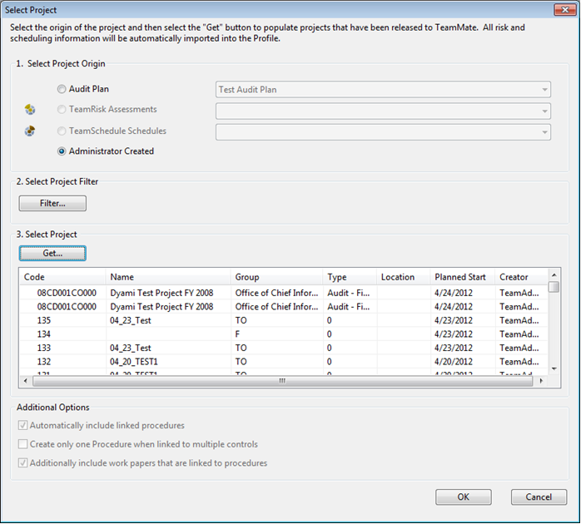

Slide 94
Leveraging Audit Management Software
Questions

Slide 95
Leveraging Audit Management Software
New MIS Reporting Framework
Reinventing our Reporting Requirements

