Slide 1


Building the CIGIE Training Institute
“The Future of Accountability”
FAEC Annual Conference
September 8, 2011

Slide 2

“…increase the professionalism and effectiveness of personnel by developing policies, standards, and approaches to aid in the establishment of a well-trained and highly skilled workforce in the offices of the Inspectors General.”
The Inspector General Reform Act of 2008

Slide 3
Training Institute’s Mission
CIGIE’s Gateway to Responsive, High-Quality, Cost Effective, State-of-the-Art, IG Specific Training and Professional Development

Slide 4
Training Institute Briefing Points
References, Reports, and Reviews
Structure, Expectations, and Staffing
Vision
Services
Strategies

Slide 5
References, Reports, and Reviews
  HR Committee IGATI curriculum review – 2005
  GAO guide on Assessing Training and Development Efforts in the Federal Government – 2005
  TVA review of IGCIA resource requirements – 2010
  I&E Committee’s survey results on the Growth and Development of the I&E Community – 2010
  IGCIA training validation survey reports – 2010
  CIGIE Business Plans
  CIGIE Charter 2011
  Other

Slide 6

Training Institute Organizational Chart
Structure
Chair and Executive Council
Executive
Director
Professional
Development
Committee
Standing Committees
Training Institute
Executive Director
Audit Committee
(FAEC)
Leadership and
Mission Support
Academy
Criminal Investigator
Academy
Audit, Inspection, and Evaluation Academy
The Training Institute Executive Director will report to the CIGIE Executive Director and receive input from the PDC.
The individual standing committees will advise and coordinate with the PDC and Training Institute on job task analyses, career development models, needs assessments, training requests, curriculum reviews, content development and other training related matters.

Slide 7
  Expectations
  The Executive Director, on behalf of the CIGIE Executive Council, will retain approval on:
the Training Institute's annual budget submission to the full body,
ensuring the Training Institute is operating within the budgetary framework approved by the full body,
permanent staffing level for the Training Institute, and
major procurements related to business operations of the Training Institute.

Slide 8
Expectations
The standing CIGIE committees and practitioners (FAEC) will
advise, assist, and provide input toward:
  job task analyses
  career development models
  needs assessments and training requests
  curriculum reviews, content development, and
  other training related matters.
CIGIE members will provide technical expertise and instructional support so as to mitigate the need for the Training Institute to hire permanent staff instructors.

Slide 9
Expectations
The Professional Development Committee, on behalf of
the CIGIE community, will:
  ensure periodic evaluations of the Training Institute’s products and services are conducted,
  review the Training Institute’s annual training plan,
  develop annual performance metrics for the Training Institute,
  approve formal partnerships with outside entities, such as academia,
  resolve conflicts among training demands,
  make recommendations on operations and oversight of the Training Institute, and
  coordinate with the standing CIGIE Committees, Roundtables and Training Institute staff on job task analyses, career development models, needs assessments, training requests, curriculum reviews, content development, and other training-related matters.

Slide 10
CIGIE Training Institute
Executive Council
Business Efficiency
Technical Expertise
Quality
Assurance
CIGIE Committees
Professional Development Committee

Slide 11
Staffing
Executive Director for the Training Institute (*)
  Registrar (*)
  Budget Officer (*)
  Administrative Support Specialist (FY12)
  Information Technology Specialist (FY12)
  Instructional Design Specialist (FY13)
  Academy Accreditation Manager (FY14)
Academy Directors
  Audit, Inspection, and Evaluation Academy (*)
  Leadership and Mission Support Academy (*)
  IG Criminal Investigator Academy (*)
Rotational Course Managers
*on board

Slide 12

Vision
The Training Institute will focus on:
Developing and facilitating high quality, accessible, cost-effective training across the IG workforce.
Working together collaboratively with centralized functions, and shared instructional resources.
Leveraging resources and technology to increase services and community resources.
Promoting collaboration among IG professions and working to increase the professionalism of the IG workforce in order to enhance each IG’s effectiveness in accomplishing its mission.

Slide 13
Training Institute Services
  1. Provide or facilitate high-quality, IG-specific training by:
collaborating and partnering with the standing CIGIE committees and other subject matter experts,
utilizing the finest faculty available with an appropriate mix of IG practitioners, academicians and other subject matter experts, internal and external to government,
employing best practices in our operations through partnerships with academia, appropriate accrediting bodies, other government training entities and the private sector, and
utilizing technology to expand training resources.

Slide 14
Training Institute Services
Facilitate the development of workforce competency models in order to link training to IG mission success.
Promote a community-wide commitment for continuous professional development and professional identity.
Provide increase awareness of and accessibility to training opportunities, both internal and external to the Training Institute.
Support and facilitate Training Institute initiatives through interagency collaboration and teamwork among IG professions by utilizing a technology toolbox (e.g. online bulleting boards, discussion forums, wiki/blog, social networking, etc.).

Slide 15
Training Institute Strategies
Deliver high quality, cost-effective, IG-specific training and professional development that links to workforce competencies by:
  building a comprehensive annual needs assessment process,
  implementing an instructional systems design process,
  constructing an effective multi-level training evaluation process,
  establishing an instructor development program,
  procuring a consolidated learning management system,
  developing strategic partnerships with academia, government, and commercial training partners, and
  creating a CIGIE learning portal and professional development toolbox.

Slide 16
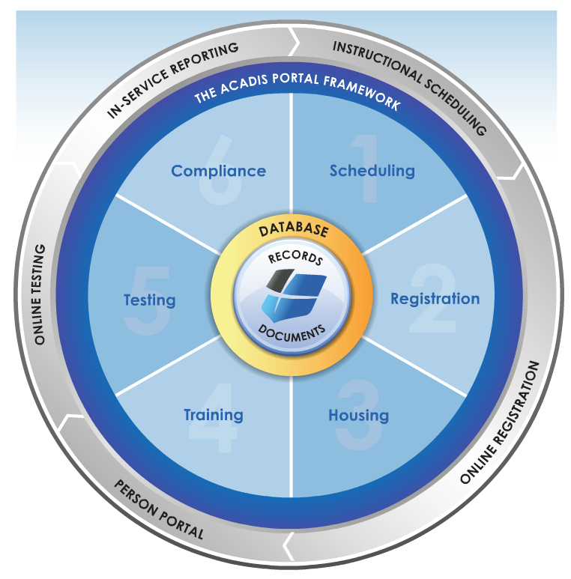
CIGIE Learning Portal
Electronically Searchable Clearinghouse to External Training
Scheduling
Registration
Evaluation
Tracking (CPEs)
Consolidated List of Shared Interagency Training
Technology
Professional Development Toolbox
E-Learning
Blended Learning
Blog/Wiki

Slide 17
P
CIGIE Organization
Executive Chair Jeffrey Zients
Deputy Director for Management, OMB
Chair Phyllis Fong Inspector General, USDA
Vice Chair Carl Clinefelter
Inspector General, FCA
Executive Director Mark Jones
For more information on CIGIE go to http://www.ignet.gov

Slide 18
P
CIGIE Committees
Audit Committee:
Jon Rymer, Chair John Seeba, Vice Chair
Inspector General, FDIC Inspector General, FTC
Information Technology Committee:
Gordon Heddell, Chair Rebecca Anne Batts, Vice Chair
Inspector General, DOD Inspector General, PBGC
Inspection and Evaluation Committee:
Daniel Levinson, Co-Chair Kathy Buller, Co-Chair
Inspector General, HHS Inspector General, Peace Corps
Integrity Committee: Kevin Perkins, FBI

Slide 19
P
CIGIE Committees
Investigations Committee:
Carl Hoecker, Chair Eric Thorson, Vice Chair
Inspector General, U.S. Capitol Police Inspector General, Treasury
Legislation Committee:
Peggy Gustafson, Chair Jack Callender, Vice Chair
Inspector General, SBA Inspector General, PRC
Professional Development Committee:
Mary Kendall, Chair Lynn McFarland, Vice Chair
Acting Inspector General, Interior Inspector General, FEC

Slide 20
P
CIGIE Training Institute
Tom Caulfield 202-292-2602
Executive Director Tom.Caulfield@cigie.gov
Beth Hoffman León 202-292-2579
Director Beth.Leon@cigie.gov
Audit, Inspection, and Evaluation Academy
Angela Hrdlicka 912-267-3801
Director Angela.Hrdlicka@cigie.gov
Criminal Investigator Academy
Charles Johnson, PhD 202-292-2600
Program Liaison Charles.Johnson@cigie.gov
Leadership and Mission Support Academy
1717 H Street, NW, Suite 825
Washington, D.C. 20006-3900

Slide 21

W
Questions?

