Slide 1

2017 Data Analytics Forum
Organizational Readiness for a
Data Analytics Program
Presented by Caryl Brzymialkiewicz, Ed Slevin, and Kelly Tshibaka
June 26, 2017

Slide 2
Session Objectives
  At the end of this session participants will be able to :
  Determine their organizations’ readiness to implement a data analytics program.
  Understand all of the considerations that need to be taken before deciding to implement a data analytics program.
  Obtain a better understanding of what data analytic system looks like by observing a demonstration of a Data Visualization System.

Slide 3
OVERVIEW
Caryl Brzymialkiewicz
Chief Data Officer, HHS OIG
Notes:
Collect
Describe
Discover
Predict
Advise

Slide 4
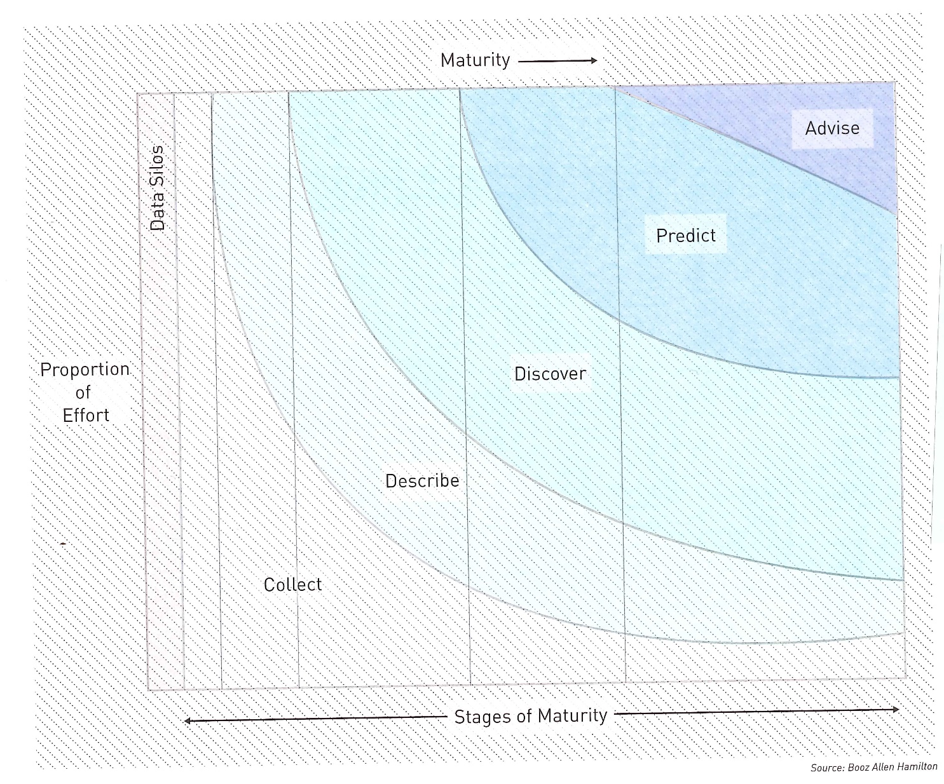
Data Science Maturity Model
  Defines possibilities, optimizes, and recommends the decision that gives the best outcome
  Uses past to predict future
  Identifies hidden relationships or patterns
  Enhancing or refining raw data; basic analytic functions such as counts
  Collecting datasets
  The Field Guide to Data Science, Second Edition, Booz Allen Hamilton, 2015

Slide 5
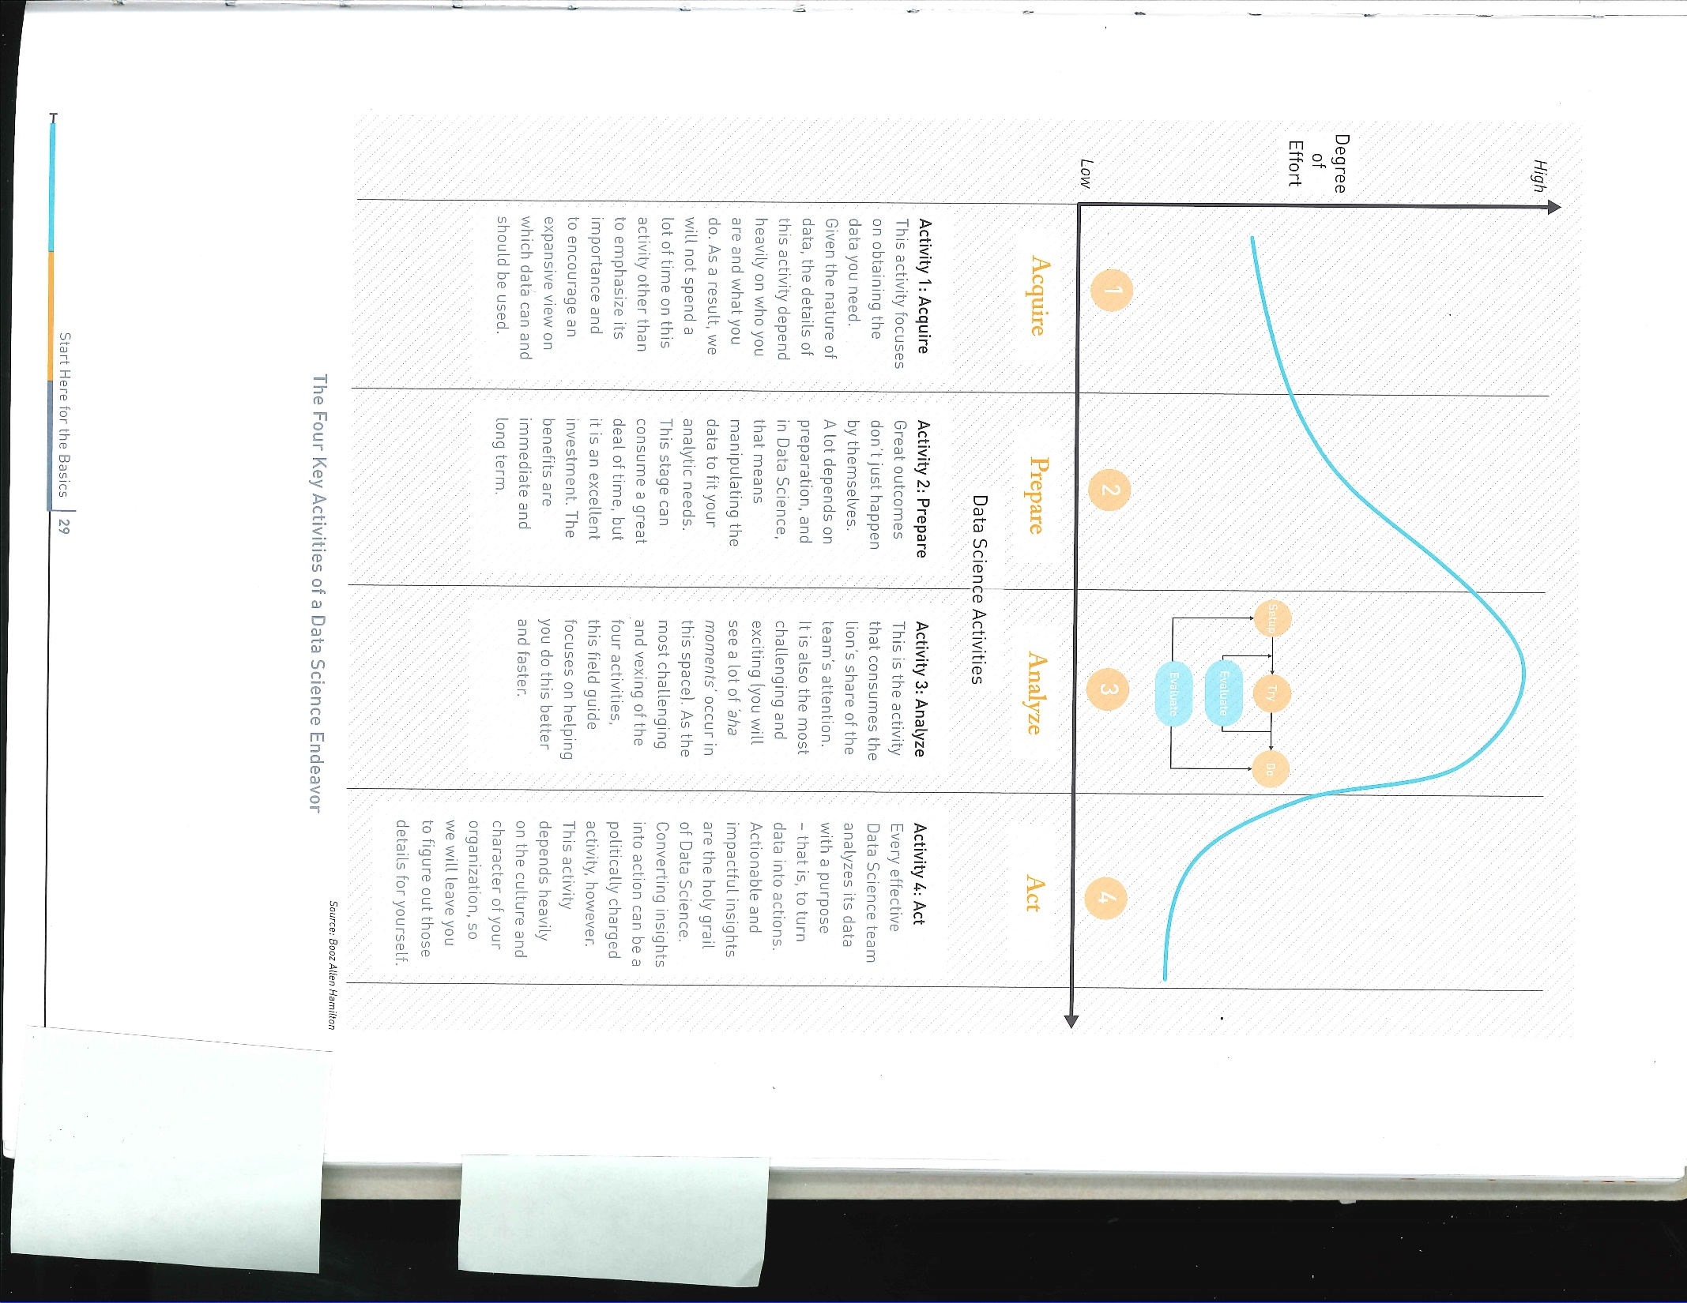
Data Science Activities
Obtaining the data you need
Manipulating the data to fit your analytic needs
Conducting the analysis
Turning data into action

Slide 6
How to Generate Momentum
Organizational buy-in
Clear ROI
Necessary Data
Limited Complexity and Duration

Slide 7
ELEMENTS
Kelly Tshibaka
Chief Data Officer, USPS OIG

Slide 8

Agency Interest
Notes:
Business/Stakeholder buy in and interest
ROI – not always monetary

Slide 9
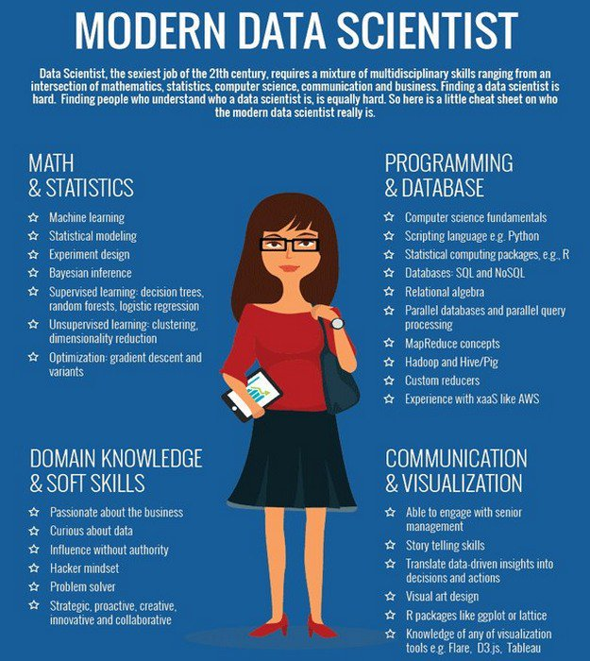
People
Notes:
Discuss skills that are important
Word Cloud
Multi-skilled people – no one trick ponies
FREE Interns ;) Co-ops are great!
Team oriented, analytical minded

Slide 10

Data
Notes:
Good data
Garbage in, Garbage Out
Knowing the business and understanding business rules that are applied to the data
Don’t assess reliability of data for audits
Don’t prove fraud

Slide 11

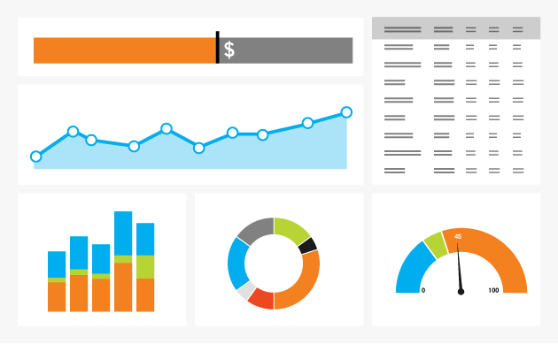
Tools
Notes:
Shiny isn’t always better
Build to solve the question not the solution
Tools that are FREE!
Not every model is perfect and some are useful.
Paying a contractor to build isn’t always the cheapest or best solution
Starting out, it is helpful to have contractors with you

Slide 12

Ed Slevin
~
CAATs, Director
Dept. of Education, OIG

Slide 13
Selecting and Standing up a
Successful Data Analytical Project
~
What are the fundamental procedures and/or guidelines to follow?
Senior Management Support
Project Selection
  Canvas senior management in key business segments.
  Doable in a limited period of time AND has known low hanging fruit.
Proof of Concept Documentation
  Clear concise project objective that can both be measured and recognized when you get there.
  Detailed process / strategy to achieve this objective.
  Identify needed staffing, skill sets and other resources needed
  Identify any anticipated barriers, delays or legal issues.
  Critical Milestone Dates – primary purpose is twofold, first and most important is the management of expectations and second is project management best practices.
  Project Team – ideally you will have identified and gotten acceptance of the core members of the project team.
Executive Champion – identify an executive champion/sponsor who has an agreed upon vision of the value and direction of the implementation the data analytic project.
Notes:
Concept has been around since the 1980’s but technology just now ready.
80’s methodology now ready for prime time….
“Method used to perform audit-related activities on a continuous basis - includes control and risk assessment.”

Slide 14


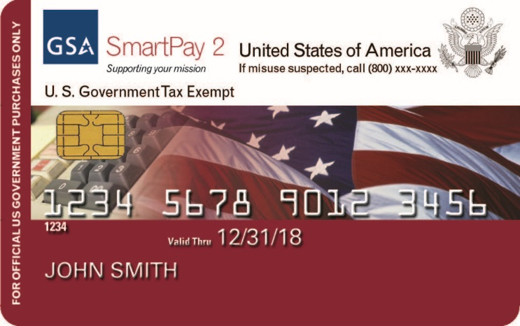
CIGIE
Data-Mining and Analysis Project

Slide 15
Data Visualization System
~
Purchase Card

Slide 16
Project Objective
Develop an automated system using data analytic techniques to identify p-card transactions having a high risk of fraud or abuse as well as to assess and identify emerging risk. More specifically, the system aims to provide an automated solution that satisfies the defined oversight responsibilities of the following OIG components:
Audit Services (AS) - the Government Charge Card Abuse Prevention Act of 2012 requires agencies’ IG to conduct periodic assessments and audits of agency card programs to identify and analyze risks of fraudulent, improper, or erroneous purchases and payments in order to develop an audit plan.
Investigation Services (IS) - conducts, supervises, and coordinates investigations of suspected fraudulent activity by Departmental employees.
Quality and Integrity Group (QIG) - conducts fair, impartial and independent reviews of OIG’s processes and business areas. It also coordinates with IS on allegations of misconduct, including criminal misconduct, by OIG employees; and as such access to travel and purchase card transactions is necessary to support QIG’s mission.

Slide 17
Assessment Rules/Indicators
Transaction Level
Billing Amount > 3 Standard Deviation
Billing Amount > Single Purchase Limit
Closed Account Activities
PayPal & Amazon Transactions
Potential Splits
Prohibited MCCs (merchant category code)
Questionable MCCs
Transactions with Sales Tax
Weekend/Holiday Transactions

Slide 18
Assessment Rules/Indicators (Cont.)
Account Level
Frequency of Purchasing from Same Vendor
a tool for identifying spending patterns of cardholders and potential fictitious vendors.
Frequency of Purchasing under Same MCC
a tool for identifying spending patterns of cardholders and potential “problem” cardholders.
Percentage of Whole Dollar Transactions
a tool for identifying potential suspicious & fictitious transactions.

Slide 19
Demonstration

Slide 20
Interagency Fraud Risk Data Mining Group
Mission Statement
The Interagency Fraud Risk Data Mining Group (IFRDMG) is a collection of investigators and auditors within the federal community that has been formed for the purpose of sharing best practices, raising awareness and offering a forum for the evaluation of data mining and risk modeling tools and techniques to detect fraudulent patterns and emerging risks.
  http://www4.va.gov/oig/ifrdmg/
Notes:
IFRDMG has been in existence for over four years now…

Slide 21
Contact information (LAST SLIDE)
Kelly Tshibaka
Email: ktshibaka@uspsoig.gov
Phone: 703-248-4509
Caryl N. Brzymialkiewicz
Email: caryl.brzymialkiewicz@oig.hhs.gov
Phone: 202-245-8183
Edward Slevin
Email: edward.slevin@ed.gov
Phone: 202-245-8183

Slide 22
APPLICATION
Caryl Brzymialkiewicz
Chief Data Officer, HHS OIG
Notes:
Collect
Describe
Discover
Predict
Advise

Slide 23
Questions for You
How many data sources do you collect?
What questions your Data Science team is trying to answer?
What are the important factors driving your office?
Do you have an understanding of future conditions? Are you able to predict future behaviors based on past observations?
What is the best course of action to take for your key decisions?
What is the right blend of talent for your data science team – domain expertise, computer science, mathematics?
Do your data scientists:
  have the technical know how?
  have a “can do” attitude in a client/customer focused environment?
  have critical thinking skills and are willing to learn?
  have the right motivation and a creative nature?

