Slide 1
GAO’s Oversight of DATA Act Implementation
U.S. Government Accountability Office
April 27, 2017
Michael LaForge
Assistant Director Financial Management and Assurance (FMA)

Slide 2
Key DATA Act Dates
We are here!
Nov. 2016: OIGs began issuance of readiness reviews.
Note: Offices of Inspector General (OIGs) and GAO will also report on data quality and use on November 2019 and November 2021.

Slide 3
DATA Act Mandate – GAO
After a review of the reports submitted by the OIGs:
Submit to Congress and make publically available a report assessing and comparing:
data completeness, timeliness, quality, and accuracy of the data submitted by Federal agencies, and
implementation and use of data standards by Federal agencies.

Slide 4
GAO’s Oversight Approach
Ongoing engagement and monitoring as implementation progresses to help identify challenges
Interim progress reports to Congress to help ensure effective implementation
Constructive engagement with OMB and Treasury to help ensure challenges are addressed early

Slide 5
GAO’s Engagement and Monitoring Activities
Agency implementation plans
Data quality, standards and technical requirements
Governance structure
Pilot program
Recovery operations center
Federal program inventory
Inspector General (IG) readiness review reports
IG coordination
Recommendation follow up

Slide 6
GAO and the IG Community
GAO’s coordination with the IG community includes:
Monthly meetings with the FAEC DATA Act working group
Consultation on the IG readiness review guide and common audit methodology
Briefing to the CIGIE Audit Committee on readiness reviews
Coordination on required audits for November 2017

Slide 7
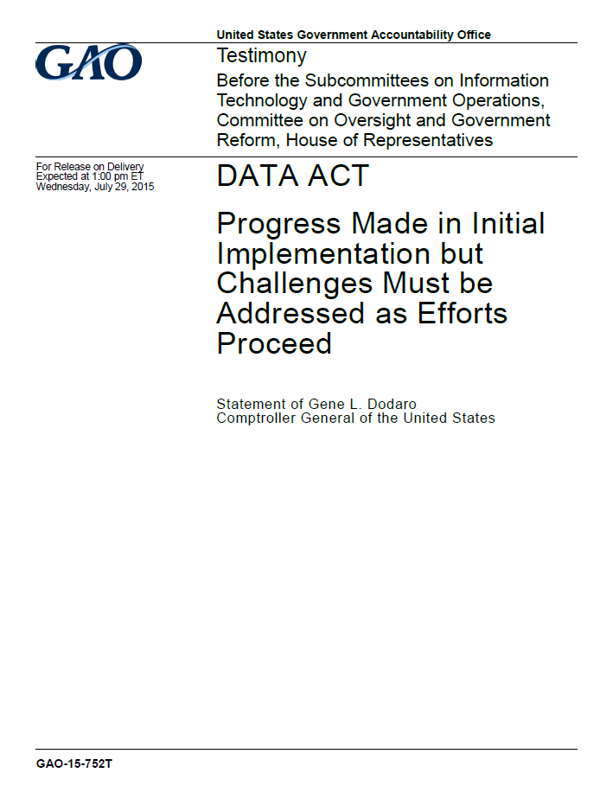
GAO’s DATA Act Testimonies
GAO has reported on DATA Act implementation in various testimonies and reports:
December 2014 - Federal Data Transparency: Effective Implementation of the DATA Act Would Help Address Government-wide Management Challenges and Improve Oversight (GAO-15-241T)
July 2015 - DATA Act: Progress Made in Initial Implementation but Challenges Must be Addressed as Efforts Proceed (GAO-15-752T)
April 2016 - DATA Act: Progress Made but Significant Challenges Must Be Addressed to Ensure Full and Effective Implementation (GAO-16-556T)
December 2016 - DATA Act: Implementation Progresses but Challenges Remain (GAO-17-282T)

Slide 8
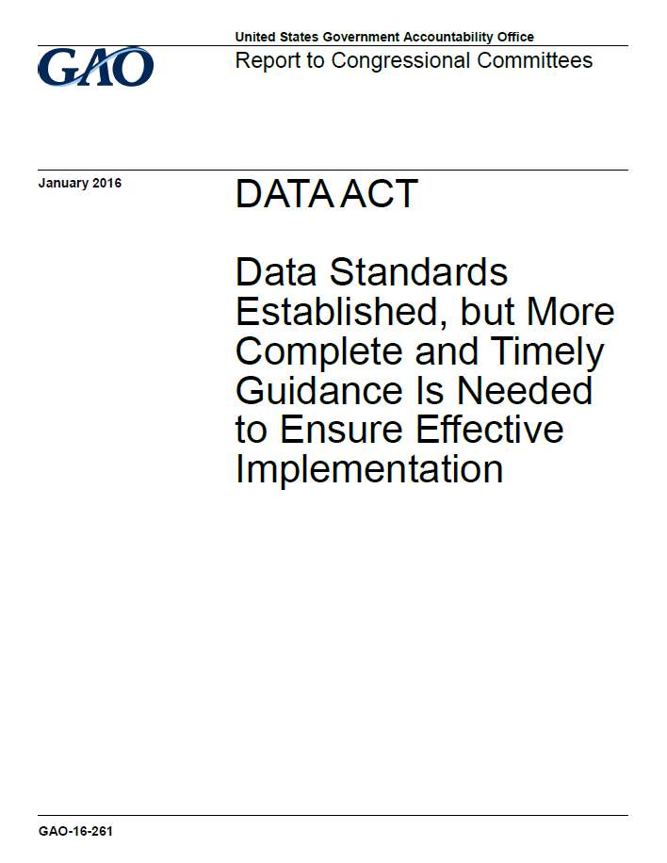
GAO’s DATA Act Related Reports
June 2014 - Oversight Needed to Address Underreporting and Inconsistencies on Federal Award Website (GAO-14-476)
September 2015 - Preserving Capabilities of the Recovery Operations Center (GAO-15-814)
January 2016 - Data Standards Established, but More Complete and Timely Guidance Is Needed to Ensure Effective Implementation (GAO-16-261)
April 2016 - Section 5 Pilot Design Issues Need to Be Addressed to Meet Goal of Reducing Recipient Reporting Burden (GAO-16-438)

Slide 9
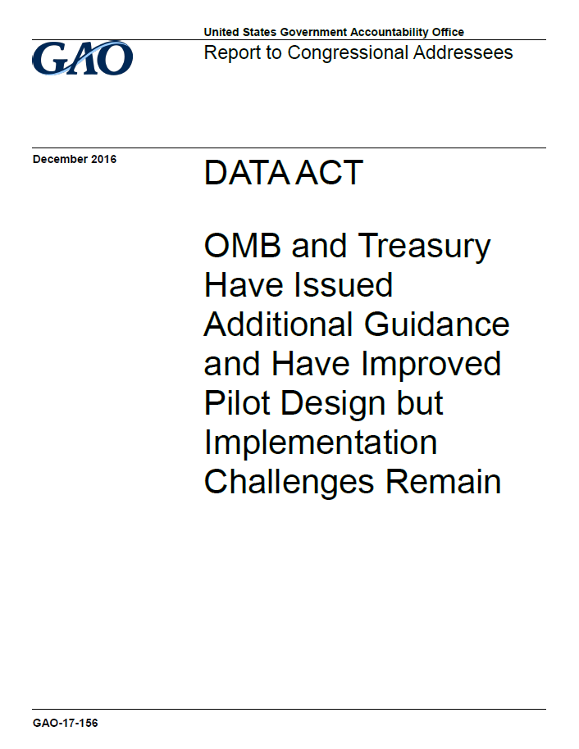
GAO’s DATA Act Related Reports (cont’d)
July 2016 - Improvements Needed in Reviewing Agency Implementation Plans and Monitoring Progress (GAO-16-698)
August 2016 - Initial Observations on Technical Implementation (GAO-16-824R)
December 2016 - OMB and Treasury Have Issued Additional Guidance and Have Improved Pilot Design but Implementation Challenges Remain (GAO-17-156)
April 2017 - Office of Inspector General Reports Help Identify Agencies' Implementation Challenges (GAO-17-460)

Slide 10
Summary of GAO Findings
We have found OMB and Treasury could address challenges or make improvements on areas such as:
Guidance development and timeliness
Monitoring agencies’ implementation progress
Population of reporting agencies
Pilot design
Governance

Slide 11
GAO’s Latest Report – Objectives
DATA Act: Readiness Reviews (GAO-17-460)
To describe the type and scope of DATA Act readiness reviews conducted by IGs as of January 31, 2017.
To describe agencies' readiness to meet DATA Act requirements, including the May 2017 deadline, as reported by the IGs.
To evaluate the extent to which OMB and Treasury used or plan to use the results of the IGs readiness reviews to assist in their monitoring of agencies' implementation of the DATA Act.

Slide 12
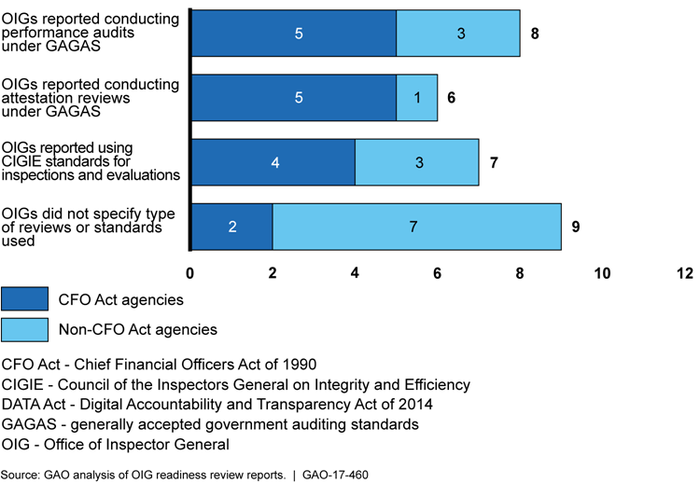
Type of Reviews and Standards Used

Slide 13
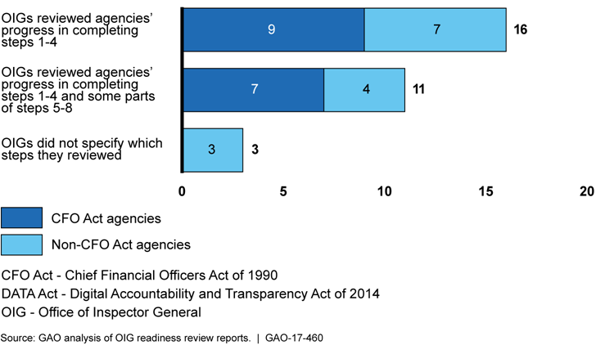
Playbook Steps Included in Scope of Reviews

Slide 14
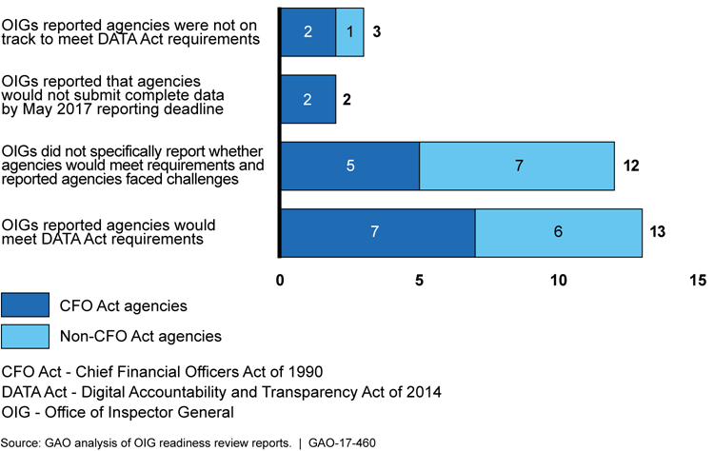
Agencies Readiness to Meet DATA Act Requirements

Slide 15
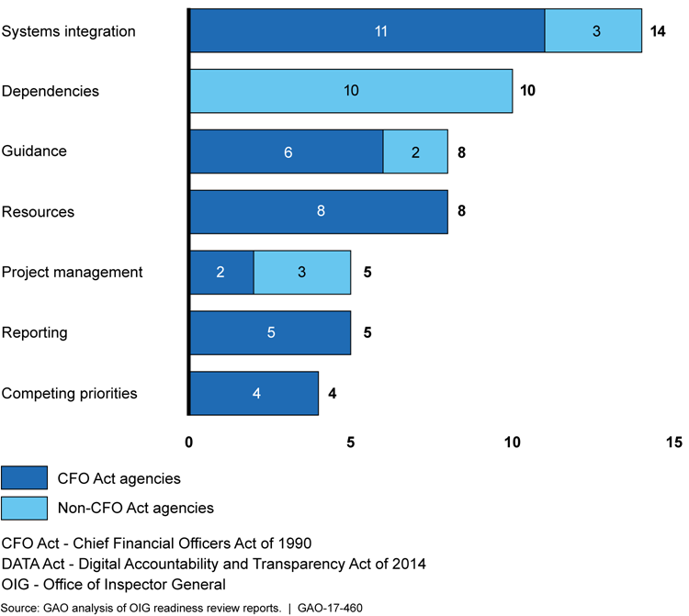
Implementation Challenges Reported
Note: Number of agencies totals more than 26 because some OIGs reported multiple challenges.

Slide 16
Description of Implementation Challenges
Systems integration - Technology issues, developing and submitting required files, integrating multiple financial and management systems, or needing to install new systems or modify existing systems.
Dependencies - Agency implementation activities depend on actions being taken by other parties (e.g., shared service providers) before the agency can proceed.
Guidance - Incomplete, unclear, missing, and evolving guidance on requirements, including data elements, the technical schema, and other key policies.
Resources - Lack of funding or human resources for implementation.
Project management - Challenges related to project or program management, such as lack of a designated project manager and inadequate documentation of progress made or key decisions.
Reporting - Issues related to meeting DATA Act reporting requirements, including completeness and quality of agency data to be reported, as well as senior accountable official certification and reporting of nonfinancial data.
Competing priorities - Statutory, regulatory, policy, or other agency-specific matters that have competing priorities or conflicting requirements that may affect an agency’s DATA Act implementation process.

Slide 17
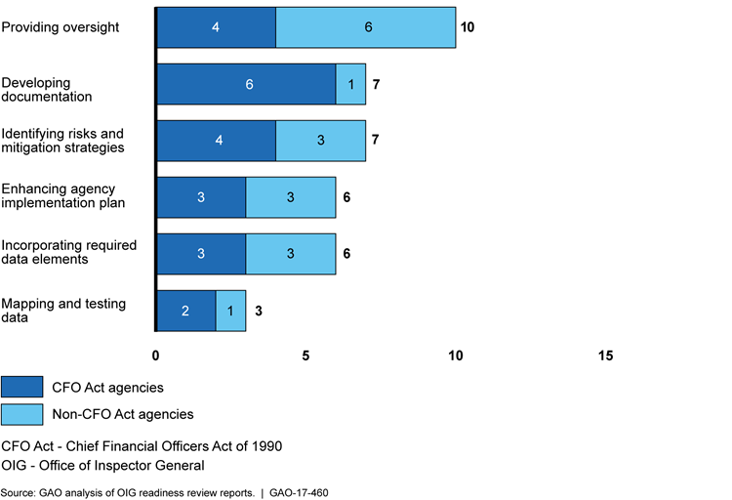
OIG Recommendations and Suggestions
Note: Number of agencies totals more than 15 because some agencies OIGs reported multiple recommendations or suggestions.

Slide 18
Description of Recommendations and Suggestions
Providing oversight - Ensuring senior accountable official more directly oversees the agency’s DATA Act implementation, strengthening project management, forming a DATA Act work group, and holding regular meetings.
Developing documentation - Documenting project activities, key decisions, and progress monitoring.
Identifying risks and risk mitigating strategies - Identifying and assessing external and internal risks and developing mitigation strategies to respond to any identified implementation risks that could hamper DATA Act reporting.
Enhancing agency implementation plan - Enhancing and updating the DATA Act implementation plan.
Incorporating required data elements - Focusing efforts on reporting required data elements, identifying the universe for DATA Act-compliant reporting, and developing a plan to transition agency contracts to the new unique award identifier.
Mapping and testing data - Mapping data, reviewing output files for accuracy and completeness, and submitting test files.

Slide 19
What GAO Found and Recommended
OIG readiness reviews are a form of independent quality audit, but OMB makes limited use of them, and Treasury does not use them.
According to OMB and Treasury officials they were not documenting their review of these reports or not using them because they have other methods for interacting with the agencies.
By not using the readiness reviews as a key project management tool to identify government-wide issues and validate agencies’ self-reported progress, OMB and Treasury may be missing opportunities to help agencies effectively implement DATA Act requirements.
OMB and Treasury should establish a process to assess the results of independent audits and reviews of agencies to help inform full implementation of the act’s requirements across government.

Slide 20
GAO’s Upcoming Report – Objectives
DATA Act: Implementation Review (GAO-17-496)
What known data quality issues could impact agencies ability to submit complete and accurate spending data?
To what extent do efforts to facilitate agency data submissions address implementation challenges?
To what extent are OMB's efforts to develop and implement a data governance structure consistent with key practices?
What progress has been made to address GAO's open DATA Act recommendations?

Slide 21
GAO’s Approach to Mandated Reports
November 2017 (Mandated report)
Assess the completeness, timeliness, and accuracy of the data submitted under the DATA Act and the implementation and use of data standards by conducting a random sample of data in USAspending.gov.
Assess OMB and Treasury’s progress toward addressing issues related to implementation of the DATA Act.
Spring 2018 (Supplemental report)
Obtain, review, and summarize the OIGs November 2017 reports on the data completeness, timeliness, quality, and accuracy of the data sampled and the implementation and use of data standards by Federal agencies.

Slide 22
GAO’s DATA Act Internal Working Group
Acquisition and Sourcing Management (ASM)
Applied Research and Methods (ARM)
Financial Management and Assurance (FMA)
Forensic Audits and Investigative Service (FAIS)
General Counsel (GC)
Information Technology (IT)
Strategic Issues (SI)
Strategic Planning & External Liaison (SPEL)

Slide 23
Q&A – Open Discussion
For additional questions or comments, contact:
DATAActImplementation@gao.gov
SI DATA Act Team
Chris Mihm, Managing Director
Peter Del Toro, Assistant Director
FMA DATA Act Team
Paula Rascona, Director
Michael LaForge, Assistant Director

