Slide 1
BOOSTING AUDITOR COMMUNICATIONS SKILLS FOR BETTER RESULTS
May 16, 2013

Slide 2
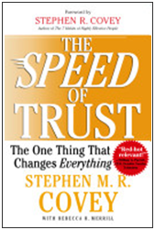
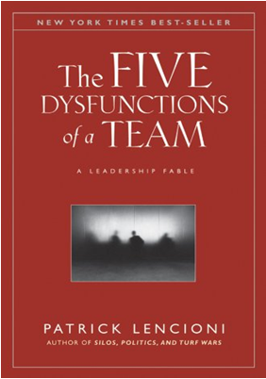
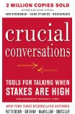

Slide 3
“I have been through some terrible things in my life, some of which actually happened.”
- Mark Twain

Slide 4
A Message from the Knoxville Chamber
of Commerce

Slide 6
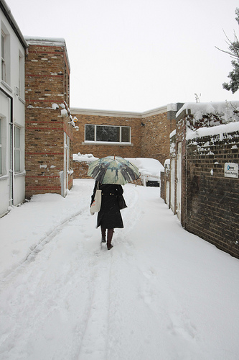

Slide 7
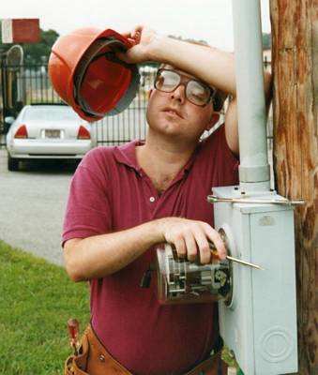

Slide 8
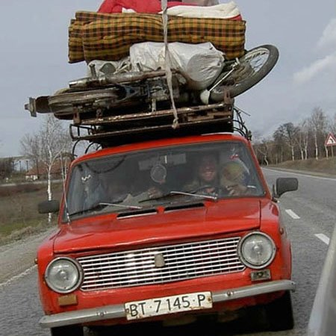

Slide 11
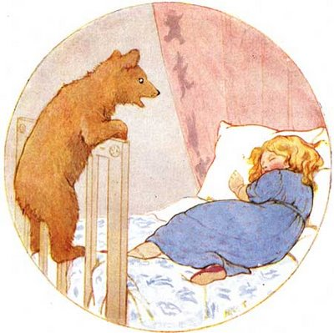

Slide 12
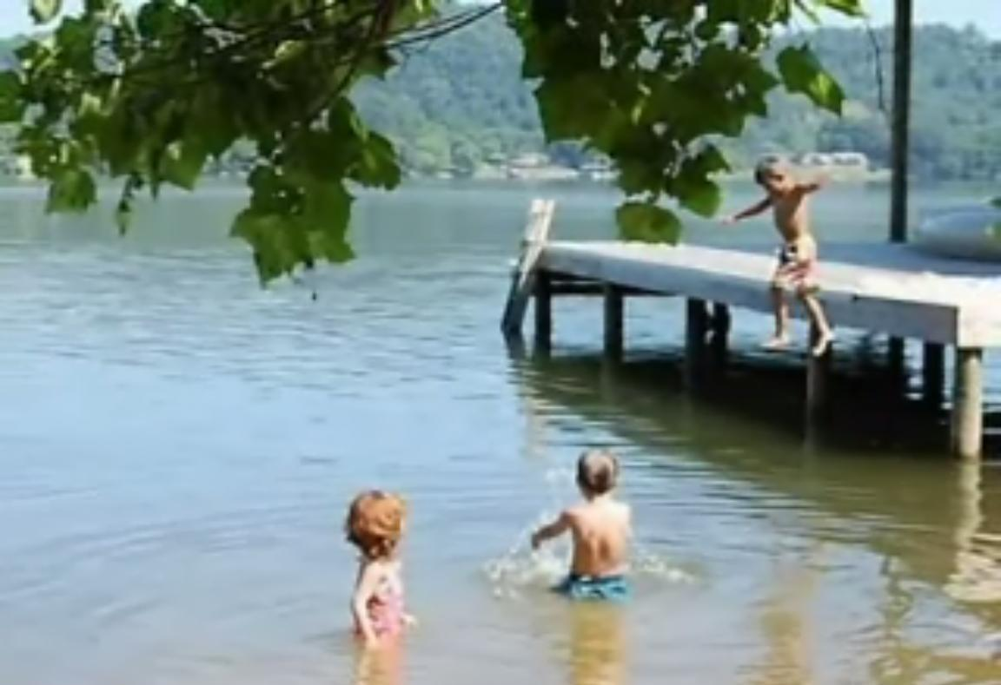

Slide 13
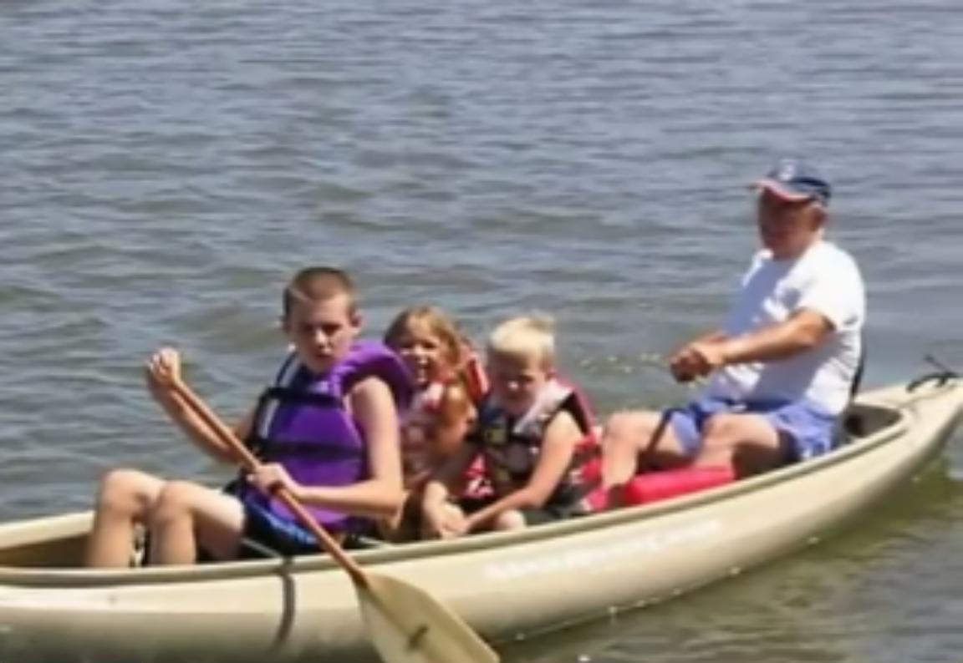

Slide 14
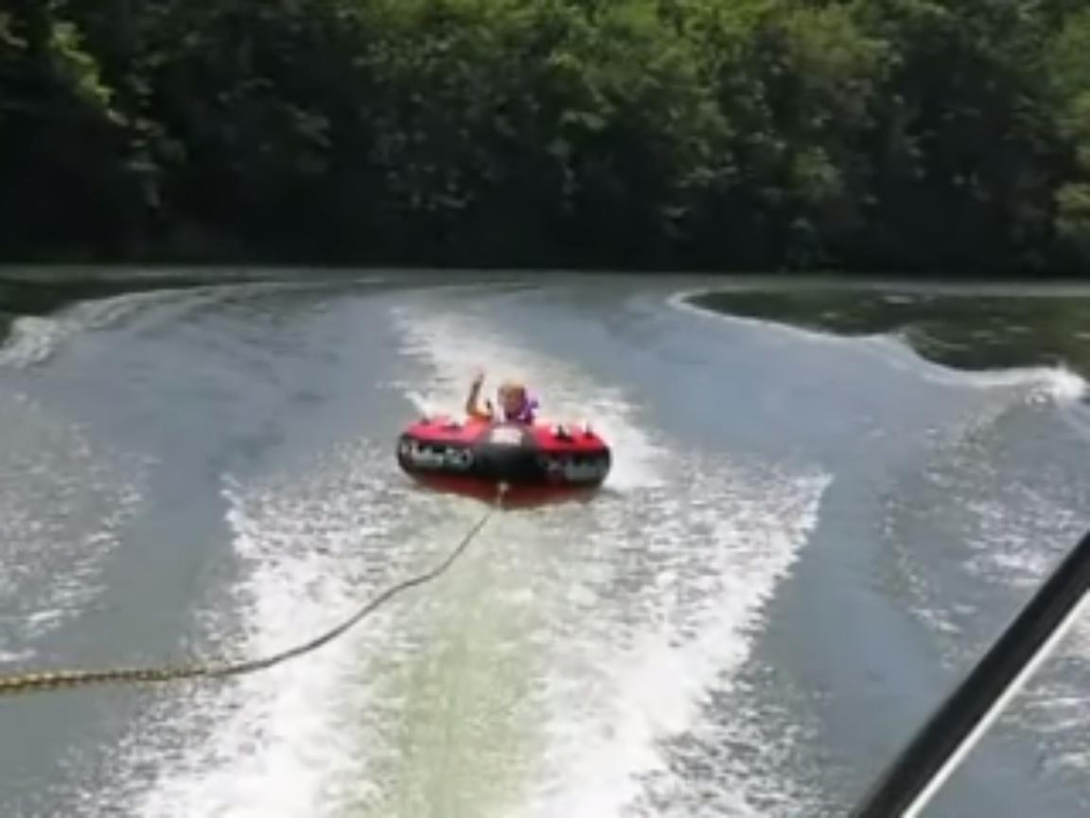

Slide 15
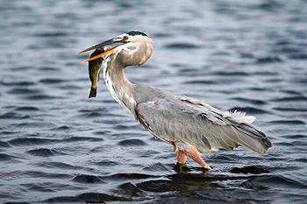

Slide 16
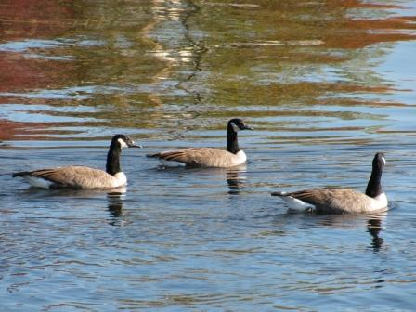

Slide 17
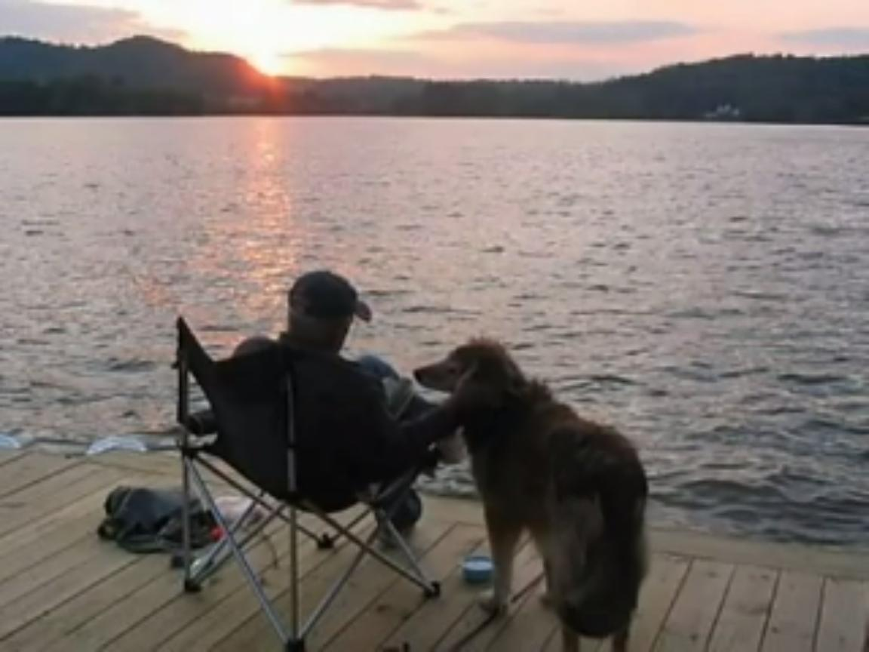

Slide 19
Objectives of This Training
To present tools available to build a more cohesive audit team
To demonstrate how trust is built between the auditor and the auditee (or agency) to get better audit results
To identify specific communication skills to resolve conflict with team members within the OIG and with auditees

Slide 20
Building a More Cohesive Audit Team
Inattention to Results
Avoidance of Accountability
Lack of Commitment
Fear of Conflict
Absence of Trust

Slide 21
Building a More Cohesive Audit Team
Absence of Trust

Slide 22
Building a More Cohesive Audit Team
Fear of Conflict

Slide 23
Building a More Cohesive Audit Team
Lack of Commitment

Slide 24
The Speed of Trust Behavior #9 Clarify Expectations
"Almost all conflict is a result of violated expectations." - Blaine Lee, Author
The Power Principle:
Influence with Honor

Slide 25
Building a More Cohesive Audit Team
Avoidance of Accountability

Slide 26
Building a More Cohesive Audit Team
Inattention to Results

Slide 27
The Speed of Trust
Author: Stephen M. R. Covey

Slide 28
The 4 Cores of Credibility
4. Results
Competence
3. Capabilities
2. Intent
Character
1. Integrity
© 2004-2006 CoveyLink

Slide 29
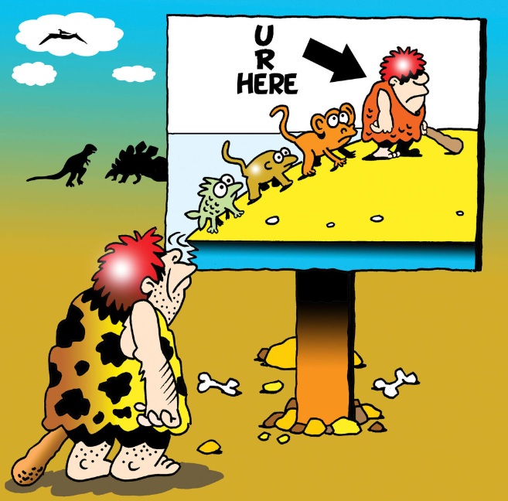

Slide 30
How Can You Assess the Health of Your Audit Team?

Slide 31
The Expectation Gap

Slide 32
Recognizing the Expectation Gap

Slide 33
“Happy Land”

Slide 34
The “Happy Land” Auditor
Kristi Reynolds

Slide 35
The Expectation Gap
Do members feel safe enough to offer differing opinions even if they are contrary to the team leader’s opinions or management’s?
Are there “undiscussables” in the group?

Slide 36
The Exception Gap
3. Do members of the team confront each other about performance expectation issues?
4. Are mistakes made by members of the team seen as failures or opportunities to learn?

Slide 37
How to Build Trust on an Audit Team
“Stack hands” on the “How”

Slide 38
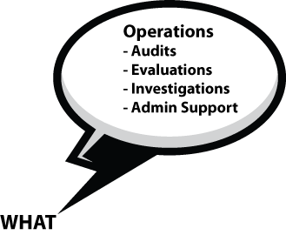
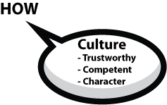

Slide 39
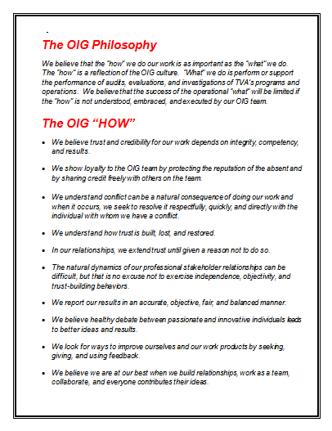

Slide 40
The “How” The OIG Philosophy
We believe that the “how” we do our work is as important as the “what” we do. The “how” is a reflection of the OIG culture. “What” we do is perform or support the performance of audits, evaluations, and investigations of TVA’s programs and operations. We believe that the success of the operational “what” will be limited if the “how” is not understood, embraced, and executed by our OIG team.

Slide 41
The “How”
We show loyalty to the OIG team by protecting the reputation of the absent and by sharing credit freely with others on the team.

Slide 42
How to Build Trust on an Audit Team
1. “Stack hands” on the “How”
Over communicate expectations
Feed on feedback (peer-to-peer accountability)

Slide 43
How to Build Trust on an Audit Team
4. Take the first 5 minutes of every meeting to talk about a “How” principle
5. Get better

Slide 44
Communication Skills to
Resolve Conflict
Inattention to Results
Avoidance of Accountability
Lack of Commitment
Fear of Conflict
Absence of Trust

Slide 45
Forming
Storming
Norming
Performing
Reconciliation
Relief, lowered anxiety
Members are engaged and supportive
Developing cohesion
Demonstration of interdependence
Health System
Ability as a team to effectively produce
Balance of task and process orientation
Resistance
Lack of participation
Conflict
Competition
High Emotions
Questioning
Socializing
Displaying Eagerness
Focus on Group Identity and Purpose
Sticking to safe topics
Tuckman Model (1965)
“Developmental Sequence in Small Groups”

Slide 46
Communication Skills to
Resolve Conflict
Know when to initiate a Crucial Conversation
A crucial conversation is one where:
There is a strong difference of opinion.
The stakes are high.
You have strong emotion about it.

Slide 47
Communication Skills to
Resolve Conflict
Initiate the Crucial Conversation when:
The conflict is between you and someone you are likely to continue to have a relationship with.
Your emotion about the issue has affected the trust level between you.

Slide 48
Communication Skills to
Resolve Conflict
3. You have formed an opinion that the other person’s motive is not good.
4. You find yourself filtering everything the person says through the issue that bothers you.

Slide 49
Communication Skills to
Resolve Conflict
Ask Your Reptilian Brain the Trick Question

Slide 50
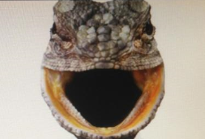
Communication Skills to
Resolve Conflict

Slide 51
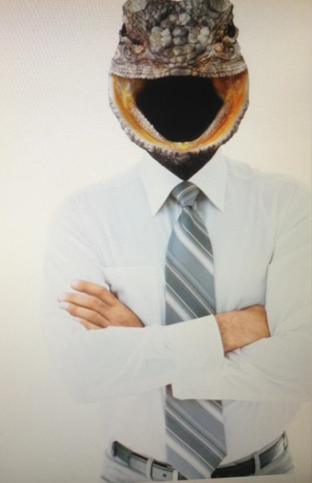
Communication Skills to
Resolve Conflict

Slide 52
Communication Skills to
Resolve Conflict
Start the Crucial Conversation with the Facts and not your Story
See/ Tell a Feel Act
Hear Story

Slide 53
Communication Skills to
Resolve Conflict
Use Tentative Words

Slide 54
Talk Tentatively
“I was wondering why . . .” NOT
“I know this is probably not true” and NOT
“Call me crazy but . . . ”

Slide 55
The Goldilocks Test
Too soft: “This is probably stupid, but . . .”
Too Hard: “How come you ripped us off?”
Just right: “It’s starting to look like you’re taking this home for your own use. Is that right?”

Slide 56
The Goldilocks Test
Too soft: “I’m ashamed to even mention this, but . . .”
Too Hard: “Just when did you start using hard drugs?”
Just right: “It’s leading me to conclude that you’re starting to use drugs. Do you have another explanation that I’m missing here?”

Slide 57
How Auditors Can Build Trust for Better Results
Trust Building is not intuitive for all Auditors

Slide 58
The 4 Cores of Credibility
4. Results
Competence
3. Capabilities
2. Intent
Character
1. Integrity
© 2004-2006 CoveyLink

Slide 59
How Auditors Can Build Trust for Better Results
CRIB to get a Mutual Purpose
Commit to seek Mutual Purpose
Recognize the purpose behind the strategy
Invent a Mutual Purpose
Brainstorm New Strategies

Slide 60
How Auditors Can Build Trust for Better Results
Listen First

Slide 61
How Auditors Can Build Trust for Better Results
“If there is any great secret in of success in life, it lies in the ability to put yourself in the other person’s place and to see things from his point of view--as well as your own.”
- Henry Ford

Slide 62
How Auditors Can Build Trust for Better Results
The Speed of Trust Principles for Listening
Understanding
Respect
Mutual Purpose
Know What You Want
Focus on the “What” and the “How”

Slide 64
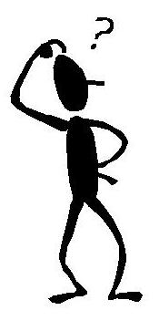
Questions?
Richard W. Moore
Inspector General
Tennessee Valley Authority
E-mail: richard.moore@tvaoig.gov
Phone: (865) 633-7300
400 W. Summit Hill Drive
Knoxville, TN 37902

