Slide 1
Leading Change Management: Models for Making Change
Anita Blair
Department of the Treasury
Deputy Assistant Secretary for Human Resources
& Chief Human Capital Officer
* Views and opinions are those of the author and not necessarily the Department of the Treasury or the US Government.
Presentation to
Federal Audit Executive Council
2013 Annual Conference
Thursday, September 26, 2013

Slide 2
Three Models for Making Change
Cultural Change
Eight Stages from John Kotter’s Leading Change (1996)
Process Change (Improvement)
Lean Six Sigma “DMAIC”
Complex Change (Dealing with Unknowns)
Spiral (or Agile) Development

Slide 3
A Basic Tool: Planning
Planning is –
Thinking Before Doing
A Continuous Learning Process
The Basis for Action, Cooperation and Adaptation
The Way to Bring About Better Results
Planning enables us to –
Gain the advantage by being prepared and proactive
Save time by listing/gathering what we need in advance
Understand and manage complex problems better
Apply our experience to address new situations
How to Plan:
Envision what you want to do
Think about your options and the pros & cons of each
Decide on a course of action
Consider Who-What-When-Where-Why-How … & How Much
List actions in sequence

Slide 4
Kotter’s Eight Stages of Change
Establish a sense of urgency (“burning platform”)
Create a guiding coalition
Develop a vision and strategy
Communicate the change vision
Empower broad action
Achieve short-term wins
Solidify gains and achieve more change
Anchor changes in the culture

Slide 5
1. Establish a sense of urgency
“Burning Platform” – Even those who support change may need a push-start
Potential Opportunities:
Budget Cuts
Other legislation: new programs and organizations
Incident (e.g., data loss, disaster, etc.)
“High Risk” assessment
Technology change

Slide 6
2. Create a guiding coalition
Ensure top leadership drives the change
Examples:
Agency “STAT” oversight groups: typically led by Deputy Secretary or Chief Management Officer
Overarching Integrated Product/Project Team (OIPT)
Project champion and key stakeholders
External Commission, Council, Board

Slide 7
3. Develop a vision and strategy
Vision: what we want the future to look like
Strategy: how we plan to get there (ends, ways and means) (+ measures)
Where do we want to go?
Where are we now?
How will we get from here to there?
How will we know we’re making progress?

Slide 8
4. Communicate the change vision
Successful Communication Planning: Remember the Ms
Message | What do we need people to know, think, do?
Members | Who are members of the target audiences? What will motivate them?
Motto | A succinct, memorable phrase that sums up the message for the audience
Marketing | Materials & Media: What are the best methods to reach each audience?
Messengers | Who can best carry the message and influence the audience?
Meetings | People are moved to action when they see others are engaged
Measures | How will we know if our communications plan is working?
Modifications | What do we need to change to get better results?

Slide 9
5. Empower Broad Action
GAO Key Practices
Dedicate an implementation team to manage the transformation process
Set goals and a timeline to build momentum and show progress
Involve employees to get their ideas and gain their ownership of the transformation: formally solicit input; provide incentives
Build capacity: provide central standardized guidance and training; facilitate sharing best practices, lessons learned
Ref: GAO-11-908 (Sept 2011), Streamlining Government: Key Practices from Select Efficiency Initiatives Should Be Shared Government-wide

Slide 10
6. Achieve short-term wins
GAO: Target both short-term and long-term initiatives.
Generate immediate results / returns
Identify resources for longer-term improvements
“Organizational Jujutsu”
Take the weight of opponents’ resistance to change and turn it into positive momentum for change
Show constituents how desired change helps them succeed in what they want to do

Slide 11
7. Solidify gains and achieve more change
Aligning employee goals with organizational goals
Advances unity of effort; over time, produces a record of measurable progress and improvement
GPRAMA: How can we connect organizational and individual performance?
OPM: Performance Management includes:
planning work and setting expectations
continually monitoring performance
developing the capacity to perform
periodically rating performance in a summary fashion
rewarding good performance

Slide 12
8. Anchor changes in the culture
Conventional anchors
Documents: Regulation, Instruction, Directive
Leader Priorities (“State of the Union” mention)
Unconventional anchors – PEOPLE
Leader Development
Mentoring
Succession Planning
We are what we repeatedly do. Excellence, then, is not an act but a habit. – Aristotle

Slide 13
Change as Process Improvement: Lean Six Sigma “DMAIC” Method
Define
Measure
Analyze
Control
Improve
Change … for the better
LSS/CPI is adaptable and scalable

Slide 14
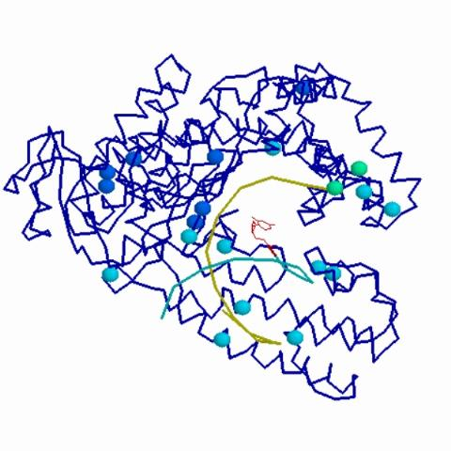
Complex Change: Spiral Development
Also called: Agile, Evolutionary or Incremental Development
When we don’t know enough about what the end result will look like –
Start by estimating the requirements, then refining each next phase through an iterative process of development, demonstration, review, and improvement.

