Slide 1
Trust Building Communication Skills for Auditors
2013 Federal Audit Executive Council Annual Conference
Richard W. Moore, Inspector General, TVA
September 27, 2013

Slide 2
WHY?

Slide 3
Auditors who step up and have the Right Conversation about the Right Things and do it the Right Way get better Results than auditors who don’t.

Slide 4
HOW?

Slide 5
How
Recognizing Crucial Conversations that are key to better audit results
Avoiding the Sucker’s Choice
Identifying where you are stuck
Use CPR to dissect the communication problem
“Stepping out of the conversation” to talk about what went wrong

Slide 6
How (cont.)
Demonstrate mutual purpose
Demonstrate mutual respect
Give an effective apology when appropriate
Use “contrasting” to rebuild safety

Slide 7
What causes Auditors to get out of sync and not “rowing” together?

Slide 8
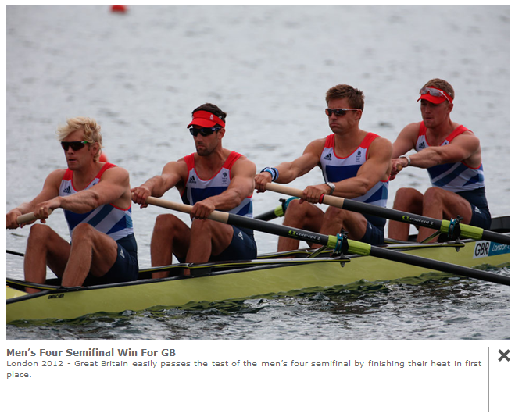

Slide 9
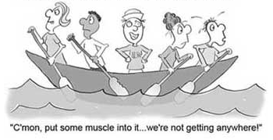

Slide 10
Internal Conflict within the OIG
Scope
Cycle Time
Resources
Poor Performers

Slide 11
Conflict with the Agency
Delays in getting the data from the agency
Push back on findings and recommendations
Disputes over the tone of the report and “gottcha” language in the report

Slide 12
Politics
Politics is when people choose their words and actions based on how they want others to react rather than based on what they really think. ~ Patrick Lencioni
The FIVE Dysfunctions of a Team

Slide 13
The Solution
Take the politics out of audits by being transparent in a respectful way that promotes staying in dialogue.

Slide 14
Video presentation of
Crucial Conversations
by Vital Smarts

