Slide 1
Federal Audit Executive Counsel
Presented by:
Louise McGlathery, Deputy Assistant Inspector General for Management
Robert Duffy, Chief Information Officer
September 9, 2011

Slide 2
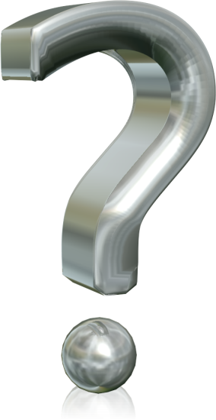
What is Cutting Edge
Technology
Notes:
For the next three year IT will have a flat or reduced budget.
IT has to do more with less and focus on efficiency and collaboration.
Evaluate all the tools that are in place to prevent using resources on similar technologies.

Slide 3
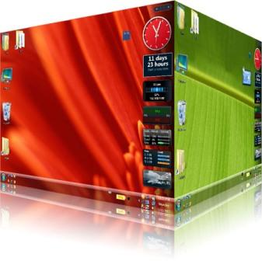
Cutting Technology for Audit Office
Big Data
Smart Network
Unified Communications
COOP
Cyber Security
Virtualization
Desktop
Applications
Infrastructure
Notes:
Agencies have to adapt to change. Auditors have always been a mobile group, but IT has not always supported this. IT has caught up and there are several technologies that enable this initiative.
Secure Access to Network
Auditors travel to client sites often, yet they need to maintain communication to managers and other team members. Virtual Private Networks (VPN) has been the answer but it had limited functionality. The technology relied on factors that were out of the auditors control (firewall ports, access to agency laptops, etc.) With the implementation of SSL VPN agencies can have a mobile workforce that is less restricted by factors out of their control. With technologies such as sandboxing, and browser based clients; auditors can use standard network ports from any computer while maintaining security.
Virtualization
Virtualization technology has advanced rapidly in the past few years. Cloud Computing is becoming more popular because it allows agencies to pool limited resources. Virtual Desktop Infrastructure (VDI) is another technology that allows the anytime, anywhere access model for business. VDI can take advantage of lower cost equipment such as This clients and tablet computers.
Voice over IP (VOIP)
VOIP is a technology that is not new but not yet universally adopted. VOIP can help agencies with shrinking IT budgets by reducing telecommunication costs. It can also help mobile users by keeping users connected no matter where they may be.

Slide 4
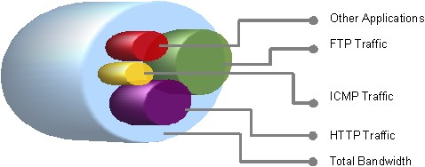
Access Anywhere, Anytime…
Collaboration Tools
Document Management
Virtual Library
Mobility
Tablet Computing
Smart Phones
Centralization
Notes:
IT is make a shift to focus on implementing and migrating to web services. This shift is being driven not only by agencies but by software vendors.
Evolution in Auditing Software
Example: TeamMate is the global market leader in Audit Management Software. With R9 TeamMate has evolved to meet the needs of large dispersed audit teams. They have moved to SQL and Oracle backend Databases. They have shifted processes to web based services.
QOS
IT has challenge of increasing data on the network. Circuits have multiple data types running across the network such as; Internet, VOIP, VTC, Email, Application, Backups etc. IT has to more efficient and achieve maximum utilization in their circuits. Quality of Service (QOS) on the circuit can help ensure the end-user experience.
Centralization
With tight IT budgets, efficiency of centralization now outweighs the performance of decentralization. This also moves towards a mobile workforce that does not rely on where the data is, they just need it to be available. Centralization also helps management in supervising work and reporting on progress.

Slide 5
Questions

