Slide 1


DATA Act Briefing
September 4, 2014

Slide 2


DATA Act Summary
Purpose: to establish government-wide financial data standards and increase the availability, accuracy, and usefulness of Federal spending information.
Passed Congress on April 28. Signed into law on May 9, 2014 (P.L. 113-101).
Amends the Federal Funding Accountability and Transparency Act (FFATA) to require full disclosure of Federal agency expenditures.
It also requires the development of Government-wide data standards, takes steps to simplify financial reporting, and improves the quality of the spending data.

Slide 3
Treasury Key Roles
Co-establish with OMB government-wide financial data standards.
Lead the Government-wide implementation of the DATA Act.
Publish additional expenditures information on USAspending.gov no later than three years after enactment.
Create a data analysis center (or expand an existing service) to support the prevention and reduction of improper payments by Federal agencies and improve efficiency and transparency in the federal government.
Notes:
Additional expenditures information on USAspending
Sec 3 requires the Secretary of the Treasury, in consultation with the Director of the Office of Management and Budget (OMB), to post on the USAspending.gov website the following information for funds made available to or expended by a Federal agency:
(1) for each appropriations account – the budget authority appropriated, the amount obligated, the unobligated balances, and any other budgetary resources;
(2) the amounts obligated and outlayed for each program activity;
(3) the amounts obligated and outlayed for each object class; and
(4) for each program activity, the amounts obligated and outlayed by object class.
Treasury has three years after the date of enactment of the DATA Act to first post this information and is then required to post information on a quarterly basis, and, where practicable, on a monthly basis.
Financial data standards
REQUIREMENTS.—The data standards established shall:
1) incorporate widely accepted common data elements, such as those developed and maintained by—
(A) an international voluntary consensus standards body;
(B) Federal agencies with authority over contracting and financial assistance; and
(C) accounting standards organizations;
(2) incorporate a widely accepted, nonproprietary, searchable, platform-independent computer3
readable format;
(3) include unique identifiers for Federal awards and entities receiving Federal awards that can be consistently applied Government-wide;
(4) be consistent with and implement applicable accounting principles;
(5) be capable of being continually upgraded as necessary;
(6) produce consistent and comparable data, including across program activities; and
(7) establish a standard method of conveying the reporting period, reporting entity, unit of measure, and other associated attributes.

Slide 4
DATA Act Implementation Timeline
Agencies report information in accordance with the standards. Information published on public website (May)
Issue guidance to agencies on data standards and conduct pilot (May)
First IG report (Nov.)
DATA Act passes (May)
2015
2014
2016
2017
USAspending transitioned to Treasury (Feb.)
Launch improved USAspending(Feb.)

Slide 5
Background – Treasury Vision:
360 Spending Life Cycle
Treasury Vision
  Provide reliable, timely, secure, and consumable financial management data for the purpose of promoting transparency, facilitating better decision making, and improving operational efficiency.
  Better Data, Better Decisions, Better Government
GOALS
Capture and make available financial management data to enable the data consumers to follow the complete life cycle of Federal spending -- from appropriations to the disbursements of grants, contracts, and administrative spending Standardized information exchanges – definitions and format – to enable timely access to discoverable and reusable detail transaction level data
Accomplishments-to-date
  Assumed program responsibility over USAspending.gov
  Successfully piloted “Intelligent Data” prototype
  Conducted “Award ID linkage” feasibility study
PRE-DECISIONAL/FOR DISCUSSION PURPOSES ONLY

Slide 6

360° Spending Transparency
6
LEAD. TRANSFORM. DELIVER

Slide 7
DATA Act in Context of Spending Life Cycle
Receipts/
Financing
Appropriation
Payment
Apportionment
Obligation
Allotment
(Allocation)
Award
 | 360 Spending Life Cycle
 | DATA Act
 | FFATA (USAspending.gov)
Commitment

Slide 8
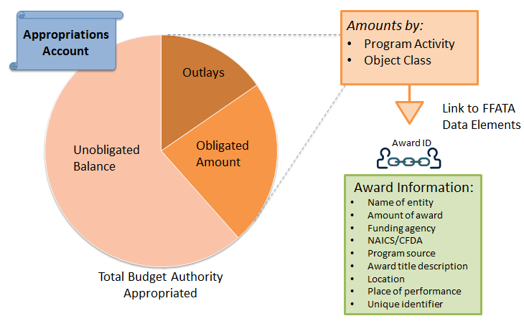
DATA Act Requirements
FFATA Sec. 3 “Full disclosure of federal funds”

Slide 9
Data Sources
Treasury Data
Summary level
Operational & Reporting
Transactional level
Financial Mgmt. & Budgeting
Agency Award Data
Management system data
(i.e., procurement, grant systems)
Agency Financial Data
Appropriations account
Budgetary resources
Amount obligated
Unobligated balance
Outlays
Standard Data Exchange
Object class
Program activity
Award ID
Recipient
Location
Notes:
To meet the DATA Act requirements and our long-term goal (360 spending lifecycle), we need access to three sets of data:
Award data (recipient, location, purpose, etc.) that is currently only housed within the management systems at agencies.
Agency financial data (object class, program activity) that is currently only housed within the financial systems at agencies.
Summary account data (outlays, unobligated balances, appropriation accounts, payment) that is current stored at Fiscal Service as well as agencies.
We want to access the data in a way that is least burdensome to agencies, creates the most value to agencies, most expedient and practical.

Slide 10
DATA Act Implementation Approach
Data-centric
Avoid massive system changes, focus on managing data
Release data as it becomes available
Maximize and leverage use of existing processes and investments
Feedback drives improvements
Conduct many small scale pilots
Incremental
Reuse
Collaborative
Iterative/Agile

Slide 11
Governance and Implementation Structure
Executive Steering Committee – OMB and Treasury
Inter-Agency Advisory Committee – OMB, Treasury, OSTP, GSA and
Representatives from: CFOC, BOAC, ACE, COFAR, CAOC, CIOC, PIC
Lead
Treasury
(Data Transparency PMO)
OMB
Design and Implement
Treasury
Data Exchange Standards
OMB
Data Definition Standards
Support
Industry
Non-Federal stakeholders
Consult
Treasury
Data Analytics
Senior Accountable Officials from each of the 24 CFO Act agencies
Federal Lines of Business
OMB
Pilot to Reduce Admin Burden
Treasury
Blueprint/roadmap between data elements

Slide 12
Creating Value through Better Access to Data
Benefits | Examples of use cases
Provide Transparency Reduce fraud and mitigate risk | Disaster relief spending: Reduce time spent on answering requests by making it easy for stakeholders to find accurate information
Greater insights Expose variation and use benchmarks/best practices to assess best approach | Improve grantee oversight: Agencies can compare grant funding use and depletion across recipients (e.g., state-level comparisons for education and infrastructure spending)
Customize services/actions Segment populations to customize actions | Loans and fraud management: Identify and proactively address risks and fraud
Enable data driven decisions Faster, more accurate, less biased decisions | Performance based decision making: Better decision making by being able to better track performance and spending
Enable Innovation Create or enhance products and services | Economic growth: Providing open and consumable data will help new and existing businesses to use data to inform activities (e.g., national weather service, geospatial data)

Slide 13
What is Ahead of Us?
Finalize the plan to implement the DATA Act.
Develop and implement an outreach model for all federal and non-federal stakeholders.
Consult with public and private stakeholders in establishing the data standards.
Standardize the data element definitions.
Develop a blueprint of the data elements based on the standard definitions.
Continue pilot effort on data exchange standards and publication options.

