Slide 1
2017 Inspector General
FISMA Metrics
Federal Audit Executive Council
Bimonthly Meeting and Training
Peter Sheridan
Khalid Hasan
June 27, 2017

Slide 2

Who are We?
Peter Sheridan, Assistant Inspector General for Information Technology, CISA, CPA
  30+ years’ experience in managing and directing audits, including IT and cybersecurity reviews in the federal government
  Chair of the Federal Audit Executive Council’s (FAEC) IT Committee
Khalid Hasan, Senior IT Audit Manager, CISA, PMP
  15+ years’ experience in conducting, managing, and directing IT audits of complex federal information systems, processes, and programs, including cybersecurity reviews
Members of the Council of the Inspectors General on Integrity and Efficiency (CIGIE) IT Committee
FAEC Bimonthly Meeting and Training
June 27, 2017

Slide 3
Agenda
Overview of the Federal Information Security Modernization Act of 2014 (FISMA)
Development and evolution of the annual Inspector General (IG) FISMA metrics
Maturity model approach to independent evaluations of agency information security programs
Cyberscope overview
Cybersecurity executive order and OMB reporting guidance
Next steps
FAEC Bimonthly Meeting and Training
June 27, 2017

Slide 4
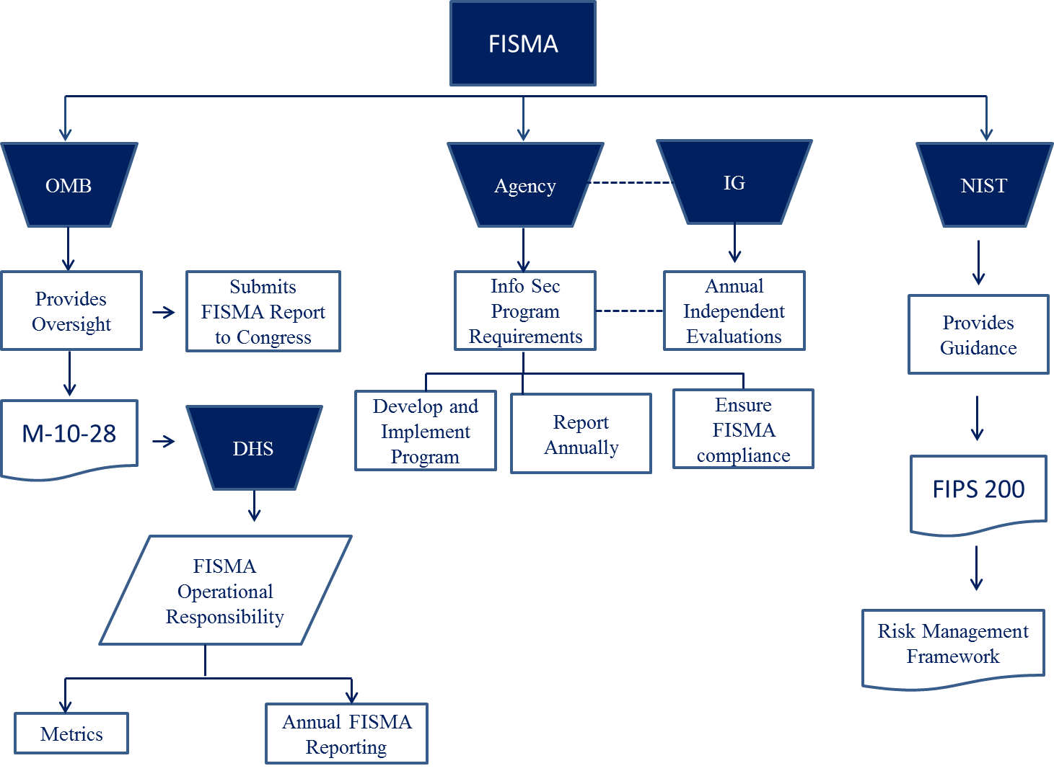
Key FISMA Responsibilities
CIO Council
CIGIE
FAEC Bimonthly Meeting and Training
June 27, 2017

Slide 5
FISMA of 2002 vs. FISMA of 2014
FISMA of 2002
FISMA of 2014
Perform an annual independent evaluation of information security program and practices
  Testing effectiveness of policies and procedures for subset of systems
  An assessment of compliance with FISMA and related policies, procedures, standards, and guidelines
Perform an annual independent evaluation of information security program and practices
  Testing effectiveness of policies and procedures for subset of systems
  An assessment of the effectiveness of the information security policies, procedures, and practices of the agency
FAEC Bimonthly Meeting and Training
June 27, 2017

Slide 6
Security Control Effectiveness
Security control effectiveness addresses the extent to which the controls are implemented correctly, operating as intended, and producing the desired outcome with respect to meeting the security requirements for the information system in its operational environment or enforcing/mediating established security policies
Source: NIST Special Publication 800-53, Rev. 4, Security and Privacy Controls for Federal Information Systems and Organizations
FAEC Bimonthly Meeting and Training
June 27, 2017

Slide 7
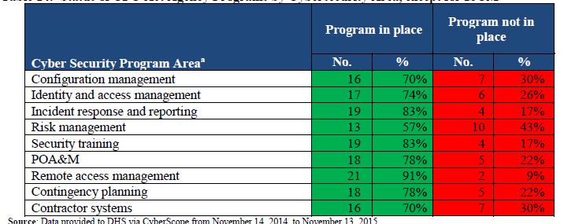
Previous Years’ FISMA Reporting Approach
FISMA reporting guidance for IGs has generally included compliance-based measures across various domains that IGs must respond to with a “Yes” or “No”
  Information security continuous monitoring
  Configuration management
  Identity and access management
  Incident response and reporting
  Risk management
  Security training
  Plan of action and milestones
  Contingency planning
  Contractor systems
FAEC Bimonthly Meeting and Training
June 27, 2017

Slide 8
Government-wide FISMA Compliance “Scorecard”
(2012 – 2015)
FAEC Bimonthly Meeting and Training
June 27, 2017

Slide 9
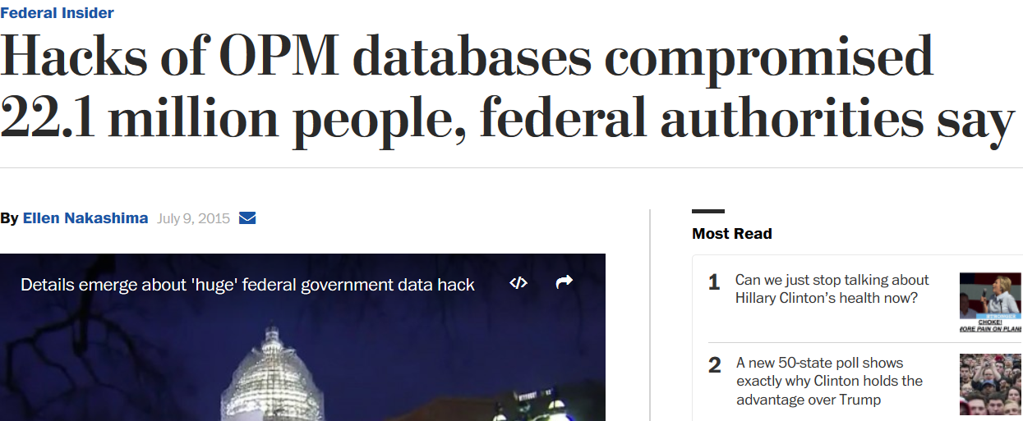
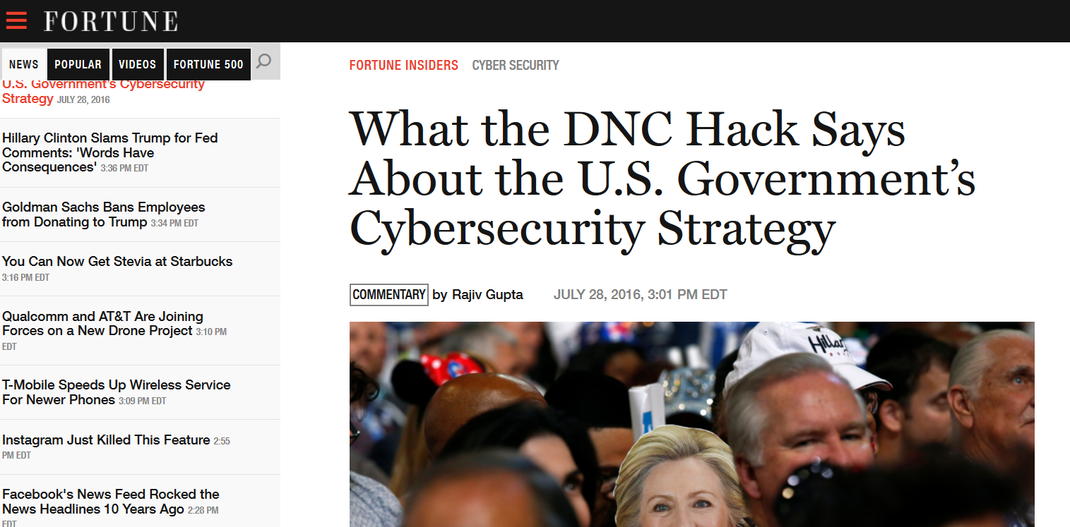

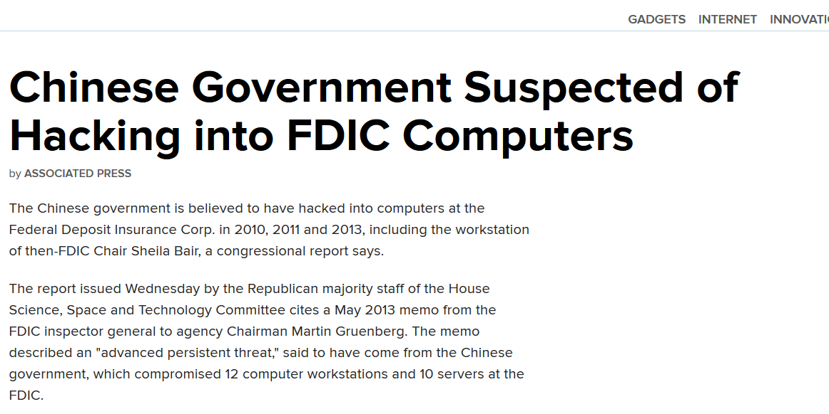
What Does This Mean?
FAEC Bimonthly Meeting and Training
June 27, 2017

Slide 10
Maturity Models
A maturity model refers to a set of characteristics, attributes, indicators, or patterns that represent capability and progression in a certain discipline
Can be used to identify current status of information security against set of requirements
Cold reader can understand the status of an organization’s information security against specified requirements and in relation to other organizations
NIST has developed approaches for information security maturity models
Maturity models used in IT organizations and electric industry
FAEC Bimonthly Meeting and Training
June 27, 2017

Slide 11
Maturity Model Approach to FISMA Evaluations
In 2015, a FISMA metrics subcommittee of the FAEC IT Committee was formed to develop effectiveness based measures
Collaboration with the Office of Management and Budget, Department of Homeland Security, CIGIE, CIO Council, and other stakeholders
Result was a maturity model for information security continuous monitoring
FAEC Bimonthly Meeting and Training
June 27, 2017

Slide 12
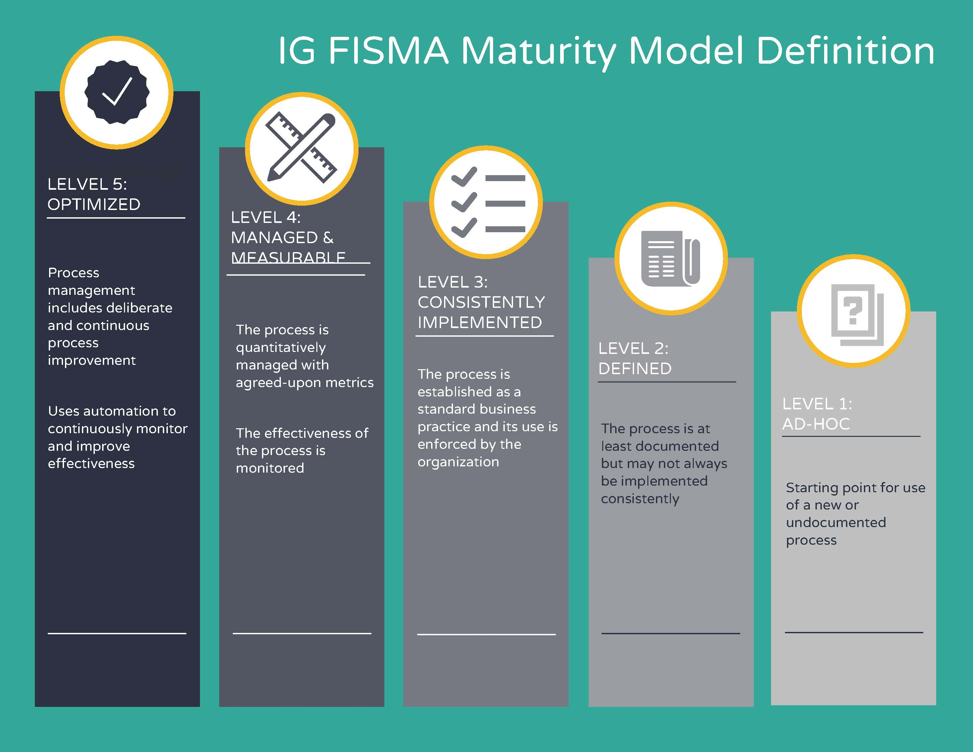
FISMA Evaluation Maturity Model
FAEC Bimonthly Meeting and Training
June 27, 2017

Slide 13
Effectiveness within the Maturity Model
Level 1 Ad-hoc
Level 2
Defined
Level 3 Consistently Implemented
Level 4 Managed & Measurable
Level 5 Optimized
Implement
Operate
Desired Results
Effectiveness
FAEC Bimonthly Meeting and Training
June 27, 2017

Slide 14
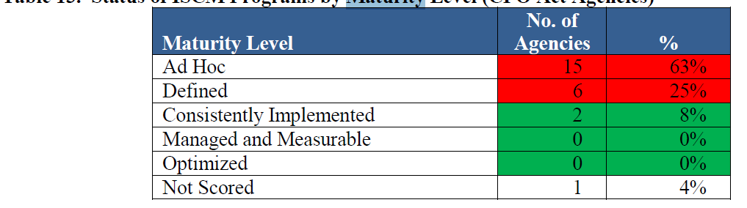
2015 ISCM Evaluation Results
Agency Progress Against ISCM CAP Goals
Automated Software Asset Inventory | 89%
Capability to Detect & Block Unauthorized Software | 68%
Secure Configuration Management | 92%
Vulnerability Management | 52%
OIG ISCM Maturity Evaluations
Source: OMB FY 2016 FISMA Report to Congress
FAEC Bimonthly Meeting and Training
June 27, 2017

Slide 15
Maturity Model Enhancements
In 2016, developed a maturity model to assess incident response programs
In 2017, transitioned all FISMA metrics areas to a maturity model and mapped metrics to the NIST Cybersecurity Framework
Function (Section) | IG Metrics | CIO Metrics
Identify (Risk Assessment) | X
Identify (Contractor Systems) | X | •
Protect (Configuration Management) | X | X
Protect (Identification and Authentication) | X | X
Protect (Security Training) | X | X
Detect (ISCM) | X | X
Respond (Incident Response) | X | X
Recover (Contingency Planning) | X | X
FAEC Bimonthly Meeting and Training
June 27, 2017

Slide 16
NIST Cybersecurity Framework (CSF)
Executive Order 13636, “Improving Critical Infrastructure Cybersecurity,” called for the development of a voluntary risk-based Cybersecurity Framework – a set of industry standards and best practices to help organizations manage cybersecurity risks
NIST issued the CSF in February 2014
  Core
  Implementation Tiers
  Profile
FAEC Bimonthly Meeting and Training
June 27, 2017

Slide 17
NIST CSF and Relation to FISMA Metrics
CSF Function Area | CSF Categories/Attributes | FISMA Metric Areas
Identify | Asset management, business environment, governance, risk management | Identify – risk management
Protect | Access control, training, data security, config mgmt, change control, remote access, sdlc | Protect – configuration mgmt; I&A, training
Detect | Continuous monitoring, incident detection, | Detect – ISCM Respond – incident response
Respond | Response planning, communications, analysis, mitigation | Respond – incident response
Recover | Recovery planning, improvements, communications | Recover - contingency planning
FAEC Bimonthly Meeting and Training
June 27, 2017

Slide 18
Example Maturity Indicator for Risk Management
To what extent does the organization utilize technology to provide a centralized, enterprise wide (portfolio) view of risks across the organization, including risk control and remediation activities, dependencies, risk scores/levels, and management dashboards?
Level 1 Ad-hoc
Level 2
Defined
Level 3 Consistently Implemented
Level 4 Managed & Measurable
Level 5 Optimized
Analysis of trends, performance against benchmarks, continuous improvement
Scenario analysis and threat modeling
Solution consistently implemented; all sources of risk information are integrated into the solution
Requirements defined; solution selected, but not implemented across the agency
Requirements not identified and defined
FAEC Bimonthly Meeting and Training
June 27, 2017

Slide 19
Example Maturity Indicator for Configuration Management
To what extent does the organization utilize configuration settings/common secure configurations for its information systems?
Level 1 Ad-hoc
Level 2
Defined
Level 3 Consistently Implemented
Level 4 Managed & Measurable
Level 5 Optimized
Uses system configuration tools to automatically enforce and redeploy configuration settings at frequent intervals
Uses automation to maintain an up to date, accurate, and readily available view of the security configuration for all system components connected to the network
Implement, assess, and maintain secure configurations for systems
Policies and procedures established and communicated
Policies & procedures not established
FAEC Bimonthly Meeting and Training
June 27, 2017

Slide 20
Scoring Methodology
FY 2017 FISMA IG Metrics scoring methodology will seek to provide a balanced assessment of agency information security capabilities
Agency IGs will assess capabilities on a spectrum of potential maturity levels
Overall maturity for each NIST Function will be recommended based on the most frequently occurring level (mode)
  Goal is to provide a representative maturity level, but IGs can substitute a different score if they choose
Overall agency maturity will be determined by the IG
  This allows IGs to customize their assessments based on agency circumstances
FAEC Bimonthly Meeting and Training
June 27, 2017

Slide 21
What Results are we Seeing?
Previous Government-wide Compliance-based Scorecard
New Government-wide Maturity-based Scorecard
Cybersecurity Framework Area | Average Rating
Identify | Level 2: Defined
Protect | Level 3: Consistently Implemented
Detect | Level 2: Defined
Respond | Level 2: Defined
Recover | Level 3: Consistently Implemented
Overall | Level 2: Defined
FAEC Bimonthly Meeting and Training
June 27, 2017

Slide 22
Agency Cybersecurity Performance Summaries
Chief Information Officer Assessment
Inspector General Assessment
Agency xx has implemented and maintained an information security program that is consistent with FISMA requirements in all eight of the information security domains: risk management, contractor systems, configuration management, identity and access management, security and privacy training, information security continuous monitoring (ISCM), incident response, and contingency planning.
In 2016, Agency xx continued to enhance its Information Security Continuous Monitoring and vulnerability management programs. In addition, the agency met the CAP goal for Personal Identity Verification (PIV) enforcement of privileged users. In addition, the agency met CAP Goals in 2016 for Vulnerability Management, Anti-Phishing, Malware Defense, and Other Defenses.
Identify Level 2: Defined
Protect Level 3: Consistently Implemented
Detect Level 2: Defined
Respond Level 1: Ad-Hoc
Recover Level 3: Consistently Implemented
Overall, Agency xx continues to mature its information security program to ensure that it is consistent with FISMA requirements. The Inspector General also found that the agency’s information security program includes policies and procedures that are generally consistent with the requirements for all eight information security domains.
However, there are identified opportunities to strengthen controls in the areas of risk management, identity and access management, security and privacy training, and incident response, for which the audit report includes nine recommendations.
FAEC Bimonthly Meeting and Training
June 27, 2017

Slide 23
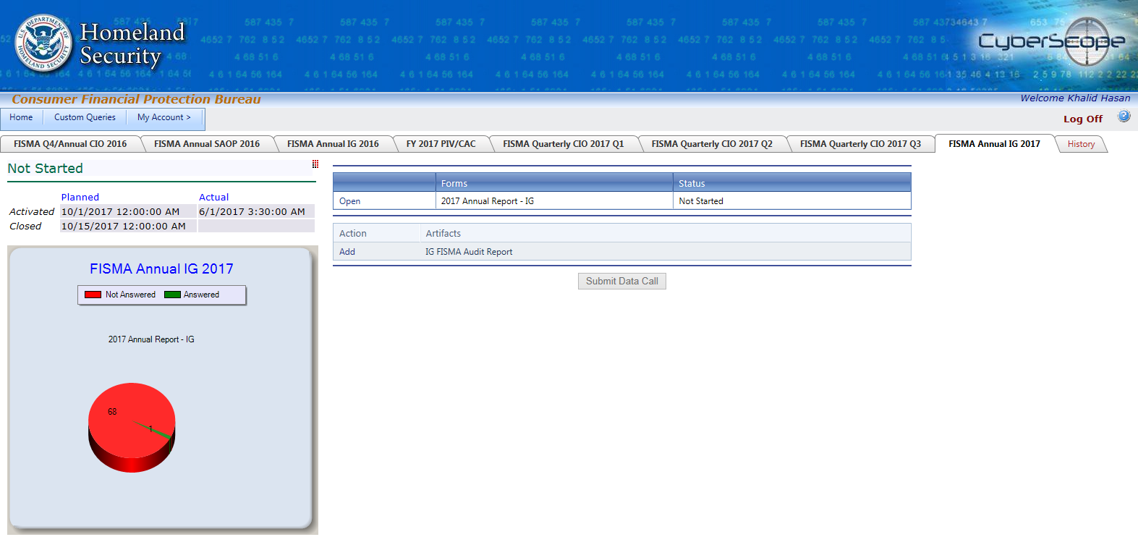
Cyberscope
FAEC Bimonthly Meeting and Training
June 27, 2017

Slide 24
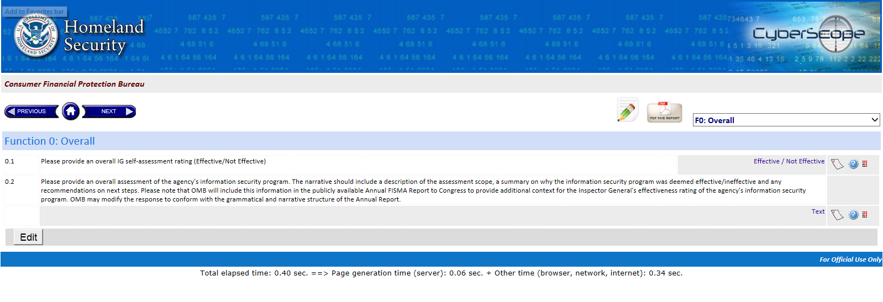
FAEC Bimonthly Meeting and Training
June 27, 2017

Slide 25
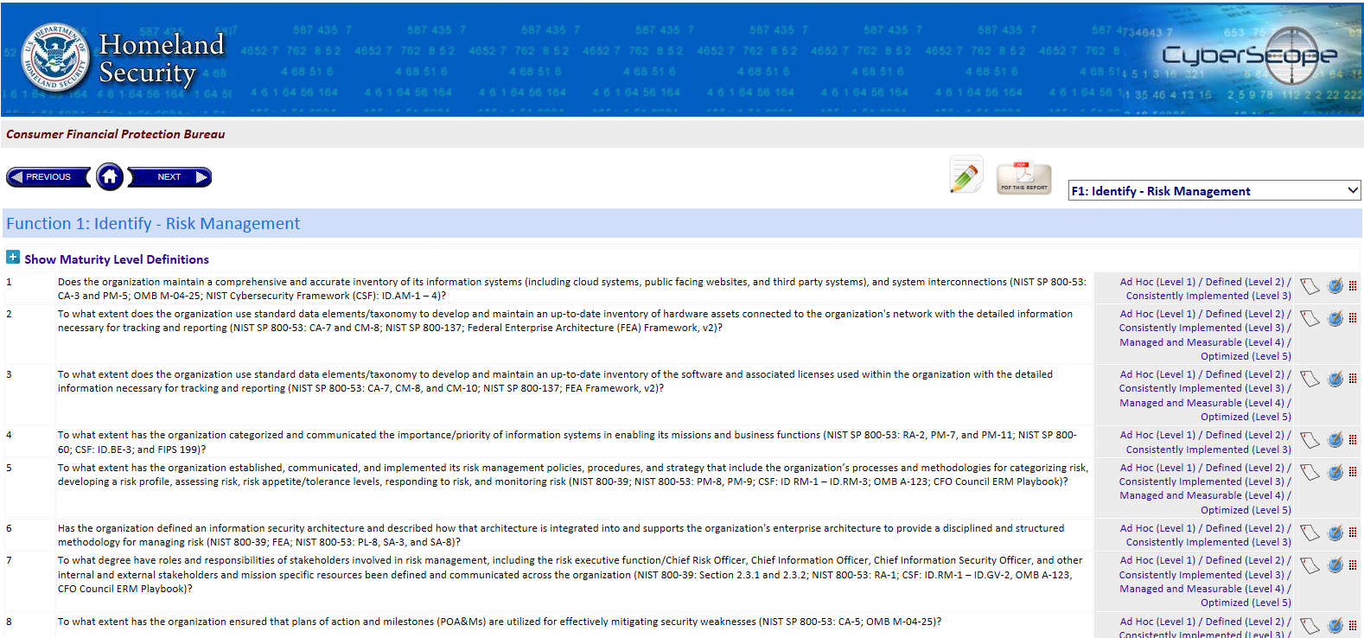
Cyberscope (cont.)
FAEC Bimonthly Meeting and Training
June 27, 2017

Slide 26
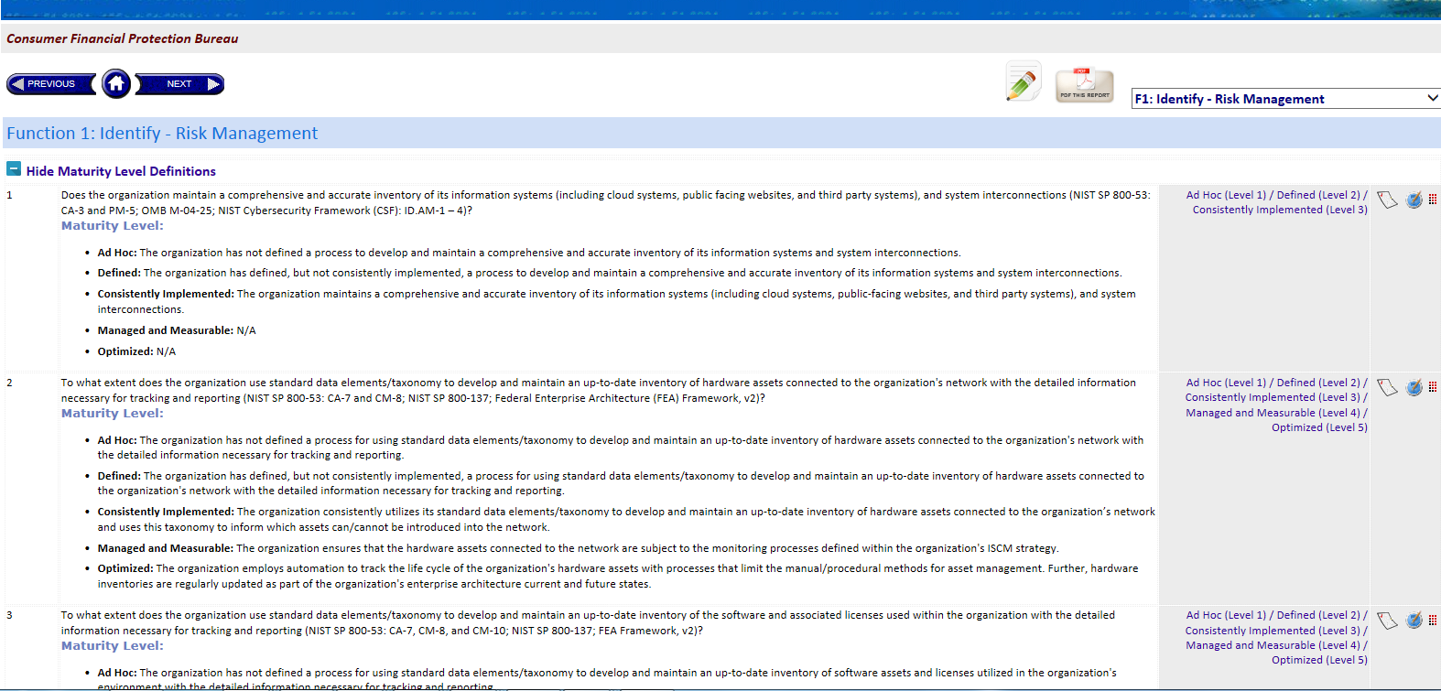
FAEC Bimonthly Meeting and Training
June 27, 2017

Slide 27
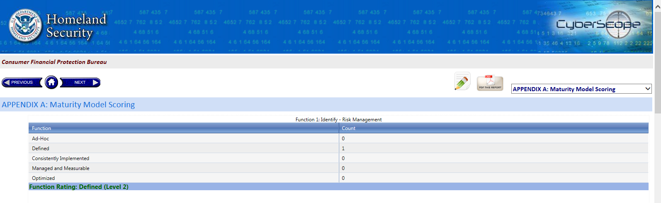
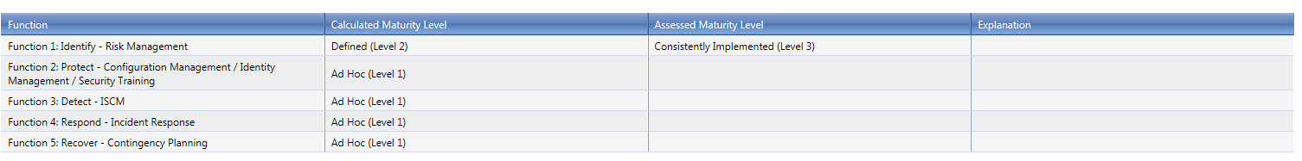
FAEC Bimonthly Meeting and Training
June 27, 2017

Slide 28
Cyberscope Summary
  Narrative responses required if
    IG response to any metric is below Level 4
    Assessed maturity level varies from calculated maturity level (appendix A)
  Cyberscope entry completed (validated and approved) by October 31, 2017
  The overall assessment narrative will be included in OMB’s annual FISMA report to Congress.
FAEC Bimonthly Meeting and Training
June 27, 2017

Slide 29
Cybersecurity Executive Order
  All agencies are required to use the NIST Cybersecurity Framework to manage cybersecurity risk
  Each agency head to provide a risk management report to DHS and OMB by August 2017
  By October 2017, DHS and OMB to
    Determine whether agency the risk mitigation and acceptance choices are appropriate and sufficient risk management reports
    A plan to adequately protect the executive branch enterprise, address budgetary needs, aligning agency policies to the framework
FAEC Bimonthly Meeting and Training
June 27, 2017

Slide 30
OMB Implementation Guidance
Requirement | Deadline
1. Notify OMB of the senior accountable official (whether the agency head or the agency head’s designee) responsible for the implementation of Section 1(c) of the Executive Order. | May 26, 2017
2. Submit responses to the FY 2017 Quarter 3 FISMA CIO metrics, through the DHS CyberScope system | July 14, 2017
3. Provide a written response to the assessment that is signed by the senior accountable official (agency head or the agency head’s designee) and describes how the agency plans to accept, avoid, transfer, or mitigate outstanding risks. | August 9, 2017
4. Submit Framework Implementation Action Plan through DHS CyberScope. | July 14, 2017
FAEC Bimonthly Meeting and Training
June 27, 2017

Slide 31
Potential Next Steps
  Develop an “evaluation guide” to include suggested test steps/indicators for IG use
  Incorporate a more robust scoring methodology with weighting applied to attributes that are of greater risk or concern to stakeholders
  Evaluate options to tailor maturity attributes based on organizational missions/resources/risks
FAEC Bimonthly Meeting and Training
June 27, 2017

Slide 32
Points of Contact
  Peter Sheridan, Assistant Inspector General for IT, Board of Governors of the Federal Reserve System and Consumer Financial Protection Bureau and Chair, FAEC IT Committee, Peter.J.Sheridan@frb.gov
  Khalid Hasan, Senior OIG Manager, Board of Governors of the Federal Reserve System and Consumer Financial Protection Bureau, Khalid.A.Hasan@frb.gov
  FISMA FNR Team: FNR.FISMA@hq.dhs.gov
  CyberScope Help Desk: CyberScopeHelp@hq.dhs.gov
  CyberScope Max Portal Page: https://community.max.gov/x/hQIJL
FAEC Bimonthly Meeting and Training
June 27, 2017

Slide 33
FAEC Bimonthly Meeting and Training
June 27, 2017

