Slide 1
FRAUD BUSTERS

Slide 2
DHS-OIG Office of Audits
Auditing Acquisitions
For Fraud

Slide 3
Objective
Overview of the (DHS) acquisition process
Identify fraud schemes and their various indicators
Note where these occur within federal acquisitions
Discuss how we audit for them
Notes:
The objective of this brief is to gain a general overview of the acquisition process, identify various fraud indicators, and recognize where these occur within federal acquisitions. We will identify the legal requirements relevant to acquisitions and audits, occasions where common fraud schemes are perpetrated, audit processes and methods for detecting fraud, and the available administrative and legal remedies. Several examples of recent DHS-OIG fraud cases will be discussed to show the steps taken to audit and prosecute these acquisition frauds.

Slide 4
So why are we here today?
Notes:
U.S. organizations up to 5 – 7 % of their revenues each year.
66% run for more than a year before they were detected.
13% ran for five years or longer before they were detected.
Procurement fraud often starts out “under the radar screen” with a systematic abuse of trust sometimes combined with flawed internal controls. If discovered, the tendency may be to characterize it as isolated instance when a more thorough examination would uncover a pattern.
Depending on the organization being victimized; the consequences of procurement fraud will always involve the loss of money, but may also put at risk - personal safety, if the scheme involves defective products; counterfeit parts; or product substitution.

Slide 5
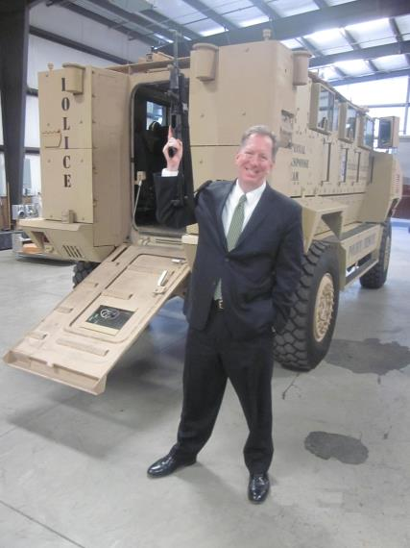
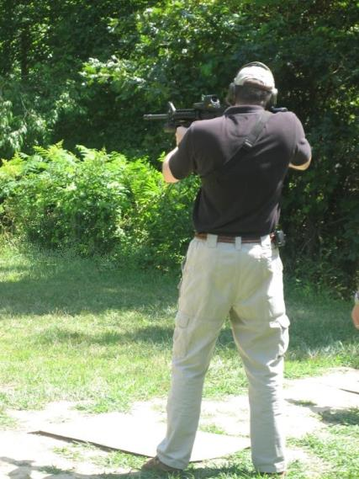
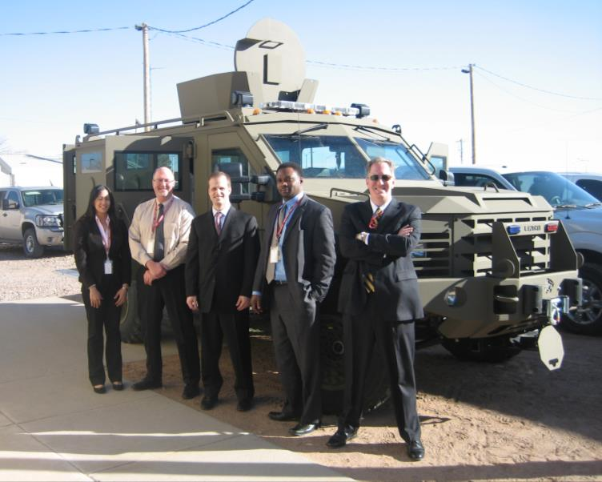
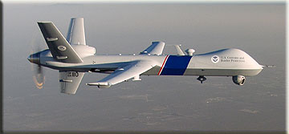
What “big ticket” items is DHS acquiring?

Slide 6
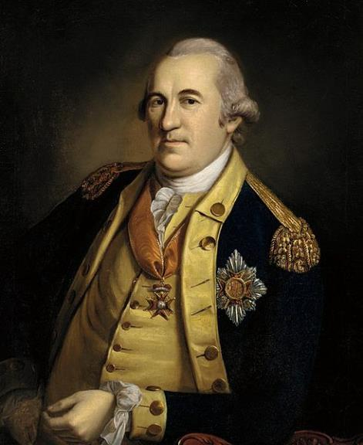
But first, an audit history lesson…
Baron Friedrich
von Steuben
1st Inspector General
Notes:
Baron Friedrich von Steuben - Born September 17, 1730 – He was a Prussian-born military officer who served as a Major General of the Continental Army during the American Revolutionary War. And he wrote the first “color coded” government regulation!
Friedrich Wilhelm August Heinrich Ferdinand von Steuben (born Friedrich Wilhelm Ludolf Gerhard Augustin von Steuben; (d. November 28, 1794)

Slide 7
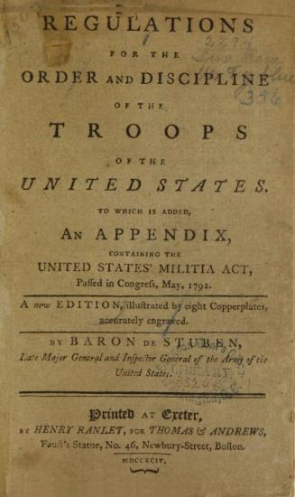
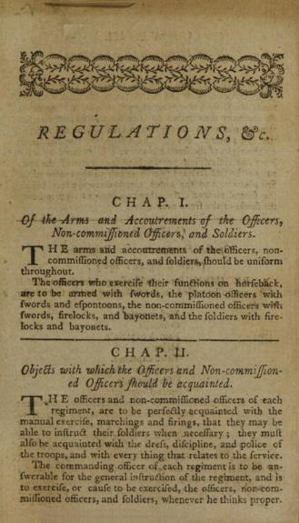
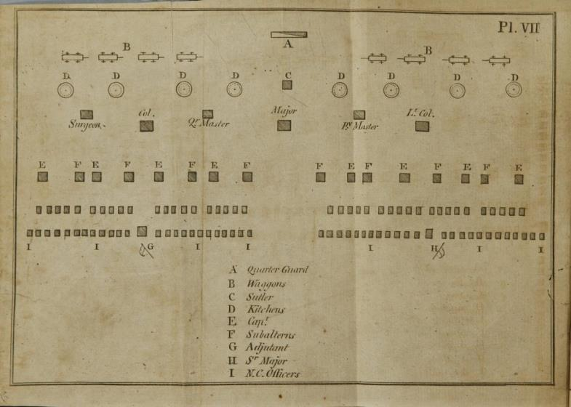
He wrote the “Blue Book”…
Notes:
“Washington recommended appointment of Steuben as inspector general on April 30, 1778; Congress approved it on May 5, 1778. During the winter of 1778–1779, Steuben prepared Regulations for the Order and Discipline of the Troops of the United States, commonly known as the "Blue Book". Its basis was the training plan he had devised at Valley Forge.”
“Steuben established standards of sanitation and camp layouts that would still be standard a century and a half later. There had previously been no set arrangement of tents and huts.
Men relieved themselves where they wished and when an animal died, it was stripped of its meat and the rest was left to rot where it lay.
Steuben laid out a plan to have rows for command, officers and enlisted men. Kitchens and latrines were on opposite sides of the camp, with latrines on the downhill side. There was the familiar arrangement of company and regimental streets.”

Slide 8
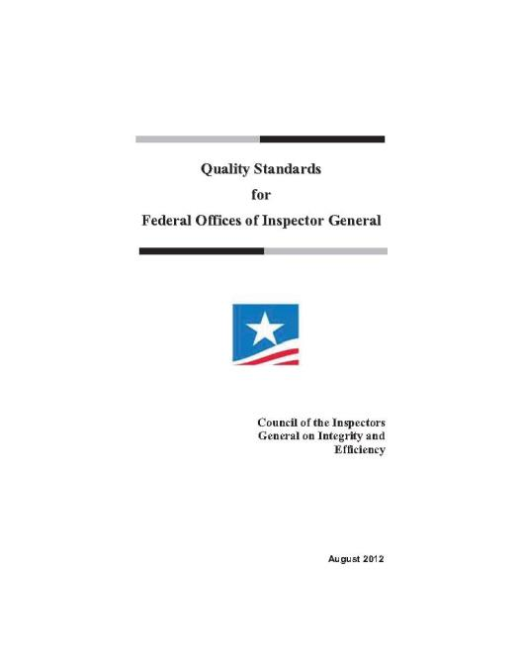
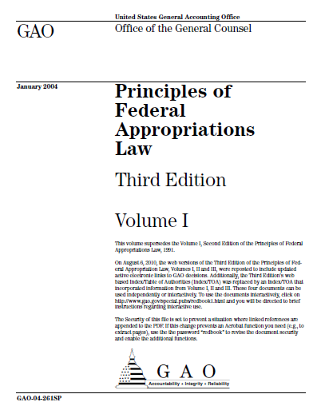
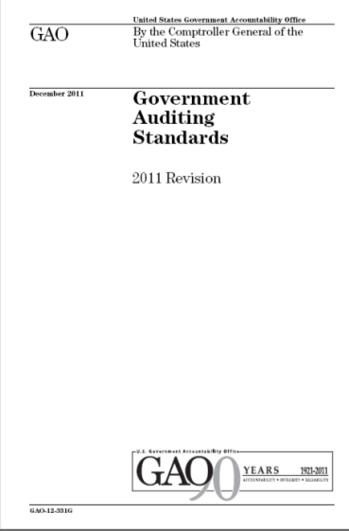
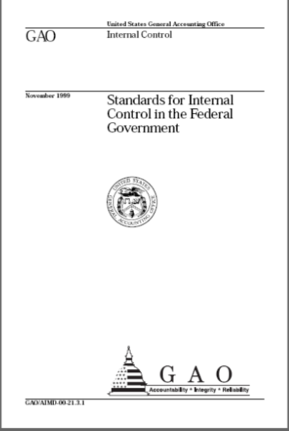
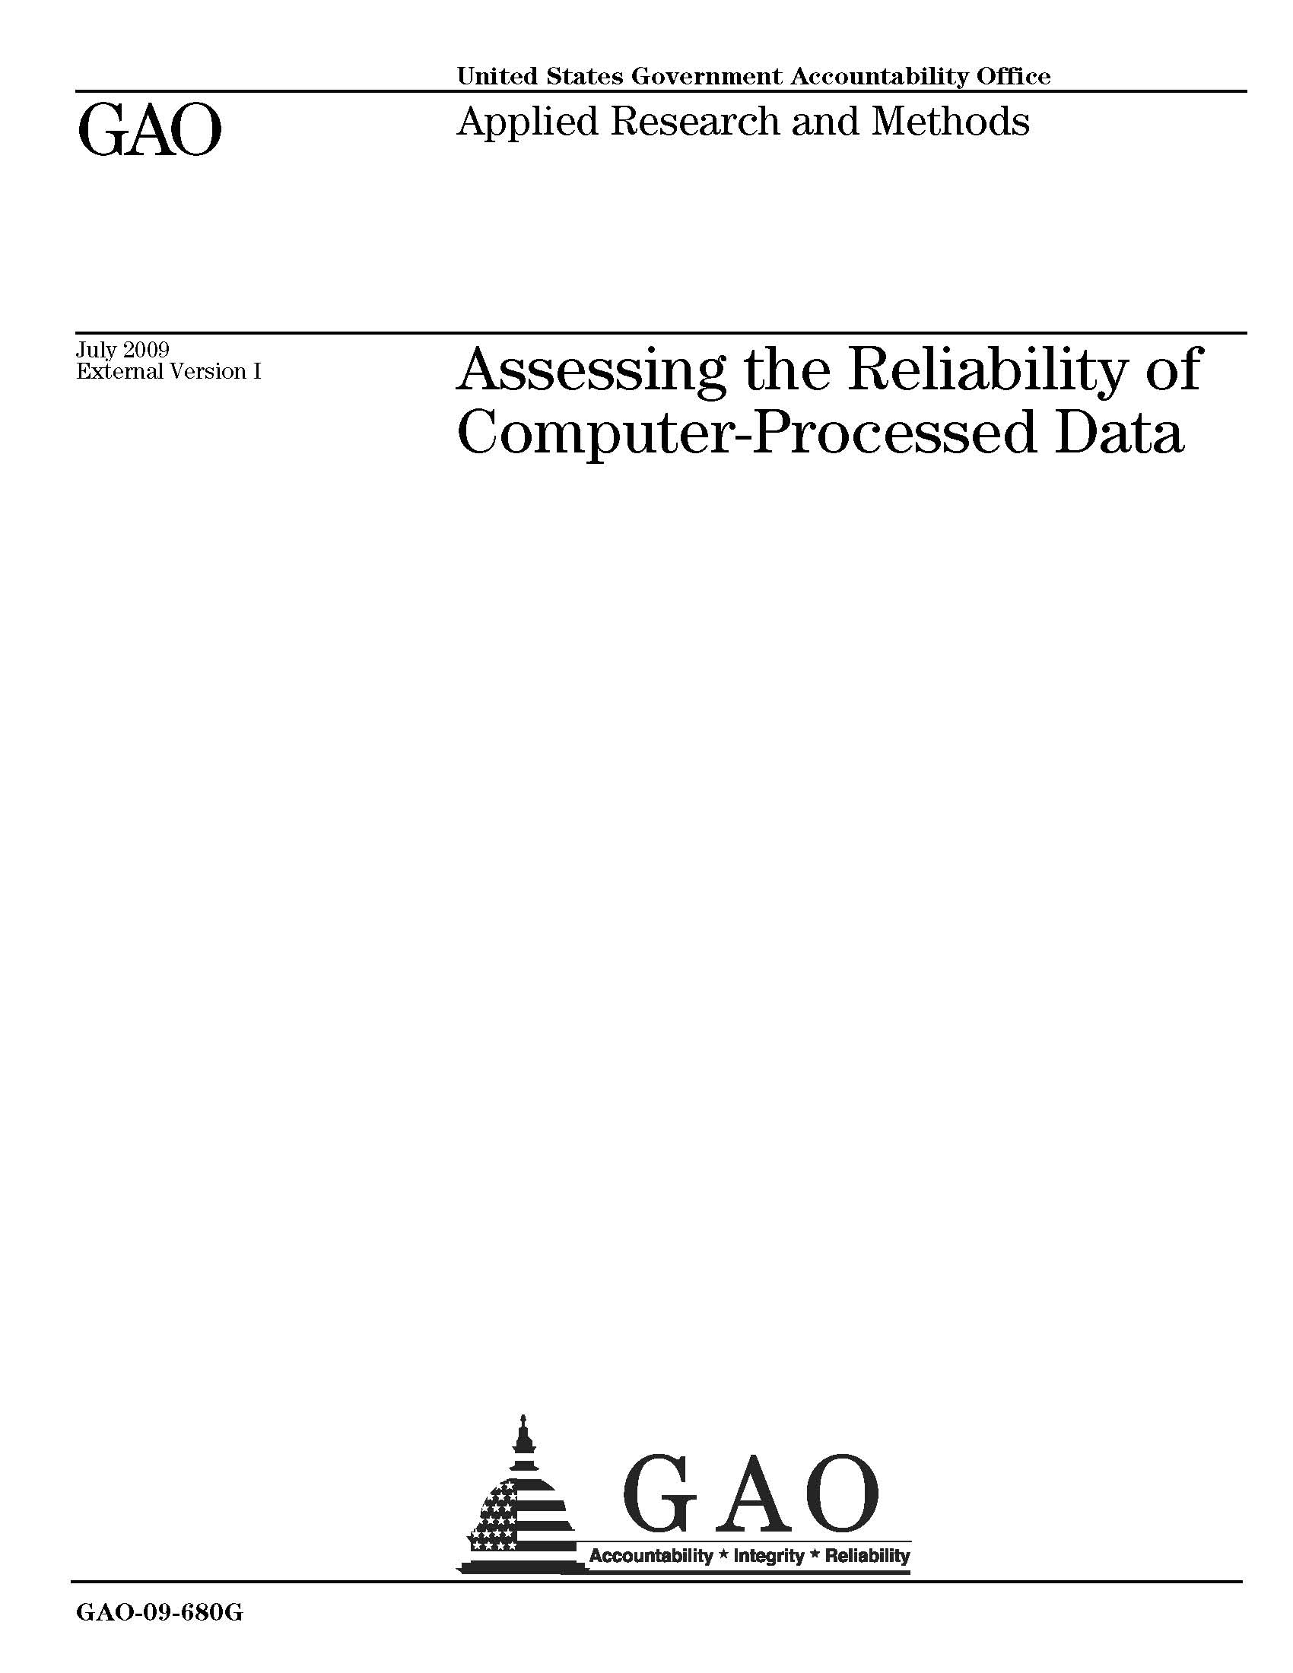
What color is your book today?
Notes:
Yellow Book – GAO Generally Accepted Government Auditing Standards
Silver Book – CIGIE Quality Standards for Federal Offices of Inspector General
Green Book – GAO Standards for Internal Controls in the Federal Government
Red Book – GAO – Principals of Federal Appropriations Law
White (?) Book – GAO – Assessing Data Reliability of Computer Processed Data

Slide 9
Legal Authority to go “fraud hunting”…
5 USC – Government Organization and Employees
Title 5 Appendix – Inspector General Act of 1978
§ 2(2)(B) …“to prevent and detect fraud and abuse in, such programs and operations”
Notes:
U.S. Code - Title 5 - Government Organization and Employees
Title 5 Appendix – Inspector General Act of 1978
§ 2. Purpose and establishment of Offices of Inspector General; departments and agencies involved
In order to create independent and objective units—
...(2) to provide leadership and coordination and recommend policies for activities designed
to promote economy, efficiency, and effectiveness in the administration of, and
(B) to prevent and detect fraud and abuse in, such programs and operations;

Slide 10
Guidance on “planning the hunt”…
GAGAS 6.30 thru 6.32 -
“… An attitude of professional skepticism in assessing these risks assists auditors in assessing which factors or risks could significantly affect the audit objectives.”
Notes:
GAGAS Yellow book: 6.30, 31, 32
6.30 – Planning –assess risk of fraud occurring…
6.31 - …design procedures to obtain reasonable assurance of detecting any such fraud…
6.32 - …. If believe fraud… auditors should extend the audit steps and procedures, as necessary, to (1) determine whether fraud has likely occurred and (2) if so, determine its effect on the audit findings.
---
6.30 - In planning the audit, auditors should assess risks of fraud occurring that is significant within the context of the audit objectives. Fraud involves obtaining something of value through willful misrepresentation. Whether an act is, in fact, fraud is a determination to be made through the judicial or other adjudicative system and is beyond auditors’ professional responsibility.
Audit team members should discuss among the team fraud risks, including factors such as individuals’ incentives or pressures to commit fraud, the opportunity for fraud to occur, and rationalizations or attitudes that could allow individuals to commit fraud. Auditors should gather and assess information to identify risks of fraud that are significant within the scope of the audit objectives or that could affect the findings and conclusions. For example, auditors may obtain information through discussion with officials of the audited entity or through other means to determine the susceptibility of the program to fraud, the status of internal controls the audited entity has established to prevent and detect fraud, or the risk that officials of the audited entity could override internal control. An attitude of professional skepticism in assessing these risks assists auditors in assessing which factors or risks could significantly affect the audit objectives.
6.31 - When auditors identify factors or risks related to fraud that has occurred or is likely to have occurred that they believe are significant within the context of the audit objectives, they should design procedures to obtain reasonable assurance of detecting any such fraud. Assessing the risk of fraud is an ongoing process throughout the audit and relates not only to planning the audit but also to evaluating evidence obtained during the audit.
6.32 - When information comes to the auditors’ attention indicating that fraud, significant within the context of the audit objectives, may have occurred, auditors should extend the audit steps and procedures, as necessary, to (1) determine whether fraud has likely occurred and (2) if so, determine its effect on the audit findings. If the fraud that may have occurred is not significant within the context of the audit objectives, the auditors may conduct additional audit work as a separate engagement, or refer the matter to other parties with oversight responsibility or jurisdiction.

Slide 11
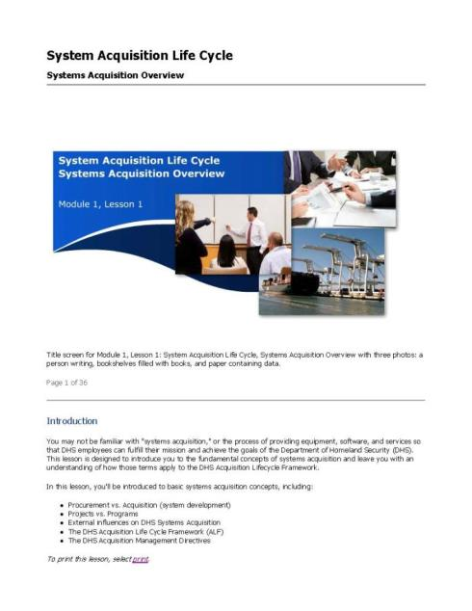
Procurement vs Acquisition…
Procurement –
is basically a contractual purchase of products or services.
Acquisition -
is a complex process to acquire the development of systems (products) designed to satisfy a specific set of user requirements.
Notes:
From the really good HSAI course AQN 101 – DHS Fundamentals of Acquisition
Procurement –
A procurement is basically a contractual purchase of products or services. Your procurement office requires supporting documentation (e.g. market research, Independent Government Cost Estimate (IGCE), acquisition plan) to demonstrate that you've properly planned your procurement request. In acquisition terms, a procurement consists of buying products (solutions) that already exist and are generally available to the public.
In DHS = generally $20 million or less
Acquisition
An acquisition is a complex process to acquire the development of systems (products) designed to satisfy a specific set of user requirements. Acquisition is a much riskier activity than procurement, and it requires disciplined, crossfunctional program management activities, including managing risks, to ensure the desired outcome is achieved. When you think of acquisition, think "cradle to the grave"--designing, developing, buying, fielding, operating, and maintaining a solution that does not exist yet.

Slide 12
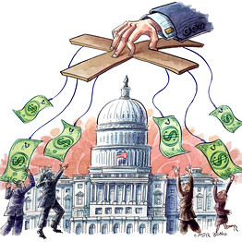
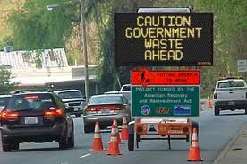
Defining the issues…
Waste
Abuse
Fraud
Notes:
Waste – involves the taxpayers not receiving reasonable value for money in connection with any government funded activities due to an inappropriate act or omission by players with control over or access to government resources. Importantly, waste occurs before / below fraud and abuse and most waste does not involve a violation of law. Rather, waste relates primarily to mismanagement, inappropriate actions, and inadequate oversight. (Only stated 2x in the Yellow book, but never defined per se.)
Abuse – involves behavior that is deficient or improper when compared with behavior that a prudent person would consider reasonable and necessary business practice given the facts and circumstances. It is more a Conduct / Ethical issue. Abuse also includes misuse of authority or position for personal financial interests or those of an immediate or close family member or business associate. Abuse can, but does not necessarily, involve fraud, violation of laws, regulations, or provisions of a contract or grant agreement. (GAGAS 6.33-34, 7.21-23)
Fraud – (GAGAS) A type of illegal act involving the obtaining of something of value through willful misrepresentation. Whether an act is, in fact, fraud is a determination to be made through the judicial or other adjudicative system, and is beyond the auditor’s professional responsibility to prosecute it, but it is an auditor’s responsibility to find it!
Illegal Acts – are violations of laws or government regulations that have a direct and material effect on the determination of financial statement amounts.

Slide 13
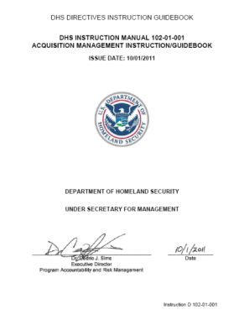
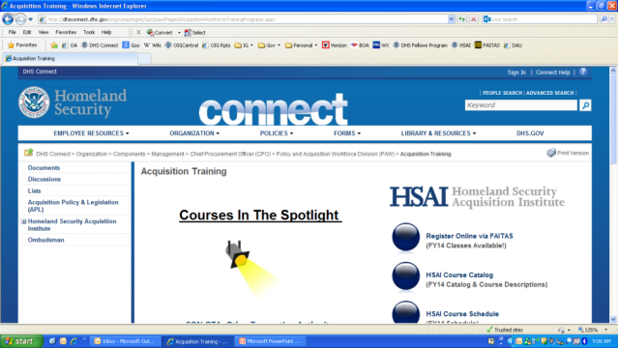
DHS Acquisition Lifecycle Framework
0
1
2A
2B
2C
3
4
Need
Analyze/ Select
Obtain
Produce / Deploy / Support
Notes:
In the Need phase, the user identifies a capability gap and documents this need in a Mission Needs Statement (MNS), which kicks off the systems acquisition life cycle process.
In the Analyze/Select phase, a newly established program management office works with the user who drafted the MNS to explore alternative solutions for meeting the mission need, and then selects the best alternative to take forward.
In the Obtain phase, the PMO manages the design, development, prototyping, modeling, and testing of the system. The PMO may decide to start Low-rate Initial Production (LRIP) to test the manufacturing process and produce articles for operational test and evaluation by the user. The user/sponsor tests the system in an operational environment.
In the Produce/Deploy/Support phase, the PMO manages the full-rate production of the tested systems; the preparation of sites are prepared to accept the new systems, including training personnel to operate and maintain the equipment; and the deployment of the system.
Users execute their mission using the system, and use a support structure to maintain the system through its active life. Ultimately, the system must be disposed of in an environmentally conscious manner.
Acquisition Decision Events (ADEs)
ADE-0 - Identify the need
ADE-1 - Validate the need
ADE-2A - Approve the program
ADE-2B - Approve projects within the program
ADE-2C - Approve Low Rate Initial Production
ADE-3 - Approve Full Rate Production and deployment
ADE 4 (USCG) – Project Transition. Authorizes the project to move into sustainment and is then managed by the Support Program Manager. It is a CG unique milestone (MS).
From the really good HSAI course AQN 101 – DHS Fundamentals of Acquisition

Slide 14
DHS required documents at reviews…
0
1
2A
2B
2C
3
4
Need
Analyze/Select
Obtain
Produce / Deploy / Support
 | Pre-Acq | ADE 1 | ADE 2A | ADE 2B | ADE 3
ADA Approved |  | MNS | APB | APB | APB
 |  | CDP | ILSP | ILSP | ILSP
 |  | AP | AP | TEMP
 |  |  | ORD
CAE Approved | P-MNS |  | LCCE | AP | LCCE
 |  |  | CONOPS | +SLA (Services)
 |  |  | AoA
Notes:
Preliminary Mission Needs Statement (P-MNS)
---
Missions Needs Statement (MNS)
Capabilities Development Plan (CDP)
Acquisition Plan (AP)
---
Acquisition Program Baseline (APB)
Integrated Logistics Support Plan (ILSP)
Operational Requirements Document (ORD)
Life Cycle Cost Estimate (LCCE)
Concept of Operations (CONOPS)
Analysis of Alternatives (AoA)
----
Test and Evaluation Master Plan (TEMP)
From the really good HSAI course AQN 101 – DHS Fundamentals of Acquisition

Slide 15
Who are we talking about?
Program Managers
Contracting Officers (COs)
Contracting Officer’s Representatives (CORs)
Procurement staff
Source selection committee members
Financial and Budget Managers
Contractors
Sub-contractors
Suppliers
Others?

Slide 16
Most Common Schemes / Illegal Acts…
Need
Analyze/ Select
Obtain
Produce / Deploy / Support
Rigged Specifications
Collusive Bidding
Excluding Qualified Bidders
Unbalanced Bidding
Leaking Bid Data
Manipulation of Bids
Defective Pricing
Cost Mischarging
Co-mingling of Contracts
Unjustified Sole Source
Failure to Meet Contract Specifications
Product Substitution
Purchase for Personal Use
Phantom Vendor
Conflicts of Interest
Bribery & Kickbacks
False Statements & Claims
Notes:
So this is the list of some of the most common fraud schemes. Remember…
Fraud in the bid, fraud in the win, and the rest of the fraud therein!
Toward the end we will note the actual LAWS that are being broken, and that folks get prosecuted for when caught implementing the schemes.

Slide 17
What it really comes down to is…
Requirements
RFP
Evaluation of RFPs
Justification
LRIP
Negotiation/Award
Need
Analyze/ Select
Obtain
Produce / Deploy / Support
Fraud in the bid…
fraud in the win…
…and the rest of the fraud therein!
Notes:
What it really comes down to is - Fraud in the bid, fraud in the win, and the rest of the fraud therein…

Slide 18
Who does what when…
Requirements
RFP
Evaluation of RFPs
Justification
LRIP
Negotiation/Award
Need
Analyze/ Select
Obtain
Produce / Deploy / Support
CO / Support Staff
Program Manager / COR
Prime Contractor / Subs
Auditor

Slide 19
Where does the fraud occur…
Requirements
RFP
Evaluation of RFPs
Justification
LRIP
Negotiation/Award
Need
Analyze/ Select
Obtain
Produce / Deploy / Support
Kickbacks/Bribery/Conflict of Interest
Bid Rigging
Product Substitution
Defective Pricing
Failure to Meet K Specs
Collusive Bidding
False Claims
Notes:
Generally where…

Slide 20
Fraud in the bid…
Evaluation of RFPs
RFP
Negotiation Award
Need
Analyze/ Select
Obtain
Produce / Deploy / Support
Complimentary Bidding
Collusive Bidding
Bid Rotation
Bid Suppression
Leaking Bid Data
Rigged Specifications
Subcontracting Fraud
Excluding Qualified Bidders
Unbalanced Bidding
Notes:
Complimentary Bidding: occurs when some competitors agree to submit bids that are either too high to be accepted or contain special terms that will not be acceptable to the government. Such bids are not intended to secure acceptance, but merely give the appearance of genuine competitive bidding. Complementary bidding schemes are the most frequently occurring forms of bid rigging, and they defraud government by creating the appearance of competition to conceal secretly inflated prices.
Collusive Bidding: is defined as bidders secretly agreeing to submit complementary high bids to allow preselected contractors to win. Suppliers and contractors agree to prohibit or limit competition and manipulate prices to increase the amount of business available to each participant.
Bid Rotation: In bid rotation schemes, all conspirators submit bids but take turns being the low bidder. The terms of the rotation may vary; for example, competitors may take turns on contracts according to the size of the contract, allocating equal amounts to each conspirator or allocating volumes that correspond to the size of each conspirator company. A strict bid rotation pattern defies the law of chance and suggests collusion is taking place.
Bid Suppression: One or more competitors who otherwise would be expected to bid, or who have previously bid, agree to refrain from bidding or withdraw a previously submitted bid so that the designated winning competitor’s bid will be accepted.
Leaking Bid Data: Leaking bid data is defined as contracting or other personnel involved in the process, sharing information to help a favored bidder formulate a proposal.
Rigged Specifications: Rigged specifications are defined as bids or proposals that contain specifications which are tailored to meet the qualifications or a particular bidder.
Subcontracting Fraud: Subcontracting arrangements are often part of a bid-rigging scheme. Competitors who agree not to bid or to submit a losing bid frequently receive subcontracts or supply contracts in exchange from the successful low bidder. In some schemes, a low bidder will agree to withdraw its bid in favor of the next low bidder in exchange for a lucrative subcontract that divides the illegally obtained higher price between them. Almost all forms of bid-rigging schemes have one thing in common: an agreement among some or all of bidders, which predetermines the winning bidder and limits or eliminates competition.
Unbalanced Bidding: is defined as contracting personnel advising a favored bidder that specific line items in a bid request will not be included in the contract and/or contracting personnel providing a favored bidder with information to meet vague or ambiguous terms in the bid request within the estimated budget.

Slide 21
Bribery & Kickbacks
Need
Analyze/ Select
Obtain
Produce / Deploy / Support
Where it occurs - anywhere
Who is involved – Government Employees / Contractors
Occurs when a government employee or contractor accepts something of value in exchange for preferential treatment. An example of bribery is if money is accepted in exchange for the awarding of a contract.
Notes:
Bribery & Kickback: Occurs when a government employee or contractor accepts something of value in exchange for preferential treatment. An example of bribery is if money is accepted in exchange for the awarding of a contract.
What’s the difference between a bribe and a kickback? Initial flow of the fraud…
Bribe – Kr bribes the CO
Kickback – CO hooks up the Kr for the kickback

Slide 22
Bribery & Kickbacks Indicators
Bribery Indicators
Corrupt Recipients
Spend big or pay off debts with large lump sums
Changes in behavior - live above their means
Dressing in expensive suits - driving a sports car - taking exotic vacations
Often break rules or direct subordinates to ignore standard operating procedures
Corrupt Payers
Routinely offer inappropriate gifts or entertainment
Once the contract is in place, the quality of their product often deteriorates
Kickback Indicators
Contractors favor specific subcontractors
Poor or late service by a contractor / sub is ignored or excused
Product documentation is routinely late or incomplete
Notes:
Bribery Indicators
Corrupt recipients:
Often spend big or pay off debts with large lump sums
Changes in behavior are common as individuals receiving bribes often live above their means
An employee suddenly begins dressing in expensive suits, driving a sports car, and taking exotic vacations
Corrupt recipients will often break rules or direct subordinates to ignore standard operating procedures
Corrupt payers:
Routinely offer inappropriate gifts or entertainment
Once the contract is in place, the quality of their product often deteriorates
Kickback Indicators:
Contractors favor specific subcontractors
Poor or late service by a subcontractor is ignored or excused
Product documentation is routinely late or incomplete
Coast Guard Officer Sentenced To 21 Months For Receiving Kickbacks From Contractors (June 19, 2012)
The CG officer’s duties included recommending contractors for maintenance and repairs onboard CG cutters stationed on the Atlantic and Gulf Coasts, and overseeing those repairs to their completion. In 2009 the CG officer recommended five procurement requests for ship repairs to their cousins company. A company that had no expertise in ship repairs. There were others involved in this scheme (current and former CG employees). In totally, the CG officer and their co-defendants fraudulently obtained approx $150,000 in less than six months.
NCIS example - S/CARTER was a Project Engineer for a company called Force Protection Industries (FPI) in SC. While working at FPI, he had a relationship with a company called Spartan Motors. S/CARTER was able to ensure Spartan Motors worked as a subcontractor for FPI to assist with the delivery of MRAP vehicles. As compensation, S/CARTER received $1,500 for every chassis FPI purchased from Spartan. When FPI learned of this relationship, S/CARTER was immediately terminated. In total, S/CARTER received approximately $101,500 in kickback payments from Spartan in exchange for FPI’s purchases of chassis units from Spartan. S/CARTER pled guilty and was sentenced to a year and a day confinement.

Slide 23
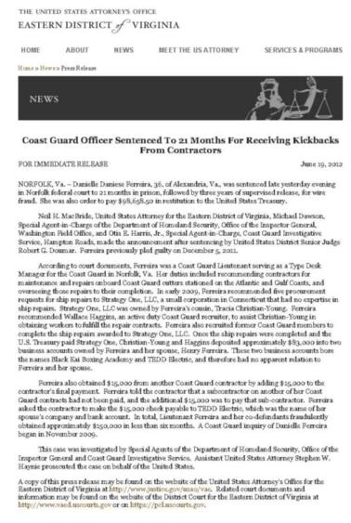
Kickback prosecuted…
Coast Guard Officer Sentenced To 21 Months For Receiving Kickbacks From Contractors (June 2012)
…recommended five procurement requests for ship repairs to Strategy One, LLC, a small corporation in Connecticut that had no expertise in ship repairs.
Once Strategy One paid, they deposited approximately $83,000 into two business accounts owned by the Lieutenant and her spouse.
Notes:
The CG officer’s duties included recommending contractors for maintenance and repairs onboard CG cutters stationed on the Atlantic and Gulf Coasts, and overseeing those repairs to their completion. In 2009 the CG officer recommended five procurement requests for ship repairs to their cousins company. A company that had no expertise in ship repairs. There were others involved in this scheme (current and former CG employees). In totally, the CG officer and their co-defendants fraudulently obtained approx $150,000 in less than six months.
“In early 2009, Ferreira recommended five procurement requests for ship repairs to Strategy One, LLC, a small corporation in Connecticut that had no expertise in ship repairs.
Once the ship repairs were completed and the U.S. Treasury paid Strategy One, Christian-Young and Haggins deposited approximately $83,000 into two business accounts owned by Ferreira and her spouse, Henry Ferreira. These two business accounts bore the names Black Kai Boxing Academy and TEDD Electric, and therefore had no apparent relation to Ferreira and her spouse.”

Slide 24
Fraud in the win…
Award
Need
Analyze/ Select
Obtain
Produce / Deploy / Support
Conflict of Interest
Defective Pricing
Manipulation of Bids
Unjustified Sole Source
Notes:
Fraud Schemes and Related Terms
Original source - http://www.dodig.mil/resources/fraud/a.html et seq.
(Pulled December 31, 2013 by Andrew C. Smith)
Conflicts of Interest: can occur personally or organizationally. Personal conflicts occur when an individual is in a position to perform his or her job or to make decisions in ways that may enhance his or her financial standing. Organizational conflicts occur when a company is part of the development or specifications process for a product and another part of the company then tests or evaluates that product. (Source: Defense Acquisition University, ”Procurement Fraud Indicators Training Module”)
Manipulation of Bids: is defined as contracting personnel tampering with bids after receipt to ensure that a favored contractor is selected. (Source: Defense Acquisition University, ”Procurement Fraud Indicators Training Module”)
Defective Pricing: is defined as contractors decreasing their prices and/or inflating their costs in order to increase profits or limit losses.
Unjustified Sole Source: is defined as a fraudulent act involving procurement personnel who, in collusion with a supplier, improperly award a contract without competition or prior review. (Source: Defense Acquisition University, ”Procurement Fraud Indicators Training Module”)
First thing I look for as an auditor – number of bids (2 or less… I question it).
Second thing – if sole source – two major actions you should have seen:
Market Research on a massive scale,
J&A (Justification & Approval) - A document required to justify and obtain appropriate level approvals to contract without providing for full and open competition as required by the Federal Acquisition Regulation (FAR).

Slide 25
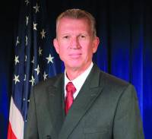
Conflict of Interest prosecuted…
Defendant Sought Job From Company That Did Work for FEMA (January 2013)
On Jan. 6, 2009 -- six days before Cannon was to interview at Gallup -- Cannon emailed the company, "I got another 500k put on the contract. Cool huh?“
Gallup sent Cannon a job offer the next month as a partner with the government division in D.C., with a salary of $175,000, prosecutors said.
Notes:
Former FEMA Executive Pleads Guilty To Federal Conflict of Interest Charge -Defendant Sought Job From Company That Did Work for FEMA (January 15, 2013)
Former director of human resources at FEMA pleaded guilty to a ‘conflict of interest’ charge for negotiating employment with a polling and consulting services company that had a multimillion-dollar contract with FEMA. The fine carries a statutory maximum of 5 years in prison.
ADD MORE DETAIL ON CASE TO WHICH TO TALK.
18 U.S.C. § 208, the basic criminal “conflict of interest” statute, prohibits an executive branch employee from participating personally and substantially in a particular Government matter that will affect his own financial interests, as well as the financial interests of:
His spouse or minor child
His general partner
An organization in which he serves as an officer, director, trustee, general partner or employee, and
A person with whom he is negotiating for or has an arrangement concerning prospective employment

Slide 26
…and the rest of the fraud therein!
Need
Analyze/ Select
Obtain
Produce / Deploy / Support
Cost Mischarging
Co-mingling of Contracts
Failure to Meet Contract Specifications
Product Substitution
Purchase for Personal Use
Phantom Vendor
False Statements & Claims
Notes:
Cost Mischarging: is defined as improper allocation of cost contracts or charging at higher than allowed rates, charging to indirect accounts those charges that should be direct, or vice versa. The result of cost mischarging is an improper overcharge to the Government for goods and services.
Co-mingling of Contract: is defined as contactors with multiple, similar work orders charging the same personnel, fees, or expenses to more than one of the work orders, resulting in overbilling.
Failure to Meet Specifications: is defined as contractors intentionally failing to meet contract specifications, but indicating that the specifications have been met in order to increase profits by providing goods or services that are usually lower in cost, quantity, or by failing indicators.
Product Substitution: is defined as contractors delivering goods to the Government which do not conform to contract requirements without informing the Government.
Purchase for Personal Use: is defined as a purchase or requisition of items by a government employee to convert for one’s own use or resale.
Phantom Vendor: Phantom vendor is defined as government personnel with accounts payable or procurement responsibility creating and/or approving invoices for fictitious companies in order to embezzle funds or to personally appropriate the goods.
False Statements and Claims: are defined as a contractor who:
• knowingly and willfully falsifies, conceals, or covers up by any trick, scheme, or device a material fact or,
• makes any materially false, fictitious, or fraudulent statement or representation or,
• makes or uses any false writing or document knowing the same to contain any materially false, fictitious, or fraudulent statement or entry. (Source: Defense Acquisition University, ”Procurement Fraud Indicators Training Module”)

Slide 27
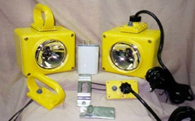
Product Substitution prosecuted…
Man convicted of selling Navy knock-off batteries used on subs and aircraft carriers (April 17, 2014)
Powerline sold more than 80,000 counterfeit batteries and battery assemblies.
They disguised the bogus nature of the batteries by affixing counterfeit labels that falsely identified the batteries as originating from approved manufacturers. Powerline employees also used chemicals to remove "Made in China" markings from the knock-off batteries.
Notes:
Former Simi Valley CEO convicted of selling Navy knock-off batteries used on subs and aircraft carriers
LOS ANGELES — A federal jury has convicted the former CEO of the Simi Valley-based battery distributor Powerline Inc. of defrauding the government by selling more than $2.6 million in cheap, knock-off batteries to the U.S. Department of Defense.
Didier De Nier, 63, who lived in Simi Valley until he fled the U.S. nearly two years ago, was found guilty Wednesday of five counts of wire fraud and one count of conspiracy to defraud the United States.
The charges stem from a probe by U.S. Immigration and Customs Enforcement's Homeland Security Investigations and the Defense Criminal Investigative Service. The Defense Logistics Agency and the Defense Contract Audit Agency also provided significant support to this investigation.
From 2004 to 2011, Powerline, which also did business as Birdman Distribution Corp, sold more than 80,000 batteries and battery assemblies that the Navy used for emergency back-up power aboard nuclear aircraft carriers, minesweepers and ballistic submarines. The batteries were installed on numerous Naval vessels.
According to the evidence presented during a six-day trial, De Nier and his employees disguised the bogus nature of the batteries by affixing counterfeit labels that falsely identified the batteries as originating from approved manufacturers. Powerline employees also used chemicals to remove "Made in China" markings from the knock-off batteries.
"Companies responsible for manufacturing equipment used by the U.S. military must be held to the highest standard - the lives of our service men and women depend on it," said Claude Arnold, special agent in charge for HSI Los Angeles. "HSI will continue to aggressively target and investigate those who jeopardize our nation's security or the welfare of those devoted to protecting it.“
De Nier's ex-wife Lisa De Nier, who had served for decades as Powerline's vice president of sales, previously pleaded guilty in this case to conspiracy to defraud the government.
De Nier is scheduled to be sentenced by U.S. District Judge Dolly M. Gee Aug. 18. At sentencing, he faces a statutory maximum sentence of 110 years in federal prison. Lisa De Nier faces up to 10 years in prison. She is expected to be sentenced by Judge Gee later this year.
Shortly after federal agents searched Powerline's offices in July 2012, De Nier fled the Los Angeles area to live aboard his yacht near the Caribbean island of St. Martin, a French territory. In October 2013, federal agents arrested De Nier, a dual French-U.S. citizen, after he had sailed his yacht to the U.S. Virgin Islands.
This case is part of an ongoing initiative called Operation Chain Reaction (OCR) coordinated by the National Intellectual Property Rights Coordination Center (IPR Center) in Washington, D.C. OCR targets and facilitates the seizure and investigation of counterfeit and substandard parts infiltrating the military and government supply chain. The HSI-led IPR Center has 21-member agencies who share information, develop initiatives, coordinate enforcement actions – most of whom participate in OCR.

Slide 28
Most Common Schemes / Illegal Acts…
Need
Analyze/ Select
Obtain
Produce / Deploy / Support
Rigged Specifications
Collusive Bidding
Excluding Qualified Bidders
Unbalanced Bidding
Leaking Bid Data
Manipulation of Bids
Defective Pricing
Cost Mischarging
Co-mingling of Contracts
Unjustified Sole Source
Failure to Meet Contract Specifications
Product Substitution
Purchase for Personal Use
Phantom Vendor
Conflicts of Interest
Bribery & Kickbacks
False Statements & Claims
Notes:
So this is the list of some of the most common fraud schemes. Remember…
Fraud in the bid, fraud in the win, and the rest of the fraud therein!
Toward the end we will note the actual LAWS that are being broken, and that folks get prosecuted for when they get caught implementing the schemes.

Slide 29
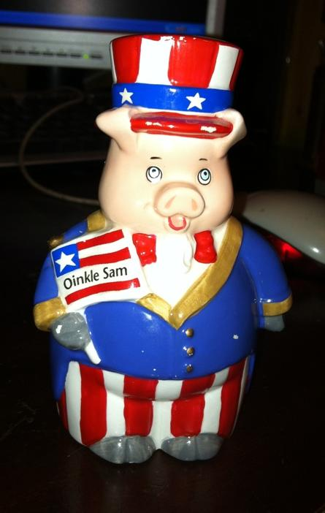
So how do you find the fraud?
Stay Flexible
Think
Focus on the Mission
Notes:
So how do we find the fraud – evidence gathering and analysis. Step 1 – remember my three rules!

Slide 30
ID all the players…
USM
CFO
OCPO
PARM
OCRSO
PA&E
CAE
CO
DIR
FIN
Staff
Proj
COR
PM
Proj
Staff
Staff
Proj
Budget
Notes:
ID the players….

Slide 31
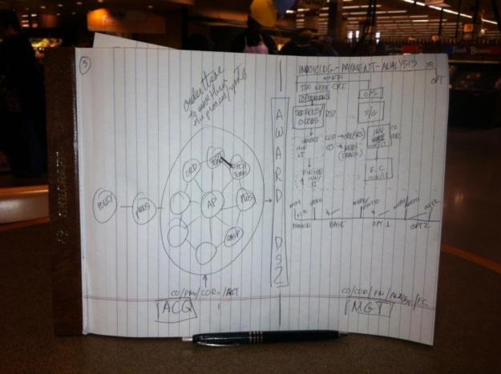
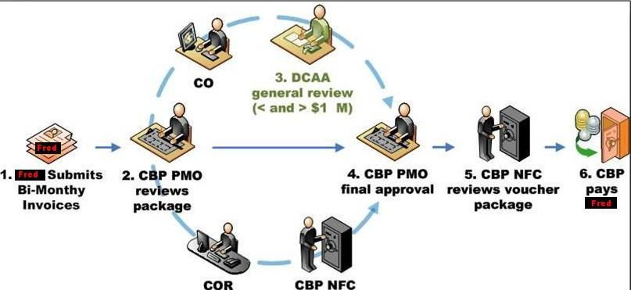
Workflow the process…
Notes:
Workflow the processes involved….

Slide 32
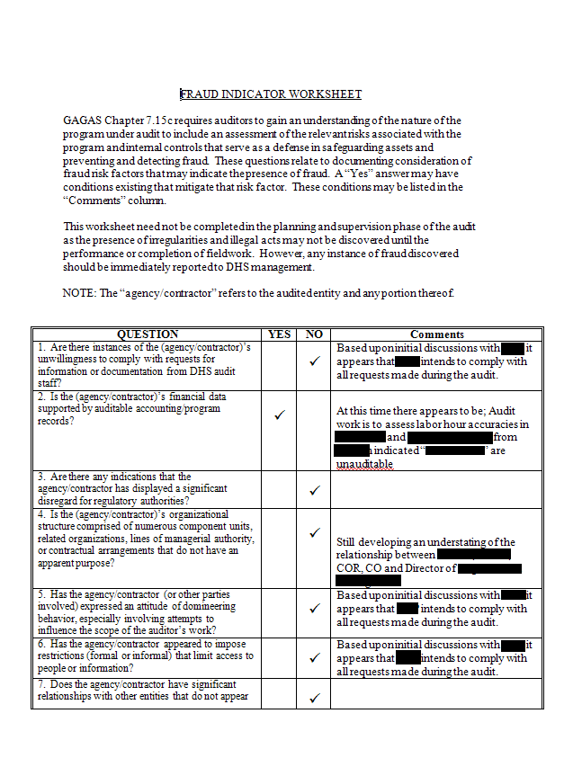
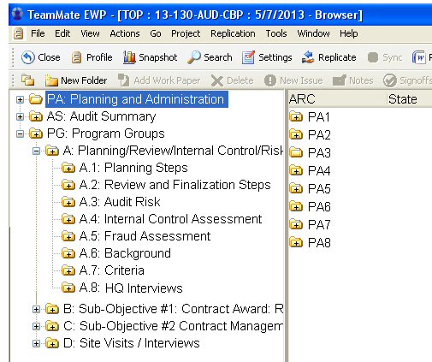
Planning - Fraud Indicator Worksheet…
Notes:
Remember GAGAS 6.30 planning for fraud hunting… how we do it in DHS-OIG….
NOTES:
GAGAS Yellow book:
6.30 - In planning the audit, auditors should assess risks of fraud occurring that is significant within the context of the audit objectives. …
Audit team members should discuss among the team fraud risks, including factors such as individuals’ incentives or pressures to commit fraud, the opportunity for fraud to occur, and rationalizations or attitudes that could allow individuals to commit fraud. Auditors should gather and assess information to identify risks of fraud that are significant within the scope of the audit objectives or that could affect the findings and conclusions. For example, auditors may obtain information through discussion with officials of the audited entity or through other means to determine the susceptibility of the program to fraud, the status of internal controls the audited entity has established to prevent and detect fraud, or the risk that officials of the audited entity could override internal control. An attitude of professional skepticism in assessing these risks assists auditors in assessing which factors or risks could significantly affect the audit objectives.

Slide 33
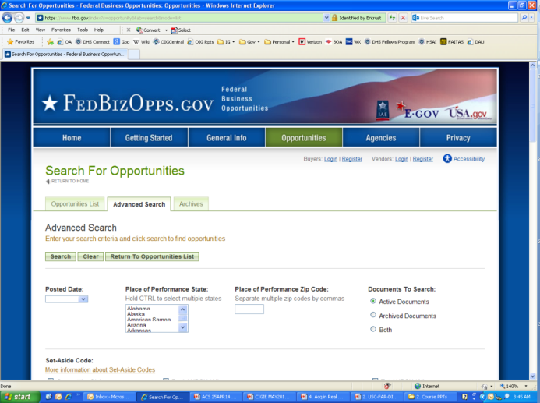
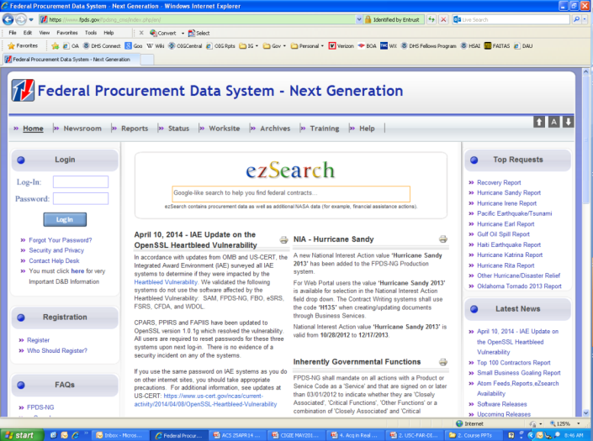
Open source contract docs…
Federal Business
Opportunities
Federal Procurement
Data System
Notes:
All info from FBO and FPDS…
Federal Business Opportunities - https://www.fbo.gov/
For all solicitations through award…..
Federal Procurement Data System - https://www.fpds.gov/fpdsng_cms/index.php/en/
For award and all other modifications / transactions

Slide 34
FAR – §4.803 - Contents of K files…
a) Contracting Officer File – 42 items
(1) Purchase request, acquisition planning information, and other pre-solicitation documents.
(8) A copy of the solicitation and all amendments thereto.
(13) Source selection documentation.
b) Contract admin office contract file – 20 items
(1) Copy of the contract and all modifications, together with official record copies of supporting documents executed by the contract administration office.
(6) Purchasing system information.
c) Paying Office Contract File – 4 items
(2) Bills, invoices, vouchers, and supporting documents.
(3) Record of payments or receipts.
Notes:
a) Contracting office contract file.
(1) Purchase request, acquisition planning information, and other presolicitation documents.
(2) Justifications and approvals, determinations and findings, and associated documents.
(3) Evidence of availability of funds.
(4) Synopsis of proposed acquisition as required by Part 5 or a reference to the synopsis.
(5) The list of sources solicited, and a list of any firms or persons whose requests for copies of the solicitation were denied, together with the reasons for denial.
(6) Set-aside decision including the type and extent of market research conducted.
(7) Government estimate of contract price.
(8) A copy of the solicitation and all amendments thereto.
(9) Security requirements and evidence of required clearances.
(10) A copy of each offer or quotation, the related abstract, and records of determinations concerning late offers or quotations. Unsuccessful offers or quotations may be maintained separately, if cross-referenced to the contract file. The only portions of the unsuccessful offer or quotation that need be retained are—
(i) Completed solicitation sections A, B, and K;
(ii) Technical and management proposals;
(iii) Cost/price proposals; and
(iv) Any other pages of the solicitation that the offeror or quoter has altered or annotated.
(11) Contractor’s representations and certifications (see 4.1201(c)).
(12) Preaward survey reports or reference to previous preaward survey reports relied upon.
(13) Source selection documentation.
(14) Contracting officer’s determination of the contractor’s responsibility.
(15) Small Business Administration Certificate of Competency.
(16) Records of contractor’s compliance with labor policies including equal employment opportunity policies.
(17) Data and information related to the contracting officer’s determination of a fair and reasonable price. This may include—
(i) Certified cost or pricing data;
(ii) Data other than certified cost or pricing data;
(iii) Justification for waiver from the requirement to submit certified cost or pricing data; or
(iv) Certificates of Current Cost or Pricing Data.
(18) Packaging and transportation data.
(19) Cost or price analysis.
(20) Audit reports or reasons for waiver.
(21) Record of negotiation.
(22) Justification for type of contract.
(23) Authority for deviations from this regulation, statutory requirements, or other restrictions.
(24) Required approvals of award and evidence of legal review.
(25) Notice of award.
(26) The original of—
(i) The signed contract or award;
(ii) All contract modifications; and
(iii) Documents supporting modifications executed by the contracting office.
(27) Synopsis of award or reference thereto.
(28) Notice to unsuccessful quoters or offerors and record of any debriefing.
(29) Acquisition management reports (see Subpart 4.6).
(30) Bid, performance, payment, or other bond documents, or a reference thereto, and notices to sureties.
(31) Report of postaward conference.
(32) Notice to proceed, stop orders, and any overtime premium approvals granted at the time of award.
(33) Documents requesting and authorizing modification in the normal assignment of contract administration functions and responsibility.
(34) Approvals or disapprovals of requests for waivers or deviations from contract requirements.
(35) Rejected engineering change proposals.
(36) Royalty, invention, and copyright reports (including invention disclosures) or reference thereto.
(37) Contract completion documents.
(38) Documentation regarding termination actions for which the contracting office is responsible.
(39) Cross-references to pertinent documents that are filed elsewhere.
(40) Any additional documents on which action was taken or that reflect actions by the contracting office pertinent to the contract.
(41) A current chronological list identifying the awarding and successor contracting officers, with inclusive dates of responsibility.
(42) When limiting competition to women-owned small business (WOSB) concerns eligible under the WOSB Program or economically disadvantaged women-owned small business (EDWOSB) concerns in accordance with subpart 19.15, include documentation—
(i) Of the type and extent of market research; and
(ii) That the NAICS code assigned to the acquisition is for an industry that SBA has designated as—
(A) Underrepresented for economically disadvantaged women-owned small business set-asides, or
(B) Substantially underrepresented for women-owned small business set-asides.
(b) Contract administration office contract file (COR/PM).
(1) Copy of the contract and all modifications, together with official record copies of supporting documents executed by the contract administration office.
(2) Any document modifying the normal assignment of contract administration functions and responsibility.
(3) Security requirements.
(4) Certified cost or pricing data, Certificates of Current Cost or Pricing Data, or data other than certified cost or pricing data; cost or price analysis; and other documentation supporting contractual actions executed by the contract administration office.
(5) Preaward survey information.
(6) Purchasing system information.
(7) Consent to subcontract or purchase.
(8) Performance and payment bonds and surety information.
(9) Postaward conference records.
(10) Orders issued under the contract.
(11) Notice to proceed and stop orders.
(12) Insurance policies or certificates of insurance or references to them.
(13) Documents supporting advance or progress payments.
(14) Progressing, expediting, and production surveillance records.
(15) Quality assurance records.
(16) Property administration records.
(17) Documentation regarding termination actions for which the contract administration office is responsible.
(18) Cross reference to other pertinent documents that are filed elsewhere.
(19) Any additional documents on which action was taken or that reflect actions by the contract administration office pertinent to the contract.
(20) Contract completion documents.
(c) Paying office contract file (in the Financial Center…)
(1) Copy of the contract and any modifications.
(2) Bills, invoices, vouchers, and supporting documents.
(3) Record of payments or receipts.
(4) Other pertinent documents.

Slide 35
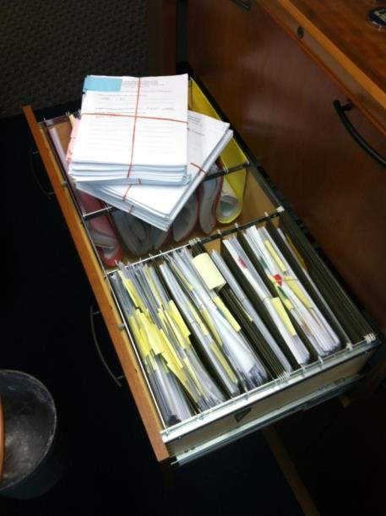
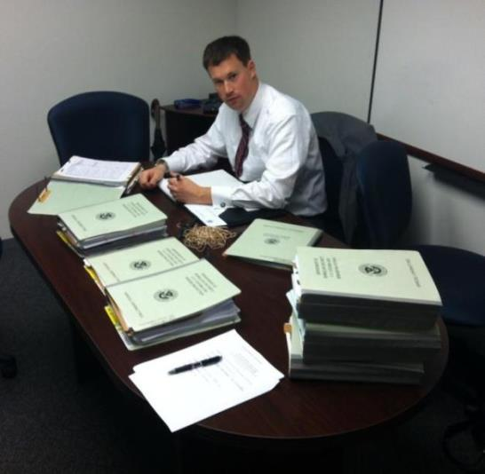
Get the Contract File… all of it!
Notes:
Get the entire contract file…

Slide 36
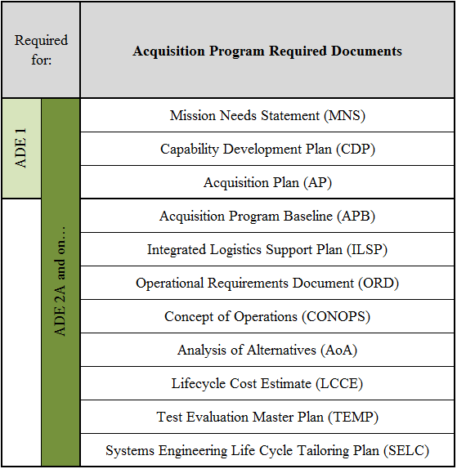
What should be in the CO files…
Notes:
These documents are the minimum!
Based on the FAR, and for DHS - the MD 102-001 Acquisition Instruction / Guidebook, the HSAR and HSAM …
PLUS all the modifications to the contract (obligating money, verifying milestones, changing requirements, and current year estimates!)

Slide 37
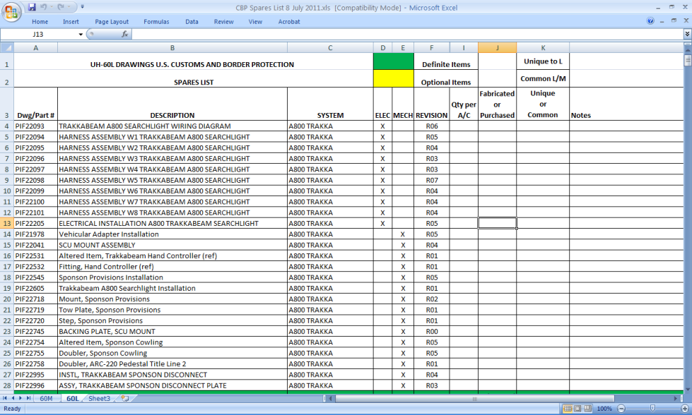
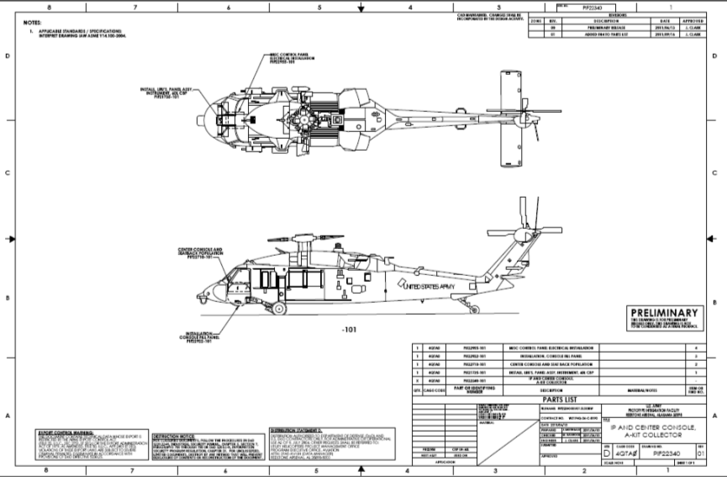
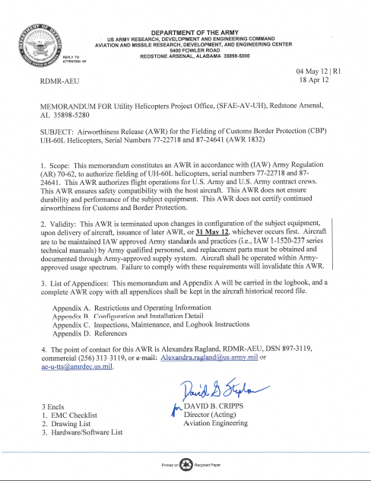
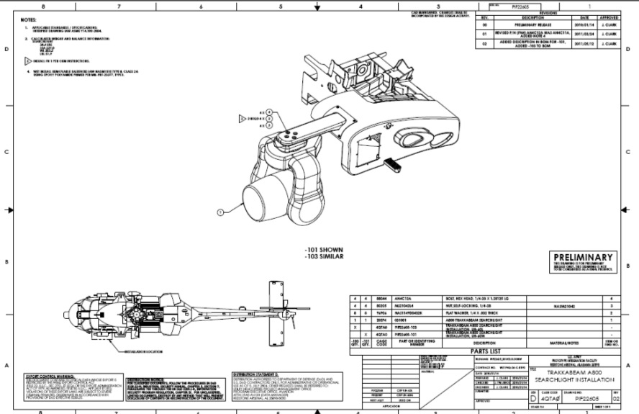
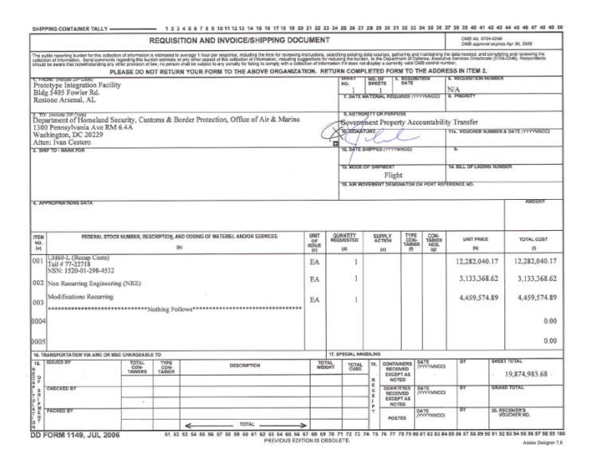
Get the COR/PM File(s)… all of it!
Notes:
Get the COR / PM Files… all of it…

Slide 38
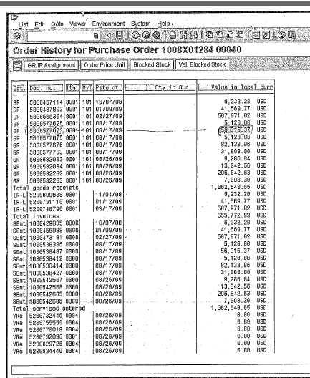
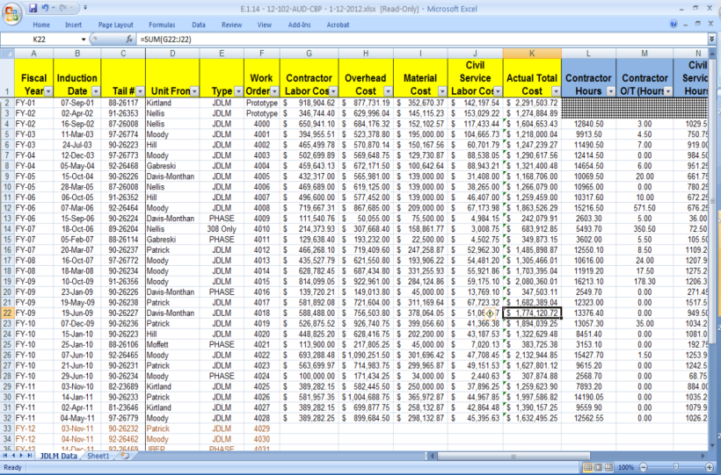
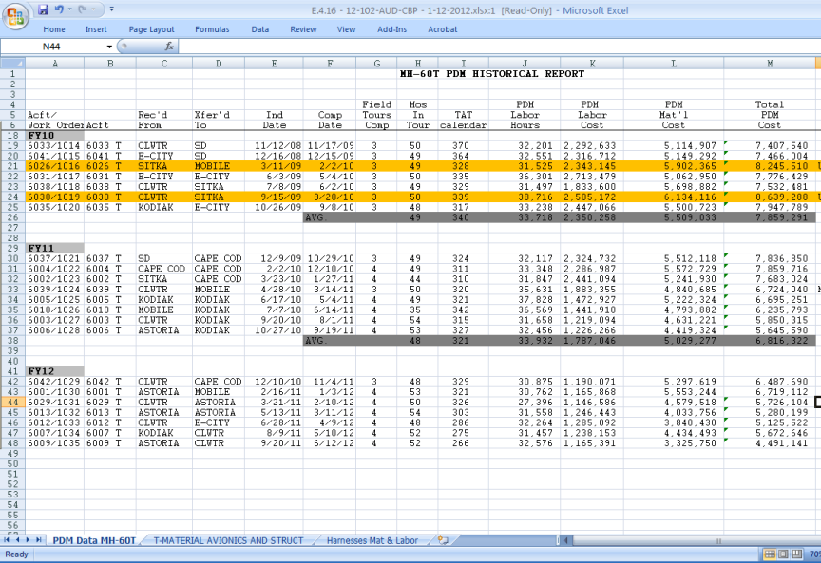
Show me the money…
Notes:
Get a listing of all the invoices in detail from their SAP system
ALSO get copies of individual invoices presented to the government (Fin Cen should have them on record).
Compare to all labor / materials orders / requests / logs / etc.
Using IDEA, Excel, ACL software as necessary

Slide 39
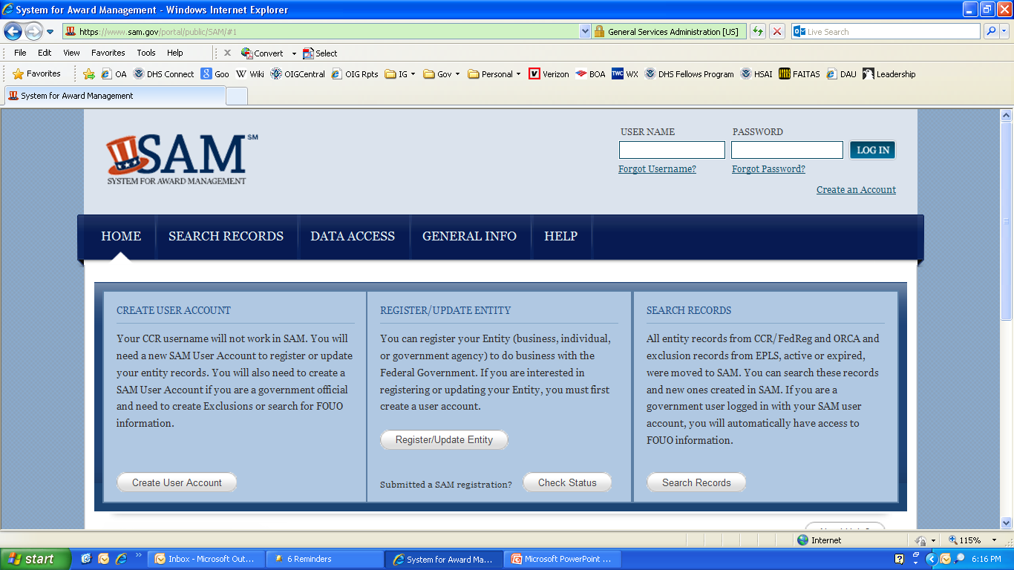
Any other previous issues…
Notes:
4) Check the SAM site - Systems for Award Management
https://www.sam.gov/portal/public/SAM/#1
Search Records
All entity records from Central Contractor Registry (CCR), the Federal Agency Registration (Fedreg), the Online Representations and Certifications Application (ORCA), and Excluded Parties List System (EPLS), active or expired, were moved to SAM. You can search these records and new ones created in SAM. If you are a government user logged in with your SAM user account, you will automatically have access to FOUO information.
EXTRA NOTES:
What is SAM? The System for Award Management (SAM) is combining federal procurement systems and the Catalog of Federal Domestic Assistance into one new system. This consolidation is being done in phases. The first phase of SAM includes the functionality from the following systems:
* Central Contractor Registry (CCR) * Federal Agency Registration (Fedreg) * Online Representations and Certifications Application * Excluded Parties List System (EPLS)
How will SAM benefit me? The overarching benefits of SAM include streamlined and integrated processes, elimination of data redundancies, and reduced costs while providing improved capability.

Slide 40
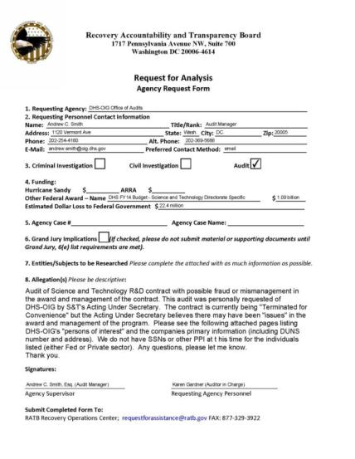
Touch base with the RAT (now GAT) Board…
The Recovery Accountability and Transparency Board is a non-partisan, non-political agency originally created by the American Recovery and Reinvestment Act of 2009 (ARRA) with two goals:
To provide transparency of ARRA-related funds
To detect and prevent fraud, waste, and mismanagement of those funds
requestforassistance@ratb.gov
Notes:
5) Get the GAT (RAT) Board to run an analysis for you (2-4 weeks depending); known associates
Recovery Accountability & Transparency Board supports the Recovery Operations Center (The ROC!)
http://www.recovery.gov/Pages/default.aspx
requestforassistance@ratb.gov
Make your findings
Make an RFI – using our DoD based DHS request
What are the remedies?
Admin – GN – Criminal Act….

Slide 41
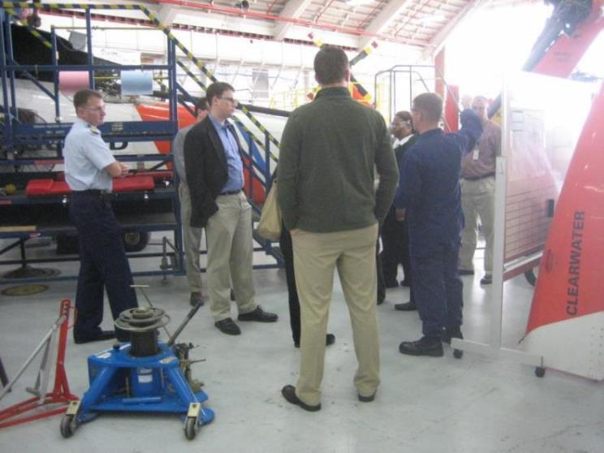
Conduct field work…
USCG H-60 Tango
Liz City, NC
Notes:
Conduct your field work…. Based on Fraud Risk Assessments and Workflow processes…. Go forth, look at it, and interview those acquiring it!
Whatever it is!

Slide 42
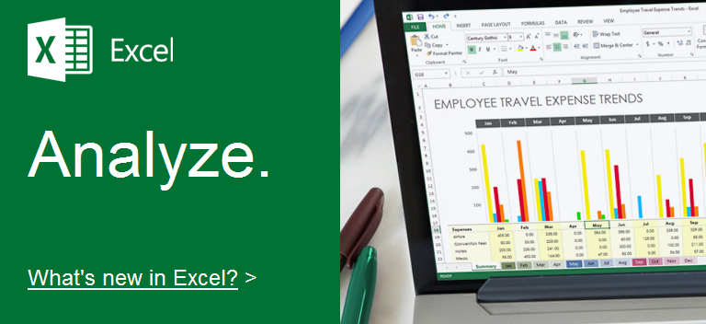
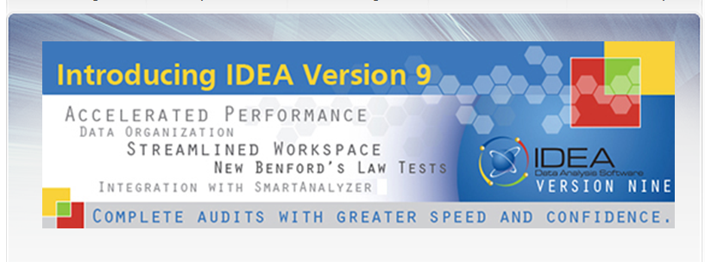
Data mine your info…
Notes:
Data mine your information…. 4 simple steps:
1) Gather your universe - Can be challenging - Different systems used to store disparate data – financial, operational, maintenance, logistics, etc, etc, etc.
2) Select your “Elements” to data mine (for PCs) - Date; Time; Amount; Type Tx; Disallowed Tx; Bypassed Tx
3) Set your “Predetermined Conditions”
4) Data Mine your universe!
Using Excel, IDEA software, several others out there.
Determine ALL “questionable transactions”

Slide 43
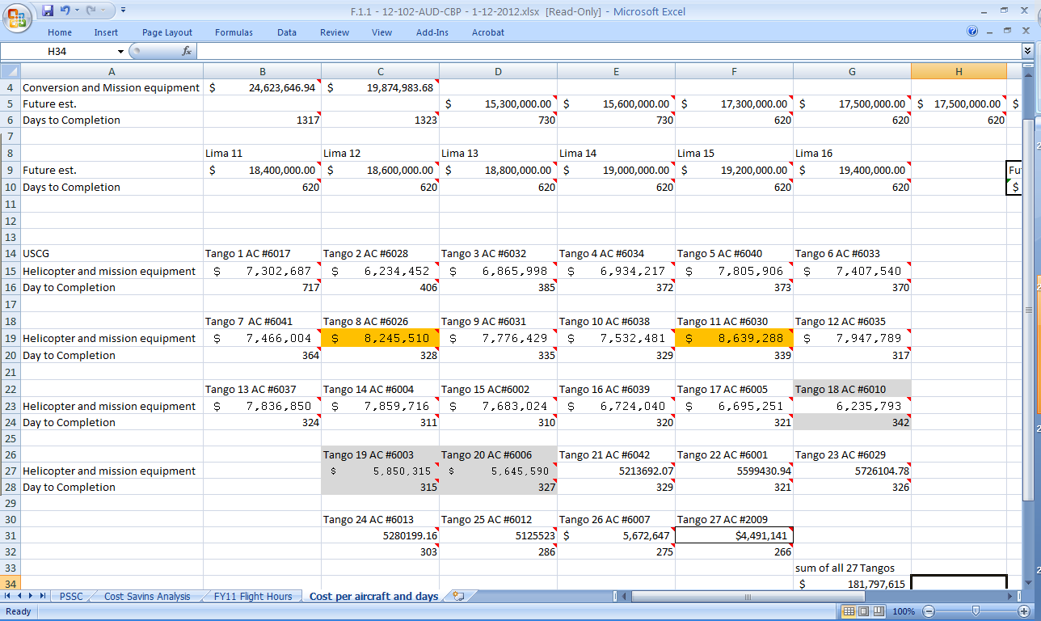
Make your financial / comparative analysis…
Notes:
Do your comparative analysis consciously looking anomalies in the data.

Slide 44
Fraud defined in the findings.…
IG Act Section 5- Paragraph (f):
…“questioned cost”
…“unsupported cost”
…“disallowed cost”
…“recommendation that funds be put to better use”
Notes:
OK, so how to define the problem as it relates back to findings of acquisition fraud:
IG Act Section 5 Paragraph f:
(f) As used in this section--
(1) the term “questioned cost” means a cost that is questioned by the Office because of--
(A) an alleged violation of a provision of a law, regulation, contract, grant, cooperative agreement, or other agreement or document governing the expenditure of funds;
(B) a finding that, at the time of the audit, such cost is not supported by adequate documentation; or
(C) a finding that the expenditure of funds for the intended purpose is unnecessary or unreasonable;
NOTES – OTHER DEFINITIONS
(2) the term “unsupported cost” means a cost that is questioned by the Office because the Office found that, at the time of the audit, such cost is not supported by adequate documentation;
(3) the term “disallowed cost” means a questioned cost that management, in a management decision, has sustained or agreed should not be charged to the Government;
(4) the term “recommendation that funds be put to better use” means a recommendation by the Office that funds could be used more efficiently if management of an establishment took actions to implement and complete the recommendation, including--
(A) reductions in outlays;
(B) deobligation of funds from programs or operations;
(C) withdrawal of interest subsidy costs on loans or loan guarantees, insurance, or bonds;
(D) costs not incurred by implementing recommended improvements related to the operations of the establishment, a contractor or grantee;
(E) avoidance of unnecessary expenditures noted in preaward reviews of contract or grant agreements; or
(F) any other savings which are specifically identified;
Make your findings
Make an RFI – using our DoD based DHS request
What are the remedies?
Admin – GN – Criminal Act….

Slide 45
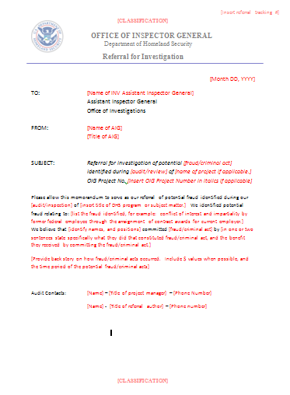
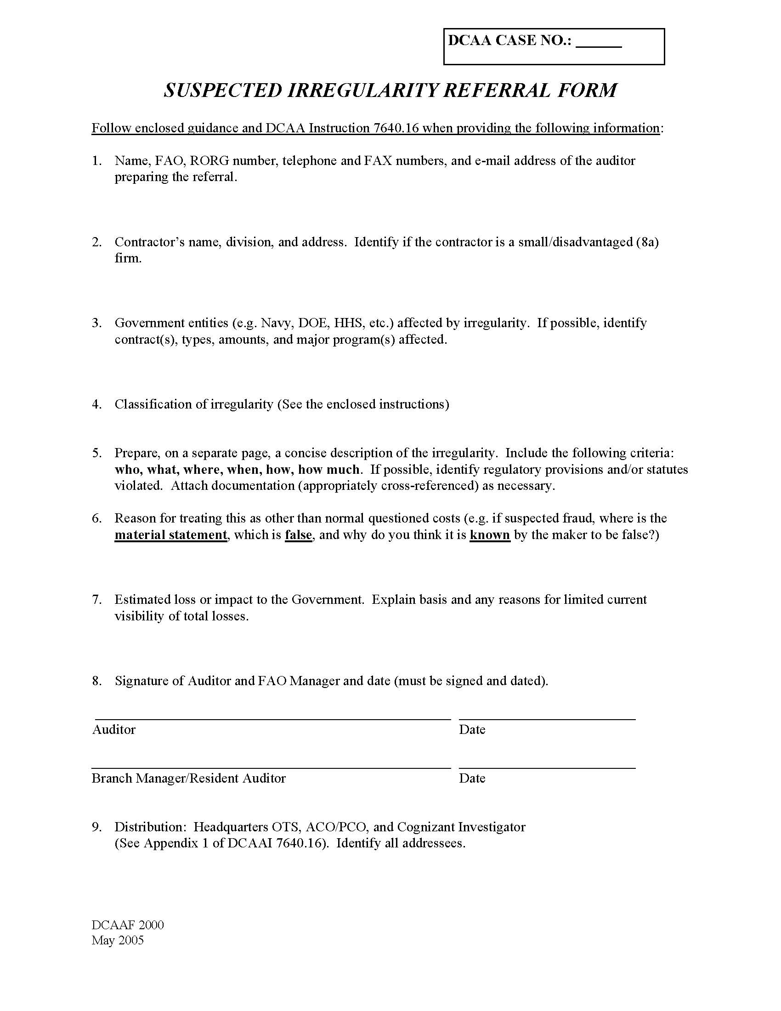
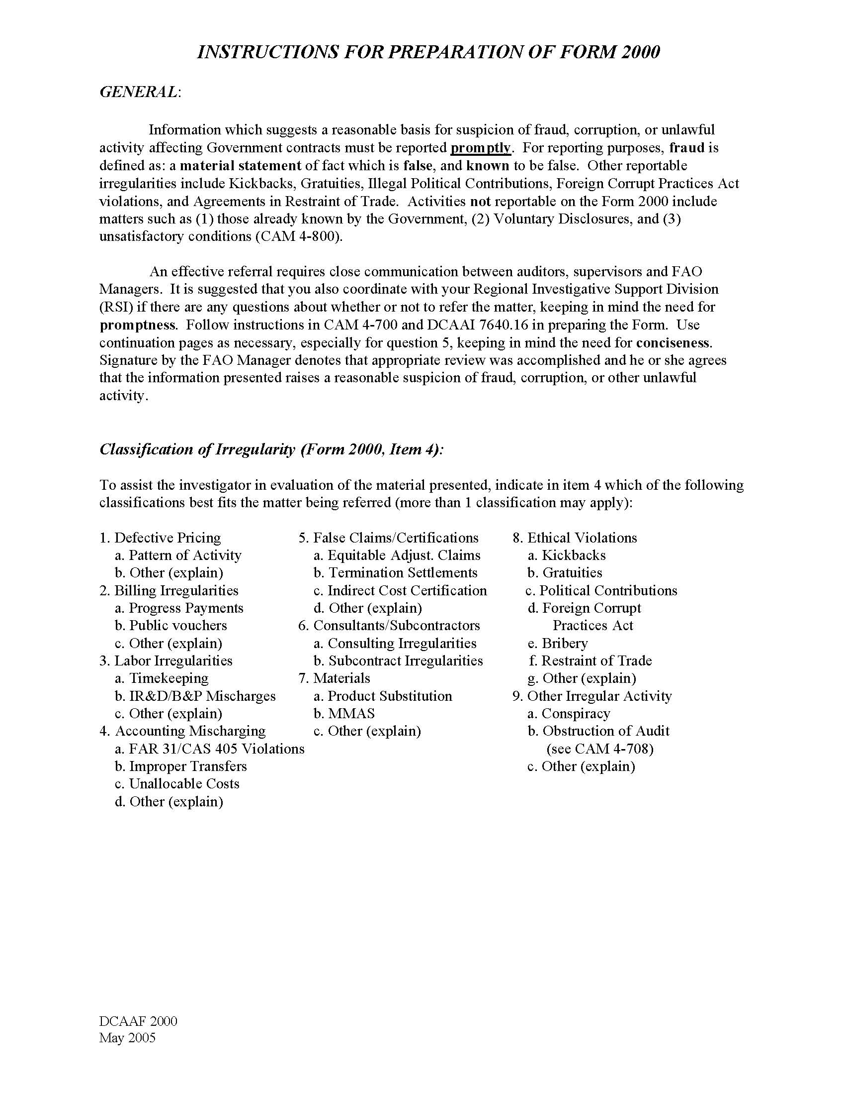
What if I find potential fraud…
Request for Investigation
Notes:
Make an RFI – using our DoD based DHS request

Slide 46
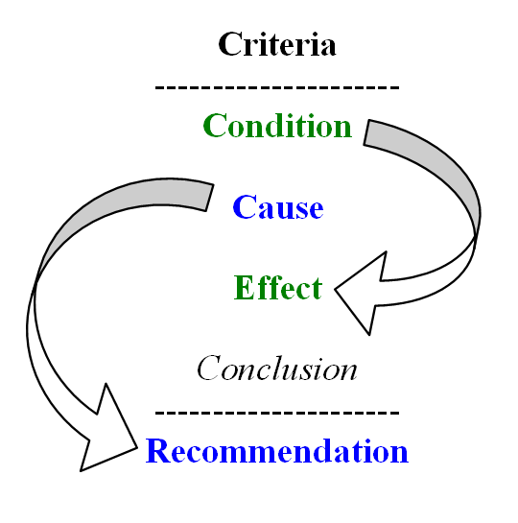
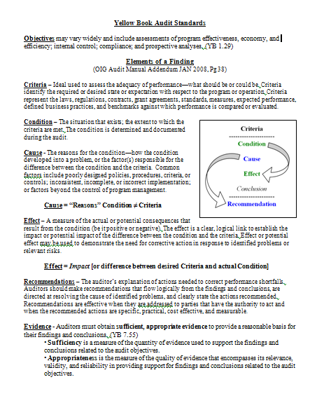
How to report fraud in the audit report…
Notes:
Right out of GAGAS:
GAGAS - 7.21 When auditors conclude, based on sufficient, appropriate evidence, that fraud, noncompliance with provisions of laws, regulations, contracts or grant agreements, or abuse either has occurred or is likely to have occurred which is significant within the context of the audit objectives, they should report the matter as a finding. Whether a particular act is, in fact, fraud or noncompliance with provisions of laws, regulations, contracts or grant agreements may have to await final determination by a court of law or other adjudicative body.
7.22 When auditors detect instances of fraud, noncompliance with provisions of laws, regulations, contracts, or grant agreements, or abuse that are not significant within the context of the audit objectives but warrant the attention of those charged with governance, they should communicate those findings in writing to audited entity officials.
EXTRA NOTES:
Criteria – what should be or could be. Laws, regs, contract, grant etc.
Condition – the situation that exists; the extent to which the criteria are met. The condition is determined and documented during the audit.
Cause = “Reasons” Condition ≠ Criteria
Cause - how the condition developed into a problem, or the factor(s) responsible for the difference between the condition and the criteria.
Common factors include poorly designed policies, procedures, criteria, or controls; inconsistent, incomplete, or incorrect implementation; factors beyond the control of program management… OR FRAUD!
Effect = Impact [or difference between desired Criteria and actual Condition]
Effect – A measure of the actual consequences that result from the condition (be it positive or negative). The effect is a clear, logical link to establish the impact or potential impact of the difference between the condition and the criteria. Effect or potential effect may be used to demonstrate the need for corrective action in response to identified problems or relevant risks.
Recommendations – The auditor’s explanation of actions needed to correct performance shortfalls. Auditors should make recommendations that flow logically from the findings and conclusions, are directed at resolving the cause of identified problems, and clearly state the actions recommended.
Recommendations are effective when they are addressed to parties that have the authority to act and when the recommended actions are specific, practical, cost effective, and measurable.
Evidence - Auditors must obtain sufficient, appropriate evidence to provide a reasonable basis for their findings and conclusions. (YB 7.55)
• Sufficiency is a measure of the quantity of evidence used to support the findings and conclusions related to the audit objectives.
• Appropriateness is the measure of the quality of evidence that encompasses its relevance, validity, and reliability in providing support for findings and conclusions related to the audit objectives.

Slide 47
So what’s your remedy?
Audit
Report
Admin
Remedy
Gross Negligence
Criminal
Act
Audit Report
Elements of a finding = waste / abuse / mismanagement
Admin Remedy (S & D)
Not amounting to gross negligence or criminal act, but…
Gross Negligence (Civil)
Failure to perform or act appropriately
Criminal Act
Intentional commission of a crime

Slide 48
Statutes Related to Fraud…
Conspiracy - 18 USC 371
Conspiracy to Defraud the Govt. Re False Claims - 18 USC 286
False, Fraudulent, or Fictitious Claims - 18 USC 287
False Statements - 18 USC 1001
False Claims - 31 USC 3729
Mail/Wire Fraud -18 USC 1341-1343
Notes:
The False Claims Act (FCA), 31 U.S.C. §§ 3729 - 3733 was enacted in 1863 by a Congress concerned that suppliers of goods to the Union Army during the Civil War were defrauding the Army. The FCA provided that any person who knowingly submitted false claims to the government was liable for double the government’s damages plus a penalty of $2,000 for each false claim. Since then, the FCA has been amended several times. In 1986, there were significant changes to the FCA, including increasing damages from double damages to treble damages and raising the penalties from $2,000 to a range of $5,000 to $10,000. The FCA has been amended three times since 1986. Over the life of the statute it has been interpreted on hundreds of occasions by federal.
Damages and penalties
After listing the seven types of conduct that result in FCA liability, the statute provides that one who is liable must pay a civil penalty of between $5,000 and $10,000 for each false claim (those amounts are adjusted from time to time; the current amounts are $5,500 to $11,000) and treble the amount of the government’s damages. Where a person who has violated the FCA reports the violation to the government under certain conditions, the FCA provides that the person shall be liable for not less than double damages.
The knowledge requirement
A person does not violate the False Claims Act by submitting a false claim to the government; to violate the FCA a person must have submitted, or caused the submission of, the false claim (or made a false statement or record) with knowledge of the falsity. In § 3729(b)(1), knowledge of false information is defined as being (1) actual knowledge, (2) deliberate ignorance of the truth or falsity of the information, or (3) reckless disregard of the truth or falsity of the information.
Definition of a claim
The FCA also defines what a claim is and says that it is a demand for money or property made directly to the Federal Government or to a contractor, grantee, or other recipient if the money is to spent on the government’s behalf and if the Federal Government provides any of the money demanded or if the Federal Government will reimburse the contractor or grantee.

Slide 49
More Statutes Related to Fraud Schemes…
Conflict of Interest – 18 USC 208
Truth in Negotiations -10 USC 2306(a)
Major Fraud -18 USC 1031
Anti-Kickback - 41 USC 51-58
Bribery (Illegal Gratuities) - 18 USC 201
Theft of Trade Secrets - 18 USC 1832
Procurement Integrity - 41 USC 423
Sherman Anti-Trust Act - 15 U.S.C. 1 – 3
Qui Tam Litigation - 31 USC 3730(b)
Notes:
18 U.S.C. § 208, the basic criminal “conflict of interest” statute, prohibits an executive branch employee from participating personally and substantially in a particular Government matter that will affect his own financial interests, as well as the financial interests of:
His spouse or minor child
His general partner
An organization in which he serves as an officer, director, trustee, general partner or employee, and
A person with whom he is negotiating for or has an arrangement concerning prospective employment.

Slide 50
So that’s what it really comes down to…
Requirements
RFP
Evaluation of RFPs
Justification
LRIP
Negotiation/Award
Need
Analyze/ Select
Obtain
Produce / Deploy / Support
Fraud in the bid…
fraud in the win…
…and the rest of the fraud therein!
Notes:
Fraud in the bid, fraud in the win, and the rest of the fraud therein!

Slide 51
Auditing Acquisitions for Fraud
Questions?
Or later…
andrew.smith@oig.dhs.gov
202-254-4160

