Slide 1
Andy Patchan Associate IG for Information Technology Federal Reserve Board & Consumer Financial Protection Bureau Chair, FAEC IT Committee Louis King Assistant Inspector General for Financial and IT Audits Department of Transportation
Proposed Maturity Model for
IG FISMA Reporting
Federal Audit Executive Council Conference
September 3 -4, 2014

Slide 2
Discussion Points
Background on FISMA
CIO and OIG FISMA reporting (limitations and inconsistencies)
Increasing cybersecurity attacks
Uses and advantages of maturity models
Proposed maturity model for IGs assessment of agencies’ information security continuous monitoring (ISCM) programs
Progress to date and next steps
References for proposed maturity model

Slide 3
Federal Information Security Management Act of 2002 (FISMA)
Requires agencies to develop, document, and implement an agency-wide information security program
Requires IGs to conduct an annual independent evaluation of
Agencies’ information security program and practices
The effectiveness of security controls and techniques for select information systems
Compliance with FISMA and related policies and guidelines
The Department of Homeland Security (DHS) also requires IGs to answer specific questions on the performance of agency information security programs in 11 areas

Slide 4
IG FISMA Metric Results (2011-2013) (% of Agencies with programs in place)
 | 2011 | 2012 | 2013
Continuous Monitoring | 37% | 71% | 74%
Configuration Management | 25% | 75% | 63%
Identity and Access Management | 25% | 83% | 78%
Incident Response & Reporting | 67% | 83% | 96%
Risk Management | 33% | 75% | 74%
Security Training | 50% | 92% | 91%
Plan of Action and Milestones | 25% | 79% | 87%
Remote Access Management | 54% | 83% | 96%
Contingency Planning | 33% | 75% | 78%
Contractor Systems | 42% | 75% | 74%
Security Capital Planning | 67% | 79% | 91%
4
4

Slide 5
CIO FISMA Metric Results (2011-2013) (% compliance)
 | 2011 | 2012 | 2013
Automated Asset Management | 80% | 86% | 83%
Automated Configuration Management | 78% | 70% | 79%
Automated Vulnerability Management | 77% | 83% | 81%
TIC Traffic Consolidation | 65% | 81% | 86%
TIC Capabilities | 72% | 84% | 87%
PIV Logical Access | 66% | 57% | 67%
Portable Device Encryption | 83% | 90% | 84%
Domain Name System Security Extensions | 65% | 74% | 93%
Remote Access Authentication | 52% | 53% | 79%
Remote Access Encryption | 83% | 82% | 98%
User Security Training | 99% | 88% | 94%
5

Slide 6
FISMA Compliance Scores (2011-2013)
 | FY2013 % | FY2012 % | FY2011 %
DHS | 99 | 99 | 93.4
GSA | 98 | 99 | 84.2
DOJ | 98 | 94 | 91.2
NRC | 98 | 99 | 94.8
SSA | 96 | 98 | 96.9
NASA | 91 | 92 | 92.9
Education | 89 | 79 | 57.5
NSF | 88 | 90 | 98.8
Commerce | 87 | 61 | 81.4
USAID | 83 | 66 | 53.8
OPM | 83 | 77 | 78.6
VA | 81 | 81 | 52.8
Interior | 79 | 92 | 42.2
EPA | 77 | 77 | 94.9
Labor | 76 | 82 | 71.6
Treasury | 76 | 76 | 79.4
Energy | 75 | 72 | 84.3
Transportation | 61 | 53 | 44.2
SBA | 55 | 57 | 68.7
State | 51 | 53 | 63.2
HHS | 43 | 50 | 50.9
USDA | 37 | 34 | 32.5
HUD | 29 | 66 | 66.1
DOD | NA | NA | NA
6
6

Slide 7
Information Security Incidents Reported to US-CERT by all Federal Agencies
7

Slide 8
What is the Status of Information Security?
8

Slide 9
Maturity Models
A maturity model refers to a set of characteristics, attributes, indicators, or patterns that represent capability and progression in a certain discipline
Can be used to identify current status of information security against set of requirements
Cold reader can understand the status of an organization’s information security against specified requirements and in relation to other organizations
NIST has developed approaches for information security maturity models
Maturity models used in IT organizations and electric industry
9

Slide 10
OIG Approach for Development of a Maturity Model for Information Security Continuous Monitoring (ISCM)
ISCM is defined as maintaining ongoing awareness of information security, vulnerabilities, and threats to support organizational risk management decisions
ISCM is identified as an administration priority and a cross-agency priority
OMB M-14-03, Enhancing the Security of Federal Information and Information Systems, provides guidance on ISCM and managing information security risks on a “continuous” basis
10

Slide 11
Current FY 2014 IG FISMA Metrics for ISCM
Has the organization established an enterprise-wide continuous monitoring program that assesses the security state of information systems that is consistent with FISMA requirements, OMB policy, and applicable NIST guidelines? Besides the improvement opportunities that may have been identified by the OIG, does the program include the following attributes?
Documented policies and procedures for continuous monitoring
Documented strategy for information security continuous monitoring
Implemented ISCM for information technology assets
Evaluate risk assessments used to develop their ISCM strategy
Conduct and report on ISCM results in accordance with their ISCM strategy
Ongoing assessments of security controls (system-specific, hybrid, and common) that have been performed based on the approved continuous monitoring plans
Provides authorizing officials and other key system officials with security status reports covering updates to security plans and security assessment reports, as well as a common and consistent POA&M program that is updated with the frequency defined in the strategy and/or plans
11

Slide 12
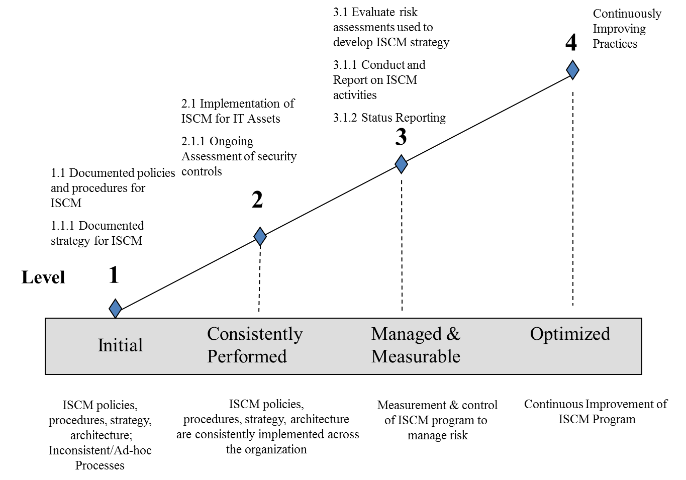
Proposed IG Maturity Model for ISCM
12

Slide 13
Example Dashboard for IG ISCM Maturity Model
 | Initial | Consistently Performed | Managed and Measurable | Optimized | Attribute Maturity Level
ISCM Policies & Procedures |  |  |  |  | 2
ISCM Strategy |  |  |  |  | 1
Implementation for IT Assets |  |  |  |  | 1
Security Controls Assessment |  |  |  |  | 3
Security Status Reporting |  |  |  |  | 2
13

Slide 14
Progress to Date
Discussed maturity model approach with members of the FAEC IT Committee, which includes representatives from 38 OIGs
Formed maturity model workgroup consisting of representatives from 7 OIGs – Treasury, FDIC, Transportation, TIGTA, Interior, CNCS, and FRB
Initial focus is on developing an IG FISMA reporting maturity model for ISCM (1 of 11 areas IGs are required to review as part of their annual FISMA evaluations)
Maturity Model workgroup held its first brainstorming session on March 13th
Working sessions held April 3, 17, and 24 to refine maturity level criteria and attributes for the different maturity levels for continuous monitoring
Met with OMB and DHS on April 25 and subsequently with GAO, NIST, Senate staffer, and CIO Council
Received positive feedback and overall support
14

Slide 15
Next Steps
Continue technical development of maturity model for continuous monitoring: subgroup on ISCM attributes, and another subgroup on integrating model with NIST framework for critical infrastructure cybersecurity
Test drive/pilot with participating IGs by end of 2014/early 2015
Make any needed tweaks for inclusion in 2015 OIG FISMA metrics
Goal of working with DHS to develop a FISMA maturity model reporting framework for all 11 information security areas
15

Slide 16
References
16

Slide 17
References
NIST Special Publication (SP) 800-53, Rev. 4, Security and Privacy Controls for Federal Information Systems and Organizations
SP 800-137, Information Security Continuous Monitoring for Federal Information Systems and Organizations
OMB Memorandum M-14-03, Enhancing the Security of Federal Information and Information Systems
United States Government Concept of Operations for Information Security Continuous Monitoring
17

Slide 18
2014 NIST Framework for Improving CyberSecurity
Functions | Categories | Subcategories
Identify | Risk Assessment | System inventory, categorization
Protect | Identification & Authentication; Security Awareness and Training | PIV card; awareness and role-based training
Detect | Continuous Monitoring | Strategy, scanning
Respond | Incident Response | Detection and reporting
Recover | Contingency Planning | BIA, backups
Implementation Tiers
Tier 1 - Partial
Tier 2 – Risk informed
Tier 3 - Repeatable
Tier 4 - Adaptive
18

Slide 19
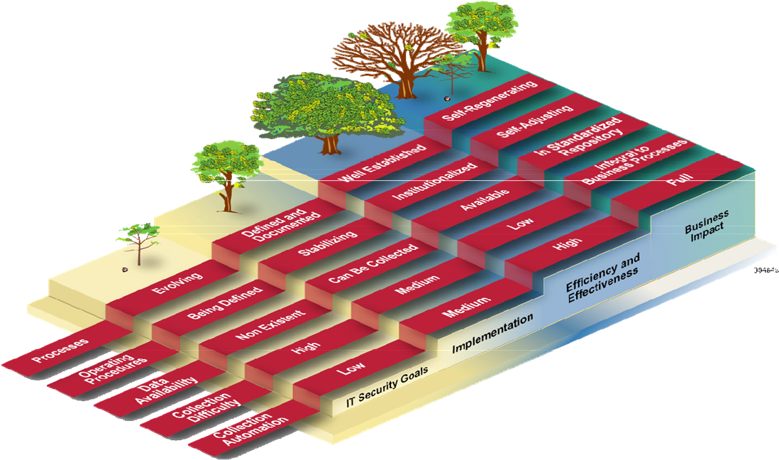
Additional NIST Guidance on Maturity Models
NIST Program Review for Information Security Management Assistance outlines five maturity levels – polices, procedures, implementation, test, and integration
NIST maturity model for information security performance measurement
19

Slide 20
Electricity Subsector Cybersecurity Capability Maturity Model (ES-CM2)
Level 1 – Initiated
Level 2 – Performed
Level 3 – Managed
Domain Specific Objectives
Domains
Focuses on control objectives
Domain Independent (Management) Objectives
Level 1 – Initiated
Level 2 – Performed
Level 3 – Managed
Continuous Monitoring
Risk Assessment
Configuration Management…
Focuses on process institutionalization
20

Slide 21
Mapping of Maturity Models
Proposed IG Model | CoBIT | ISO | NIST Framework | ES-CM2
Initial | Level 1 – Initial/Ad-hoc | Level 1 – Performed Informally | Level 1 - Partial | MIL 1 - Initial
 |  | Level 2 – Planned and Committed |  | MIL 2 - Performed
Consistently Performed | Level 2 – Repeatable Level 3 – Defined | Level 3 - Defined | Level 2 – Risk Informed | MIL 3 - Managed
Managed & Measurable | Level 4 – Managed & Measurable | Level 4 – Quantitatively Measured | Level 3 – Repeatable
Optimized | Level 5 - Optimized | Level 5 – Continuously Improving | Level 4 – Adaptive | MIL X - Reserved
21

