Slide 1
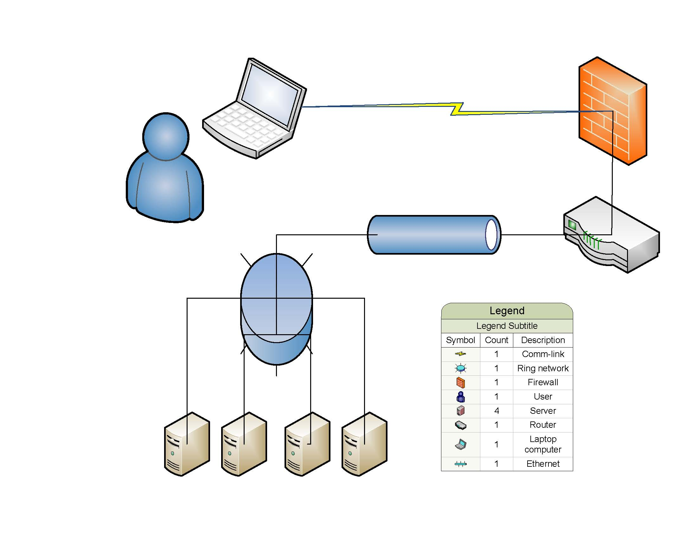
Understanding and Deploying Data Mining Analytic Modeling in Audits, Investigations, Inspections, and Reporting to Multiple Stakeholders
Federal Audit Executive Council
Procurement Conference
Potomac Center Plaza (PCP)
10th floor Auditorium, Building 550
12th Street SW Washington, DC 20024
Presented by:
Arnold Pettis
April 17, 2012

Slide 2
Overview
Introduction
What is Data Mining
Descriptive Analytics
Predictive Analytics
Next Generation Analytics
Why use Data Mining
Benefits
Personnel and Infrastructure
Resource Consumption
Analytic Data Model
Training
Data Sources
Software
Obstacles
Recovery Act Data Mining Group

Slide 3
Overview (2)
Analytical Data Modeling Elements
Potential fraud indicators
Criminal violations
Grant metrics
Contract metrics
Financial metrics
Credit card metrics
Certification schemes (2)
Proposal schemes(2)
Award schemes(2)
Invoice schemes(2)
Credit card schemes(2)
Transfer schemes
Integrity schemes
Any Questions

Slide 4
What is Data Mining
Data mining
Is a relatively young and interdisciplinary field of computer science
Is the process of discovering new patterns in past data that can be used to predict the outcome of future cases from large data sets
Involves methods at the intersection of artificial intelligence, machine learning, statistics, and database systems
Past data matching
Which contract has the highest dollar value (sorting)
Who is connected to the suspicious contractor (visualization through external data)
Do any of our current contractors claim different types of ownership during same time period (filtering data in Excel spreadsheets)
How many of our current contractors match those on the debarred/excluded party list (database join query)

Slide 5
Descriptive Analytics
Standard reporting
Reviewing flat file
Custom reporting
Filtering the data
Queries/drilldowns
Relationship query
Oracle
SQL
Access
Dashboards/alerts
Business intelligence
Statistical analysis
Percentage
Ranking
Clustering
Unsupervised learning

Slide 6
Predictive Analytics
Predictive analytic data modeling
Risk scoring based on
metrics/scenarios
potential fraud indicators
criminal violations
logic
date/time
mathematics
statistics
Optimization
Effective, efficient, and objective analytic data model affected by
space
constraints
Simulation
Risk analysis representation
ranking based on a risk score
weighted combination of the metrics

Slide 7
Next Generation Analytics
Text mining
Code driven text and phase evaluator with scoring algorithm
LexisNexis (lexisnexis.com)
iThenticate (ithenticate.com)
Link analysis
Used to evaluate relationships (connections) between objects
organizations
people
transactions
Building predictive analytic data models to score likelihood of fraud
Feedback
Re-engineering the predictive analytic data model
Redeployment

Slide 8
Why use Data Mining
Fraud can occur at any stage of an acquisition and use data mining to remove 90% of the hay to focus on the 10% with the most needles
Can be committed by vendor, sub-firm, or Agency employees
May involve collusion among bidders, internal help from Agency employees
Data mining
Employs an analytical data-driven method to identify audit needs
Deploys a systematic way of providing good leads to investigative team
Promotes accountability by conducting oversight of Recovery funds
Provides transparency on Recovery spending
Assists in detecting and preventing fraud, waste, and abuse
Reports to multiple stakeholders accurate and user-friendly information

Slide 9
Benefits
Past
Future
Limited universe
Examine random samples
Use single data sources
Reliance on tips, hotline
Pay-and-chase
Reliance on hunches, past experience
Known fraud schemes only
Subjective consideration of different suspicious activity
Selects 100% of universe(s)
Examine and score each universe item
Unified view of item (cradle to grave)
Systematic way of generating leads
Preventing fraud and stemming it early
Data-driven decision making
Identify emerging fraud schemes early
Assign weights to fraud indicators mathematically

Slide 10
Personnel and Infrastructure
Personnel needed to establish a data mining department
Innovative and supportive leadership
Disciplined project management
Subject matter expertise
Analytic data modeling expertise
Intuitive user interface
Stakeholders providing feedback
Infrastructure
Technology infrastructure and support

Slide 11
Resource Consumption
Where are the majority of resources spent
Understanding the data
Examining the data
Preparing the data
Determining data reliability
Running data extracts
Deploying the analytic data model
Evaluating feedback
Re-engineering model
Redeployment

Slide 12
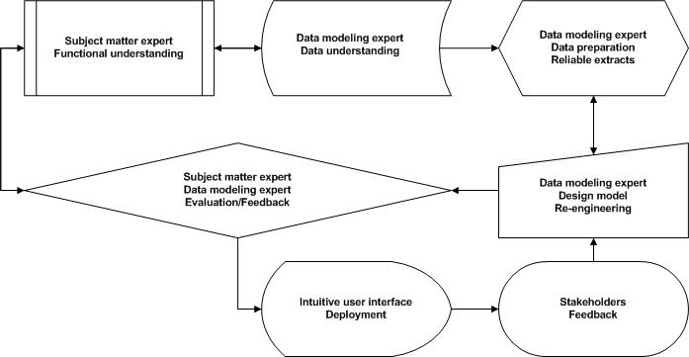
Analytic Data Model
Innovative/supportive leadership and disciplined project management

Slide 13
Training
Inspector General Auditor Training Institute
Using Data Mining Techniques in Audits and Evaluations
MIS Training Institute
Data Mining for Auditors
Association of Certified Fraud Examiners
Advance Computer Aided Fraud Prevention and Detection
The Modeling Agency
Data Mining Level I
Data Mining Level II
Data Mining Level III
SAS Institute Inc
M2011 Data Mining Conference

Slide 14
Data Sources
Internal Systems
Contracting
Grant
Purchase card
Travel
Financial
External
Federal Procurement Data System (FPDS) (fpds.gov)
Small Business Administration (TECHNet) (sbir.gov)
Small Business Administration (sba.gov)
Electronic Subcontracting Reporting System (ERRS) (esrs.gov)
Excluded Parties List System (EPLS) (epls.gov)
Dun and Bradstreet (dnb.com)
Online state incorporation records
Online local business license records

Slide 15
Software
2005 Internal Auditor Software Survey Results

Slide 16
Obstacles
Leadership, project management, and multiple stakeholders
Understanding, visualization, and acceptance
Data technology & IT support
Availability of external data (data ownership)
Obtaining a valid universe (time sensitive)
Necessary data not always captured (understanding schema)
Disparate data sources (data types)
Data cleanliness (inaccurate, incomplete)
Database controls (certification, proposal, award, invoice, integrity)
Subject matter and data modeling expert (analytic data model)
Network administrator, database maintainer, and computer programmer
Fraud
Few known cases of fraud and wide range of fraud schemes
Feedback
Long investigative times to validate the quality of leads to investigators

Slide 17
Recovery Act Data Mining Group
The Recovery Accountability and Transparency (RAT) Board is a non-partisan, non-political agency created by the American Recovery and Reinvestment Act of 2009 with two goals:
To provide transparency of Recovery-related funds
To detect and prevent fraud, waste, and mismanagement
The RAT Board
Is currently seeking to enter into memorandum of agreements with Government Agencies to provide data mining capabilities
Currently has worked out agreements data owners to periodically obtain and update their 22 different data sets including
Federal Procurement Data System (FPDS)
Excluded Parties List System (EPLS)
Small Business Administration – Dynamic Small Business Search
Dun and Bradstreet (D&B) Data- over 192 million records
Central Contractor Registration (CCR)
Accurint/LexisNexis
State Records
http://www.recovery.gov/About/board/Pages/TheBoard.aspx

Slide 18
Potential Fraud Indicators
Potential fraud indicators
No certification refers to the lack of confirmation of certain characteristics of an object, person, or organization
Defied Federal Acquisition Regulation (FAR) or Agency regulations
Duplicate proposal submitted or duplicate award funding
Substandard performance or recycled/plagiarized deliverable
Defective pricing
Faulty invoicing
Mischarging costs
Excesses transferred
No procurement integrity

Slide 19
Criminal Violations
Criminal Violations
False statement on certification can be orally or written, sworn or unsworn, signed or unsigned, made knowingly and willfully, and made to an US agency, a Government contractor, or someone acting on behalf of Government
Theft of public monies
Criminal conspiracy
Obstruction of justice
Money laundering
Wire fraud
Fraud against the US
False claims
Providing/accepting kickbacks
Conflict of interest

Slide 20
Grant Metrics
Certification
Not socially or economically disadvantaged-owned
Exceeded small business limits
No or inadequate facilities
Exploited principal investigator
No subcontract certification agreement/limits/report
No federally funded grant/awards list
Research, product, or service
Duplicate research proposal submission or duplicate funding
Questionable research or duplicate deliverable
Substandard performance
Pricing or cost
Defective pricing
Invoice lacked invoice certification or cost break-out
Invoiced for unallowable costs or mischarging costs
Transfers
Funds or excess materials transferred to commercial award

Slide 21
Contract Metrics
Contracting officer integrity
Cancelled but not zero amount
Awarded sole source
Terminated for default
Allowed product cost outlier
Not authorized for non-compete, and contract is non-compete
Splitting costs to avoid higher level review number of times
Contract
Same contract, multiple suppliers
Line amount outlier
Frequency of invoice increase
Manual entries
Modification
Number of modifications
Break in modification sequence
Days until first modification
Modifications large percentage of contract amount

Slide 22
Financial Metrics
Invoice
Same invoice number, different invoice dates
Same invoice number, different check numbers
Same invoice number, different invoice amounts
Same invoice number, different payment amounts
Weird symbols at end of invoice number
Payment
Same check number, different check dates
Same check number, different suppliers
Same check number, different check amounts
Same address, different suppliers
Analytics
Sum contract line amounts versus invoice amount
Compare payment amount versus invoice amount (account for discount/interest)
Sum payment amount versus check amount
Sum line amounts for all invoices > current contract amount

Slide 23
Credit Card Metrics
Cardholder, officer, or approving official integrity
Cardholder or officer exceeding the single purchase limit, monthly limit, or charges multiple purchases to one merchant in one day totaling up to more than the single purchase limit
Cardholder or officer purchases on Saturdays, Sundays, holidays, or outside area of authority
Approving official ID same as cardholder or officer ID
Approving official approves transactions for more than 10 cardholders or officers or responsible for reviewing over 100 transactions per month
Merchant category codes or product service codes
Labeled unknown, miscellaneous, inappropriate, or international
Personal services or items (food, water, clothing, furniture, appliance)
Excessive travel costs (airfares, cruises, hotels, rental cars, gasoline, restaurants)
Balance transfer government –personal (cash advance, convenience check, third-party payers (PayPal, eBay, Digibuy))
Specialty
Purchases requiring written approval or over $1 million per year

Slide 24
Certification Schemes
Vendor did NOT complete certification
Potentially indicating vendor intentionally knew they did NOT qualify for program
Vendor made a false statement related to the “51% ownership, organized as a for-profit US based business, or less than 500 employees including affiliates”
Potentially indicating vendor intentionally influenced the outcome of the Government’s decision or action
Vendor made a false statement related to “adequate facilities to perform the work” or did NOT provide a “detailed description, availability, location of instrumentation, proposed physical facilities”
Potentially indicating vendor intentionally did little, if any, actual research

Slide 25
Certification Schemes (2)
Vendor made a false statement related to “principal investigator was 51% primarily employed by the vendor”
Potentially indicating vendor intentionally
mischarged
unreported use of sub-firm
failed to perform research
recycled old research
Vendor made a false statement related to “use of sub-firms” or “subcontract limits”
Potentially indicating vendor intentionally
did NOT perform research
recycled or plagiarized reports
used defective pricing
inflated subcontract costs
lacked expertise
inadequate facilities

Slide 26
Proposal Schemes
Vendor did NOT certify that the research proposal was NOT submitted to or funded by another Federal Agency or did NOT certify the accuracy of the federally funded grants/awards list
Potentially indicating vendor intentionally sought after or hide duplicate Government funding for the same research

Slide 27
Proposal Schemes (2)
Vendor submitted inaccurate, incomplete, or noncurrent cost or pricing data, but did not disclose this to the Government
Potentially indicating vendor intentionally
used out-dated standard costs or indirect cost rates to get the award
failed to disclose the data to significantly increase the award funding
created or altered supporting documentation
falsified data in the proposal that resulted in a significant variance in proposed versus actual costs
channeled work or leftover materials through a created company to increase prices and retain materials
proposed sub-firm that was intentionally substituted with less expensive sub-firm
***DOD, NASA and Coast Guard contractors are required to certify that the data supplied to the Government are current, complete, and accurate at the time of agreement on price for all non-competitive or negotiated procurements exceeding $500,000

Slide 28
Award Schemes
Vendor submitted questionable product, recycled, or plagiarized deliverable that did NOT conform to award specifications
Potentially indicating vendor intentionally
substituted inferior materials
conducted improper testing
falsified test records
did NOT spend award funds on research labor
did NOT posses the expertise or facilities to complete the research
Potentially indicating Agency personnel intentionally experienced a
Lack of due diligence
conflict of interest (bribe, promised position)
kickback

Slide 29
Award Schemes (2)
Vendor demonstrated substandard performance
Potentially indicating vendor intentionally
lacked expertise or facilities
spent less on actual labor than it proposed
aware of the lack of oversight to properly assess progress reports
Potentially indicating Agency personnel intentionally experienced a
lack of due diligence
conflict of interest (bribe, promised position)
kickback

Slide 30
Invoice Schemes
Vendor’s invoices contained mischarged or unallowable costs
Potentially indicating vendor intentionally received public monies by
inflating direct labor or indirect costs for nonexistent employee
overstated subcontract work for nonexistent sub-firm
billing for excess materials NOT delivered
charging for unallowable costs such as
advertising or entertainment
idle facilities costs
bid or proposal costs in excess of a set limit
stock options or some forms of deferred compensation
contributions or donations
contingencies or Interest
losses on other awards
long-term leases of property or equipment
legal costs related to a contractors defense against charges of contract fraud

Slide 31
Invoice Schemes (2)
Vendor did NOT certify the invoice was current, complete, and accurate or did NOT break-out invoice by direct labor, indirect costs, material, or subcontract
Potentially indicating vendor intentionally
suppressed direct labor costs for principal investigator because the cost conflicted with program requirements
applied overruns on the award to another cost-type award
inflated direct labor, indirect costs, material, or subcontract costs
Potentially indicating collusion between vendor and Agency personnel to certify invoice for payment, despite the evaluated costs

Slide 32
Credit Card Schemes
Cardholder, officer, or approving official violated procurement integrity standards
Potentially indicating Agency personnel intentionally violated procurement integrity standards to
receive kickbacks from vendor for purchases
act on promised personal discounts in the future (bribed) by vendor
Cardholder, officer, or approving official made purchases requiring special attention
Potentially indicating Agency personnel intentionally made purchases
requiring prior written approval to circumvent higher level reviews
avoid competition requirements and higher level reviews

Slide 33
Credit Card Schemes (2)
Cardholder, officer, or approving official made personal gain purchases
Potentially indicating Agency personnel intentionally made inappropriate purchases from vendors for personal use
public monies
supplies
equipment
services

Slide 34
Transfer Schemes
Vendor invoiced for goods not delivered, research not performed, or through collusion received excess materials or funds to transfer to support a commercial award
Potentially Indicating vendor intentionally
delivered bulk items in short quantities
inflated quantities of items removed or installed
inflated researcher's direct labor rates
Potentially indicating Agency personnel intentionally
entered into a collusion agreement
lacked due diligence
received kickbacks from vendor in exchange for approving invoices for payment
accepted a bride (promised a position in the future) by vendor

Slide 35
Integrity Schemes
Agency personnel did NOT annually submit a conflict of interest statement or external evaluators did not submit a statement of interest as required to identify any conflicts
Potentially indicating Agency and external personnel intentionally
socialized frequently with vendor or sub-firm
planned to “recommend” vendor or sub-firm for an award
planned possible bid rigging scheme for vendor or sub-firm

Slide 36
Any Questions?
Thank You

